Slide 1
ZRTP: Media Path Key Agreement for Unicast Secure RTP
April 2011 , RFC 6189
Author(s): P. Zimmermann, A. Johnston, J. Callas
Speaker :Ted

Slide 2
Outline
Introduction
Background
ZRTP
Conclusion
Reference

Slide 3
Introduction
ZRTP is a key-agreement protocol to negotiate the keys for encryption in a VoIP.
It uses Diffie-Hellman key exchange and the Secure Real-time Transport Protocol (SRTP) for encryptioneement protocol.

Slide 4
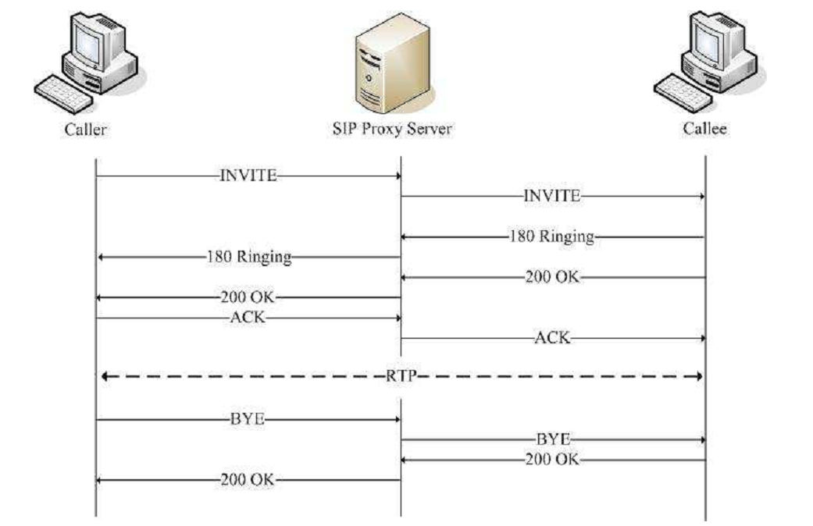
Background
SIP

Slide 5
Background(cont.)
Secure Real-time Transport Protocol (SRTP)

Slide 6
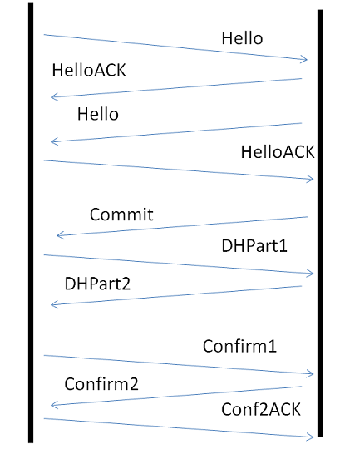
ZRTP

Slide 7
ZRTP(cont.)
Hello message
Usually sent at the start of an RTP session to determine if the other endpoint supports ZRTP.
The purpose of the Hello message is to confirm that the endpoint supports the protocol.

Slide 8
ZRTP(cont.)
Commit message
The Commit message may be sent immediately after both endpoints have completed the Hello/HelloACK discovery handshake.
Deterministically choose the same DH key size and algorithm.

Slide 9
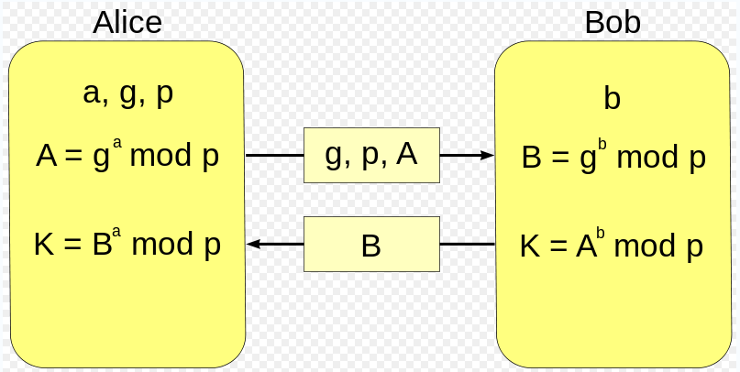
ZRTP(cont.)
DHPart message
The Diffie-Hellman public values are exchanged in the DHPart1 and DHPart2 messages.
p=23 and g=5.
If Bob chooses b=15
B = 5¹⁵ mod 23 = 19
K = 8¹⁵ mod 23
K=2
If Alice chooses a=6
A = 5⁶ mod 23 = 8
K = 19⁶ mod 23
K=2

Slide 10
ZRTP(cont.)
Confirm message
The Confirm1 message is sent by the Responder in response to a valid DHPart2 message after the SRTP session key and parameters have been negotiated.

Slide 11
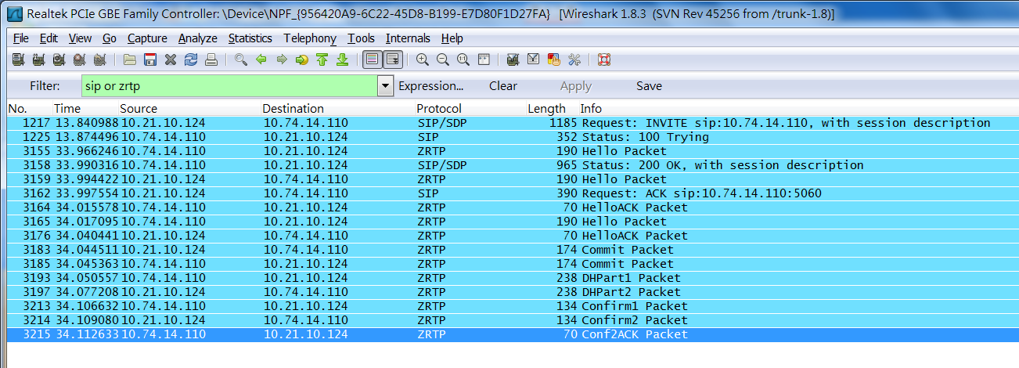
ZRTP(cont.)

Slide 12
Conclusion
This protocol does not require prior shared secrets or rely on a Public key infrastructure (PKI) or on certification authorities
ZRTP can be used with any signaling protocol, including SIP, H.323.

Slide 13
Reference
ZRTP: Media Path Key Agreement for Unicast Secure RTP
http://en.wikipedia.org/wiki/Diffie-Hellman_key_exchange

