Slide 1
Steganography of Reversible Data Hiding
Producer: Chia-Chen Lin
Speaker: Paul
2013/06/05

Slide 2
Outline
Introduction
Histogram shifting vs. reversible data hiding
  Three solutions
Conclusions

Slide 3
Introduction
Technical Steganography
  Types
    Loss
    Lossless (reversible)
  General Criteria
    Image quality
    Payload
    Reversibility ←lossless steganography
    reversible data hiding

Slide 4
Histogram shifting vs. reversible data hiding
Zhicheng Ni, Yun-Qing Shi, Nirwan Ansari, and Wei Su, “Reversible data hiding,” IEEE Transactions on Circuits and Systems for Video Technology, Vol. 16, No. 3, 2006, pp. 354-362.

Slide 5
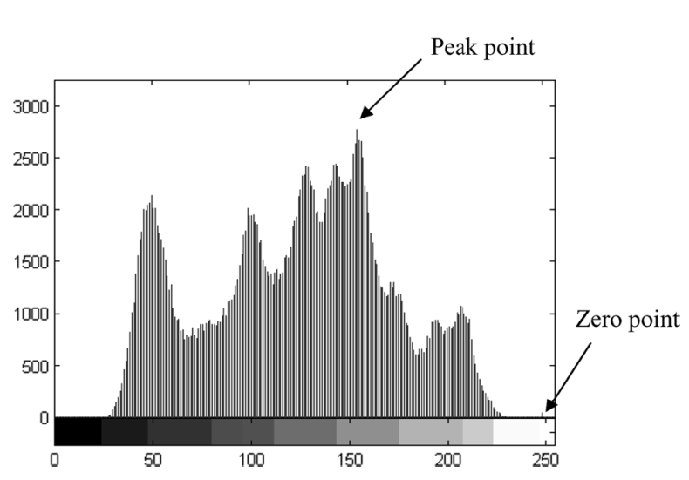
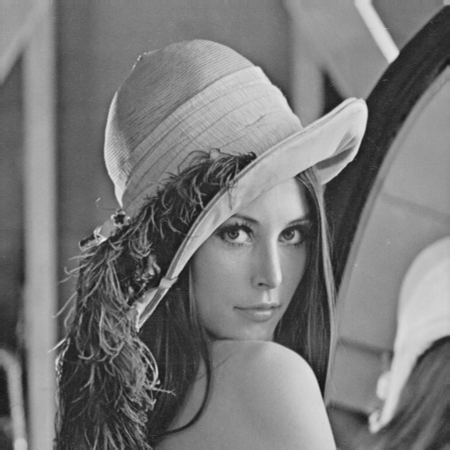
Ni et al.’s proposed method (1/7)
Step 1: Generate an image histogram
(P)
Histogram
(Z)
Original gray-scale image
Histogram of Lena image
Source: Zhicheng Ni, Yun-Qing Shi, Nirwan Ansari, and Wei Su, “Reversible Data Hiding”,
IEEE TRANSACTIONS ON CIRCUITS AND SYSTEMS FOR VIDEO TECHNOLOGY(16:3), 2006.

Slide 6
Ni et al.’s proposed method (2/7)
Step 2: To shift the pixels of histogram
  If P>Z → To shift the range of the histogram , [Z+1, P-1],
  to the left-hand side by 1 unit.
  If P<Z → To shift the range of the histogram , [P+1, Z-1],
  to the right-hand side by 1 unit.
-------------------------------------------------------------------------------------
Step 3: To hide the secret data by pixels P
  If P>Z → To be embedded bit is “1”, the pixel value is changed to P-1.
  If the bit is ”0”, the pixel value remains.
  If P<Z → To be embedded bit is “1”, the pixel value is changed to P+1.
  If the bit is ”0”, the pixel value remains.

Slide 7
Ni et al.’s proposed method (3/7)
2 | 5 | 3 | 1 | 1
4 | 2 | 5 | 1 | 1
2 | 3 | 4 | 4 | 1
3 | 3 | 1 | 2 | 5
3 | 3 | 3 | 3 | 2
Original image
Peak point
Zero point
P=3, Z=6 and P<Z shift to right-hand
2 | 6 | 3 | 1 | 1
5 | 2 | 6 | 1 | 1
2 | 3 | 5 | 5 | 1
3 | 3 | 1 | 2 | 6
3 | 3 | 3 | 3 | 2
[3+1,6-1]
4 → 5
5 → 6

Slide 8
Ni et al.’s proposed method (4/7)
2 | 6 | 3 | 1 | 1
5 | 2 | 6 | 1 | 1
2 | 3 | 5 | 5 | 1
3 | 3 | 1 | 2 | 6
3 | 3 | 3 | 3 | 2
Secret bits: 1 1 0 0 1 1 0 1
2 | 6 | 4 | 1 | 1
5 | 2 | 6 | 1 | 1
2 | 4 | 5 | 5 | 1
3 | 3 | 1 | 2 | 6
4 | 4 | 3 | 4 | 2
Using P=3,
0 → 3
1 → 4
Stego-image

Slide 9
Ni et al.’s proposed method (5/7)
P=3, Z=6
2 | 6 | 4 | 1 | 1
5 | 2 | 6 | 1 | 1
2 | 4 | 5 | 5 | 1
3 | 3 | 1 | 2 | 6
4 | 4 | 3 | 4 | 2
2 | 6 | 4 | 1 | 1
5 | 2 | 6 | 1 | 1
2 | 4 | 5 | 5 | 1
3 | 3 | 1 | 2 | 6
4 | 4 | 3 | 4 | 2
Extracted secret bits:
1 1 0 0 1 1 0 1
Extract
3 → 0
4 → 1
Stego-image
2 | 5 | 3 | 1 | 1
4 | 2 | 5 | 1 | 1
2 | 3 | 4 | 4 | 1
3 | 3 | 1 | 2 | 5
3 | 3 | 3 | 3 | 2
6 → 5
5 → 4
4 → 3
3 → 3
Recover
Original image

Slide 10
Ni et al.’s proposed method (6/7)
Maximum and minimum points
2 | 5 | 3 | 0 | 0
4 | 2 | 5 | 1 | 6
2 | 3 | 4 | 4 | 7
3 | 3 | 1 | 2 | 5
3 | 3 | 3 | 3 | 2
Original image
maximum point
minimum point

Slide 11
Ni et al.’s proposed method (7/7)
Multiple pairs
Example of 2 pairs.
2 | 5 | 3 | 0 | 0
4 | 2 | 5 | 1 | 6
2 | 3 | 4 | 4 | 7
3 | 3 | 1 | 2 | 5
3 | 3 | 3 | 3 | 2
Original image
Z2
P2
P1
Z1

Slide 12
Summary of Ni et al.’s scheme
  It is simple and efficient.
  The PSNR of the marked image is above 48dB.
  The pure payload is about 5k-80k bits for a 512*512 grayscale image

Slide 13
Questions:
How to increase the pixel number of peak point?
  Difference image
Is there any different way to generate a difference image
Possible extension(s)?
  Frequency domain

Slide 14
Solution 1:
Chia-Chen Lin, Wei-Liang Tai and Chin-Chen Chang, “Multilevel reversible data hiding based on histogram modification of difference images,” Pattern Recognition, Vol. 41, Issue 12, December, 2008, pp. 3582-3591.

Slide 15
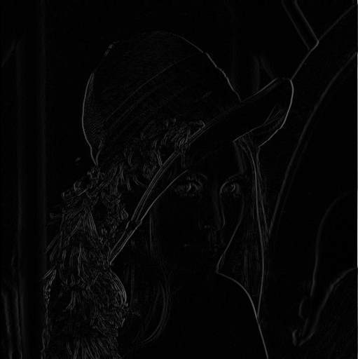
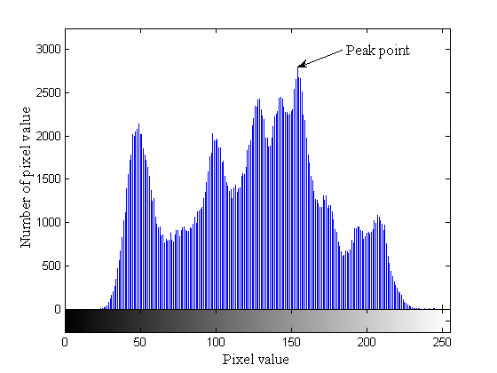
Basic idea

Slide 16

Lin et al.’s proposed method (1/2)
Hiding Phase
Peak Point
6 | 7 | 3
2 | 1 | 1
1 | 2 | 4
0 | 2 | 1
7 | 8 | 4
3 | 1 | 1
1 | 3 | 5
0 | 3 | 1
7 | 8 | 4
3 | 1 | 1
1 | 3 | 5
0 | 3 | 1
7 | 8 | 4
3 | 1 | 2
1 | 3 | 5
0 | 3 | 1
7 | 8 | 4
3 | 1 | 2
2 | 3 | 5
0 | 3 | 1
162 | 156 | 163 | 160
161 | 159 | 158 | 159
160 | 161 | 159 | 155
158 | 158 | 156 | 157
Difference Image
Original Block
|162 – 156| = 6
Message = “0110”
|161 – 159| = 2
Original Image

Slide 17
Lin et al.’s proposed method (1/2)
Hiding phase
162 | 156 | 163 | 160
161 | 159 | 158 | 159
160 | 161 | 159 | 155
158 | 158 | 156 | 157
163 | 156 | 163 | 160
161 | 159 | 158 | 159
160 | 161 | 159 | 155
158 | 158 | 156 | 157
163 | 156 | 163 | 160
162 | 159 | 158 | 159
160 | 161 | 159 | 155
158 | 158 | 156 | 157
163 | 156 | 163 | 160
162 | 159 | 158 | 159
160 | 162 | 159 | 155
158 | 158 | 156 | 157
163 | 156 | 164 | 160
162 | 159 | 158 | 159
160 | 162 | 159 | 155
158 | 158 | 156 | 157
163 | 156 | 164 | 160
162 | 159 | 158 | 159
160 | 162 | 159 | 155
158 | 158 | 155 | 157
163 | 156 | 164 | 160
162 | 159 | 158 | 160
160 | 162 | 159 | 154
158 | 158 | 155 | 156
7 | 8 | 4
3 | 1 | 2
2 | 3 | 5
0 | 3 | 1
Original image
Difference image
Stego-image
156 + 7 = 163
156 + 8 = 164
160 + 4 = 164
159 + 3 = 162

Slide 18
Lin et al.’s proposed method (1/2)
Extracting and reversing phase
7 | 8 | 4
3 | 1 | 1
1 | 3 | 5
0 | 3 | 1
6 | 7 | 3
2 | 1 | 1
1 | 2 | 4
0 | 2 | 1
7 | 8 | 4
3 | 1 | 2
2 | 3 | 5
0 | 3 | 1
163 | 156 | 164 | 160
162 | 159 | 158 | 160
160 | 162 | 159 | 154
158 | 158 | 155 | 156
7 | 8 | 4
3 | 1 | 2
2 | 3 | 5
0 | 3 | 1
162 | 156 | 164 | 160
162 | 159 | 158 | 160
160 | 162 | 159 | 154
158 | 158 | 155 | 156
162 | 156 | 164 | 160
161 | 159 | 158 | 160
160 | 161 | 159 | 154
158 | 158 | 155 | 156
162 | 156 | 163 | 160
161 | 159 | 158 | 160
160 | 161 | 159 | 154
158 | 158 | 155 | 156
162 | 156 | 163 | 160
161 | 159 | 158 | 160
160 | 161 | 159 | 154
158 | 158 | 156 | 156
162 | 156 | 163 | 160
161 | 159 | 158 | 159
160 | 161 | 159 | 155
158 | 158 | 156 | 157
Stego image
Difference image
Original image
Peak Point = 1
Message =
0
1
1
0

Slide 19
Solution 2:
  Wei-Liang Tai, Chia-Ming Yeh, and Chin-Chen Chang, “Reversible data hiding Based on histogram modification of pixel differences,” IEEE Transactions on Circuits and Systems for Video Technology, Vol. 19, No. 6, JUNE 2009, pp. 906-910.

Slide 20
Tai et al.’s proposed method (1/4)
Cover image
155 | 156 | 155 | 158
159 | 158 | 156 | 158
160 | 158 | 158 | 156
153 | 157 | 158 | 155
 | 0 | 1 | 2 | 3 | 4 | 5 | 6 | 7 | 8 | 9 | 10 | 11 | 12 | 13 | 14 | 15
x_{i} | 155 | 156 | 155 | 158 | 158 | 156 | 158 | 159 | 160 | 158 | 158 | 156 | 155 | 158 | 157 | 153
 | 0 | 1 | 2 | 3 | 4 | 5 | 6 | 7 | 8 | 9 | 10 | 11 | 12 | 13 | 14 | 15
d_{i} | 155 | 1 | 1 | 3 | 0 | 2 | 2 | 1 | 1 | 2 | 0 | 2 | 1 | 3 | 1 | 4
Peak point P=1

Slide 21
Tai et al.’s proposed method (1/4)
Shift x_{i} by 1 units:
P=1
 | 0 | 1 | 2 | 3 | 4 | 5 | 6 | 7 | 8 | 9 | 10 | 11 | 12 | 13 | 14 | 15
x_{i} | 155 | 156 | 155 | 158 | 158 | 156 | 158 | 159 | 160 | 158 | 158 | 156 | 155 | 158 | 157 | 153
 | 0 | 1 | 2 | 3 | 4 | 5 | 6 | 7 | 8 | 9 | 10 | 11 | 12 | 13 | 14 | 15
d_{i} | 155 | 1 | 1 | 3 | 0 | 2 | 2 | 1 | 1 | 2 | 0 | 2 | 1 | 3 | 1 | 4
 | 0 | 1 | 2 | 3 | 4 | 5 | 6 | 7 | 8 | 9 | 10 | 11 | 12 | 13 | 14 | 15
y_{i} | 155 |  |  | 159 | 158 | 155 | 159 |  |  | 157 | 158 | 155 |  | 159 |  | 152

Slide 22
Tai et al.’s proposed method (1/4)
Let m be the secret data to be embedded m={0 ,1}.
P = 1, message to be embedded: 011001
 | 0 | 1 | 2 | 3 | 4 | 5 | 6 | 7 | 8 | 9 | 10 | 11 | 12 | 13 | 14 | 15
x_{i} | 155 | 156 | 155 | 158 | 158 | 156 | 158 | 159 | 160 | 158 | 158 | 156 | 155 | 158 | 157 | 153
 | 0 | 1 | 2 | 3 | 4 | 5 | 6 | 7 | 8 | 9 | 10 | 11 | 12 | 13 | 14 | 15
d_{i} | 155 | 1(0) | 1(1) | 3 | 0 | 2 | 2 | 1(1) | 1(0) | 2 | 0 | 2 | 1(0) | 3 | 1(1) | 4
 | 0 | 1 | 2 | 3 | 4 | 5 | 6 | 7 | 8 | 9 | 10 | 11 | 12 | 13 | 14 | 15
y_{i} | 155 | 156 | 154 | 159 | 158 | 155 | 159 | 160 | 160 | 157 | 158 | 155 | 155 | 159 | 156 | 152

Slide 23
Tai et al.’s extraction and recovery
 | 0 | 1 | 2 | 3 | 4 | 5 | 6 | 7 | 8 | 9 | 10 | 11 | 12 | 13 | 14 | 15
y_{i} | 155 | 156 | 154 | 159 | 158 | 155 | 159 | 160 | 160 | 157 | 158 | 155 | 155 | 159 | 156 | 152
 | 0 | 1 | 2 | 3 | 4 | 5 | 6 | 7 | 8 | 9 | 10 | 11 | 12 | 13 | 14 | 15
x_{i} | 155 | 156 | 155 | 158 | 158 | 156 | 158 | 159 | 160 | 158 | 158 | 156 | 155 | 158 | 157 | 153
(1)
(2)
P=1, extracted message m= 011001

Slide 24
Solution 3:
  Piyu Tsai,Yu-Chen Hu,Hsiu-Lien Yen, “Reversible image hiding scheme using predictive coding and histogram shifting,” Signal Processing, Vol. 89, 2009, pp. 1129-1143.

Slide 25
Tsai et al.’s proposed method (1/5)
r | r | r
r | b | r
r | r | r
error value=basic pixel-residual pixel
154 | 155 | 155 | 155 | 154 | 151
154 | 154 | 155 | 156 | 154 | 151
153 | 154 | 155 | 156 | 154 | 151
153 | 154 | 155 | 156 | 154 | 151
154 | 154 | 154 | 154 | 153 | 151
155 | 154 | 153 | 152 | 151 | 150
0 | -1 | -1
0 | 154 | -1
1 | 0 | -1
-1 | 0 | 3
-2 | 154 | 3
-2 | 0 | 3
154 | 155 | 155 | 155 | 154 | 151
154 | 154 | 155 | 156 | 154 | 151
153 | 154 | 155 | 156 | 154 | 151
153 | 154 | 155 | 156 | 154 | 151
154 | 154 | 154 | 154 | 153 | 151
155 | 154 | 153 | 152 | 151 | 150
1 | 0 | -1
0 | 154 | 0
-1 | 0 | 1
-3 | -1 | 2
-1 | 153 | 2
1 | 2 | 3
Original image

Slide 26
Tsai et al.’s proposed method (2/5)
0 | -1 | -1 | -1 | 0 | 3
0 | 154 | -1 | -2 | 154 | 3
1 | 0 | -1 | -2 | 0 | 3
1 | 0 | -1 | -3 | -1 | 2
0 | 154 | 0 | -1 | 153 | 2
-1 | 0 | 1 | 1 | 2 | 3
0 | -1 | -1 | -1 | 0 | 4
0 | 154 | -1 | -3 | 154 | 4
2 | 0 | -1 | -3 | 0 | 4
2 | 0 | -1 | -4 | -1 | 3
0 | 154 | 0 | -1 | 153 | 3
-1 | 0 | 2 | 2 | 3 | 4
P2
P1
Z2
Z1
residual value
P1=-1, Z1=-4
P2=0, Z2=4

Slide 27
Tsai et al.’s proposed method (3/5)
Secret data={11000 00100 10100 110}
0 | -1 | -1 | -1 | 0 | 4
0 | 154 | -1 | -3 | 154 | 4
2 | 0 | -1 | -3 | 0 | 4
2 | 0 | -1 | -4 | -1 | 3
0 | 154 | 0 | -1 | 153 | 3
-1 | 0 | 2 | 2 | 3 | 4
0 | -1 | -1 | -1 | 0 | 4
0 | 154 | -1 | -3 | 154 | 4
2 | 0 | -1 | -3 | 0 | 4
2 | 0 | -1 | -4 | -1 | 3
0 | 154 | 0 | -1 | 153 | 3
-1 | 0 | 2 | 2 | 3 | 4
01 | -1-2 | -1-1 | -1-1 | 00 | 4
0 | 154 | -1 | -3 | 154 | 4
2 | 1 | -1 | -3 | 0 | 4
2 | 1 | -1 | -4 | -2 | 3
0 | 154 | 0 | -2 | 153 | 3
-2 | 0 | 2 | 2 | 3 | 4

Slide 28
Tsai et al.’s proposed method (4/5)
r | r | r
r | b | r
r | r | r
residual pixel=basic pixel-error value
1 | -2 | -1 | -1 | 0 | 4
0 | 154 | -1 | -3 | 154 | 4
2 | 1 | -1 | -3 | 0 | 4
2 | 1 | -1 | -4 | -2 | 3
0 | 154 | 0 | -2 | 153 | 3
-2 | 0 | 2 | 2 | 3 | 4
153 | 156 | 155
154 | 154 | 155
152 | 153 | 155
155 | 154 | 150
157 | 154 | 150
157 | 154 | 150
152 | 153 | 155
154 | 154 | 154
156 | 154 | 152
157 | 155 | 150
155 | 153 | 150
151 | 150 | 149
stego image

Slide 29
Tsai et al.’s proposed method (5/5)
153 | 156 | 155 | 155 | 154 | 150
154 | 154 | 155 | 157 | 154 | 150
152 | 153 | 155 | 157 | 154 | 150
152 | 153 | 155 | 157 | 155 | 150
154 | 154 | 154 | 155 | 153 | 150
156 | 154 | 152 | 151 | 150 | 149
1 | -2 | -1 | -1 | 0 | 4
0 | 154 | -1 | -3 | 154 | 4
2 | 1 | -1 | -3 | 0 | 4
2 | 1 | -1 | -4 | -2 | 3
0 | 154 | 0 | -2 | 153 | 3
-2 | 0 | 2 | 2 | 3 | 4
153 | 156 | 155 | 155 | 154 | 150
154 | 154 | 155 | 157 | 154 | 150
152 | 153 | 155 | 157 | 154 | 150
152 | 153 | 155 | 157 | 155 | 156
154 | 154 | 154 | 155 | 153 | 150
156 | 154 | 152 | 151 | 151 | 149
P1=-1, Z1=-4 P2=0, Z2=4
Secret data={11000 00100 10100 110}
154 | 155 | 155 | 155 | 154 | 151
154 | 154 | 155 | 156 | 154 | 151
153 | 154 | 155 | 156 | 154 | 151
153 | 154 | 155 | 156 | 154 | 151
154 | 154 | 154 | 154 | 153 | 151
155 | 154 | 153 | 152 | 151 | 150
0 | -1 | -1 | -1 | 0 | 3
0 | 154 | -1 | -2 | 154 | 3
1 | 0 | -1 | -2 | 0 | 3
1 | 0 | -1 | -3 | -1 | 2
0 | 154 | 0 | -1 | 153 | 2
-1 | 0 | 1 | 1 | 2 | 3

Slide 30
Conclusions
Simple is good.
Possible improvements
  Different shifting methods
  Apply different prediction algorithms

Slide 31
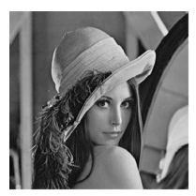
Thanks for your attention !

