Slide 1
An Evaluation of Secure Real-time Transport Protocol (SRTP) Performance for VoIP
2009 Third International Conference on Network and System Security
Author: Andre L. Alexander, Alexander L. Wijesinha , Ramesh Karne

Slide 2
Outline
Introduction
SRTP overview
Key management
Experiments
conclusion

Slide 3
Introduction
VoIP performance is affected primarily by network delay, jitter (delay variation), and packet loss, excessive levels of which may degrade voice quality
In particular, the additional overhead due to securing VoIP conversations may have an adverse effect on performance and voice quality

Slide 4
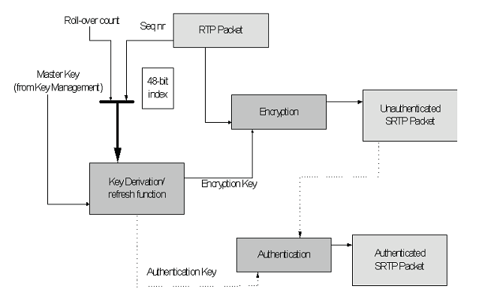
SRTP overview
SRTP are AES in counter mode or f8 mode for encryption and HMAC-SHA-1 for message authentication

Slide 5
Key management
In experiments, the snom and bare PC oftphones use SDES/SIP, and the Twinkle softphone uses ZRTP for key exchange the snom and bare PC softphones use SDES/SIP

Slide 6
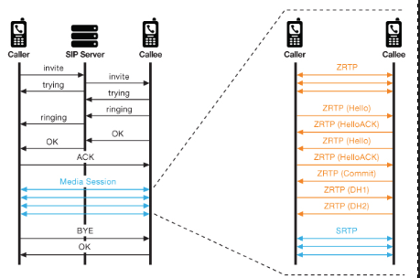
Key management (cont.)

Slide 7
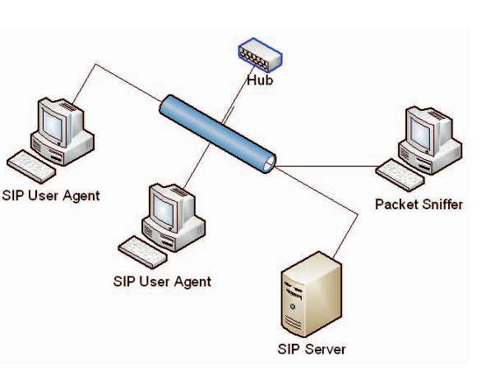
experiments
Windows XP, snom softphone
Linux Ubuntu , Twinkle softphone
Bare PC softphone with no operating system

Slide 8
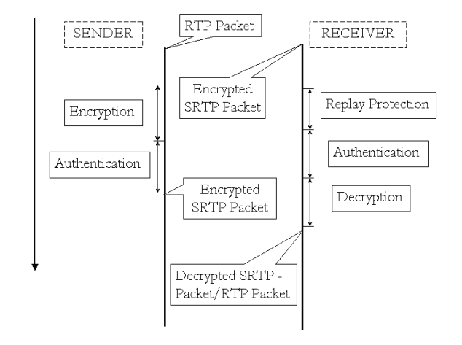
Experiments (cont.)

Slide 9
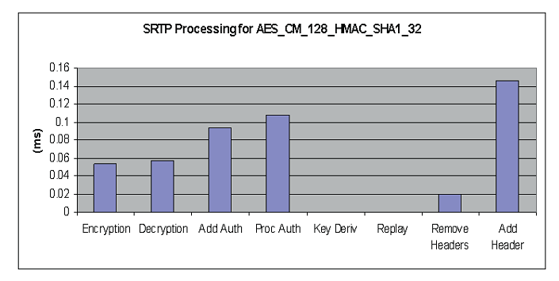
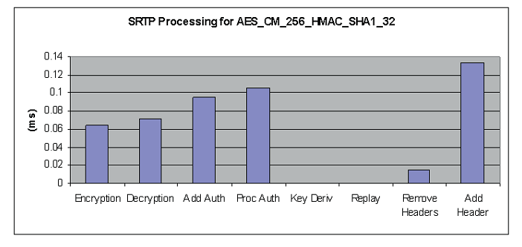
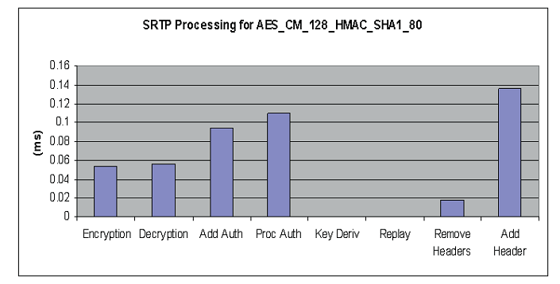
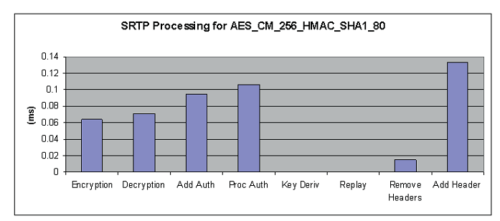
Experiments (cont.)

Slide 10
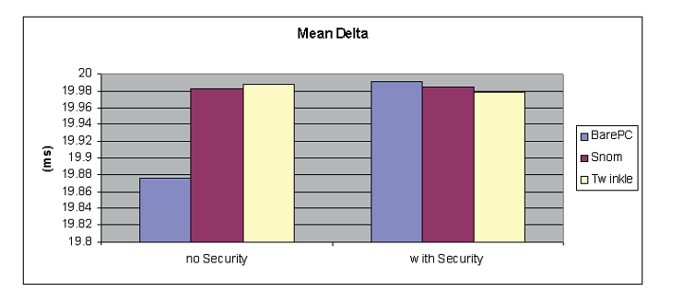
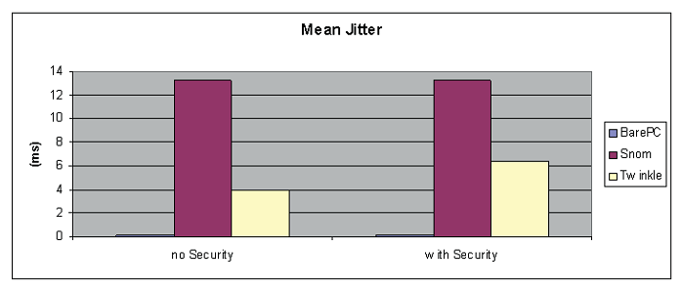
Experiments (cont.)

Slide 11
conclusion
Processing overhead due to SRTP authentication is expensive compared to AES encryption but no operation degrades VoIP performance.
It can also be seen that processingtimes are about the same regardless of authentication tag size.
Overall, the results indicate that SRTP adds negligible overhead to VoIP processing and has no observable effect on VoIP quality

Slide 12
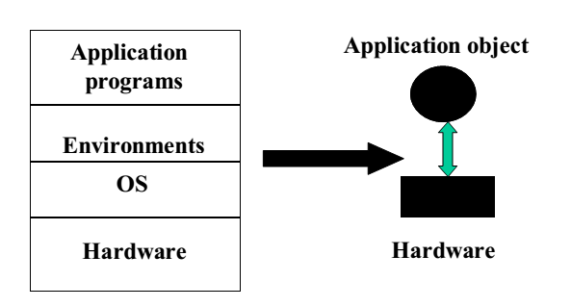
Bare PC Computing

Slide 13
jitter (delay variation)
delta (packet inter-arrival time)

