Slide 1
WaveIO
Speaker: Paul
Date:2013.08.07

Slide 2
Outline
Wave File Format
Multi-Media API (Output)
Demo
Multi-Media API (Input)
Demo
Reference

Slide 3
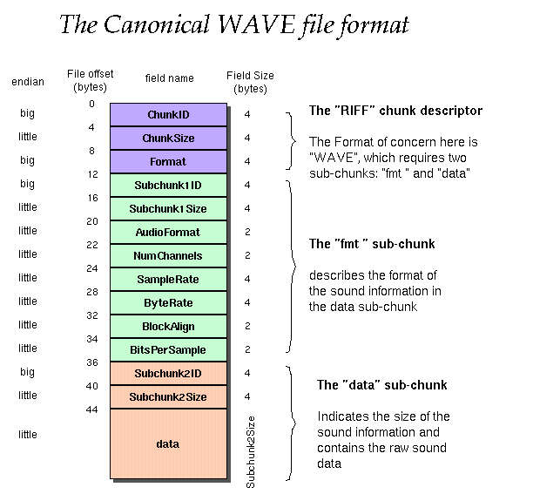
Wave File Format

Slide 4
WAVEFORMATEX
typedef struct {
WORD wFormatTag;
WORD nChannels;
DWORD nSamplesPerSec;
DWORD nAvgBytesPerSec;
WORD nBlockAlign;
WORD wBitsPerSample;
WORD cbSize;
} WAVEFORMATEX;
This structure defines the format of waveform-audio data.

Slide 5
WAVEHDR
typedef struct {
LPSTR lpData;
DWORD dwBufferLength;
DWORD dwBytesRecorded;
DWORD dwUser;
DWORD dwFlags;
DWORD dwLoops;
struct wavehdr_tag* lpNext;
DWORD reserved;
} WAVEHDR;
This structure defines the header used to identify a waveform-audio buffer.

Slide 6
MMCKINFO
typedef struct {
FOURCC ckid;
DWORD cksize;
FOURCC fccType;
DWORD dwDataOffset;
DWORD dwFlags;
} MMCKINFO;
The structure contains information about a chunk in a RIFF file.

Slide 7
mmioOpen()
HMMIO mmioOpen( LPSTR Filename, MMIOINFO mmioinfo, DWORD dwOpenFlags );
The mmioOpen function opens a file for unbuffered or buffered I/O.
Returns a handle of the opened file.
If the file cannot be opened, the return value is NULL.
dwOpenFlags :MMIO_CREATE、MMIO_WRITE、MMIO_READ …etc.

Slide 8
mmioCreateChunk()
MMRESULT mmioCreateChunk( HMMIO hmmio, MMCKINFO &ck, UINT wFlags );
The mmioCreateChunk function creates a chunk in a RIFF file that was opened by using the mmioOpen function.
wFlags :MMIO_CREATERIFF
Returns MMSYSERR_NOERROR if successful

Slide 9
mmioFOURCC()
FOURCC mmioFOURCC( CHAR ch0, CHAR ch1, CHAR ch2, CHAR ch3 );
The mmioFOURCC macro converts four characters into a four-character code.
Returns the four-character code created from the given characters.

Slide 10
mmioWrite()
LONG mmioWrite( HMMIO hmmio, char _huge* pch, LONG cch );
The mmioWrite function writes a specified number of bytes to a file opened by using the mmioOpen function
Returns the number of bytes actually written.

Slide 11
mmioAscend()
MMRESULT mmioAscend( HMMIO hmmio, MMCKINFO &ck, UINT wFlags );
The mmioAscend function ascends out of a chunk in a RIFF file
wFlags : must be zero.
Returns MMSYSERR_NOERROR if successful

Slide 12
mmioClose()
MMRESULT mmioClose( HMMIO hmmio, UINT wFlags );
Returns zero if successful or an error otherwise.

Slide 13
waveOutOpen()
MMRESULT waveOutOpen( HWAVEOUT &ohandle, UINT uDeviceID, WAVEFORMATEX &wf, DWORD dwCallback, DWORD dwInstance, DWORD fdwOpen );
Opens a specified waveform output device for playback.
Returns MMSYSERR_NOERROR if successful.

Slide 14
waveOutPrepareHeader()
MMRESULT waveOutPrepareHeader( HWAVEOUT ohandle, WAVEHDR &wh, UINT cbwh );
Prepares a waveform data block for playback.
Returns MMSYSERR_NOERROR if successful.

Slide 15
waveOutWrite()
MMRESULT waveOutWrite( HWAVEOUT ohandle, WAVEHDR &wh, UINT cbwh );
Sends a data block to the specified waveform output device.
Returns MMSYSERR_NOERROR if successful.

Slide 16
waveOutReset()
MMRESULT waveOutReset( HWAVEOUT ohandle );
Stops playback on a specified waveform output device and resets the current position to 0.
Returns MMSYSERR_NOERROR if successful.

Slide 17
waveOutUnprepareHeader()
MMRESULT waveOutUnprepareHeader( HWAVEOUT ohandle, WAVEHDR &wh, UINT cbwh );
Cleans up the preparation performed by waveOutPrepareHeader.
Returns MMSYSERR_NOERROR if successful.

Slide 18
waveOutClose( )
MMRESULT waveOutClose( HWAVEOUT ohandle );
Closes the specified waveform output device.
Returns MMSYSERR_NOERROR if successful.

Slide 19
Demo

Slide 20
waveInOpen()
MMRESULT waveInOpen(HWAVEIN &ihandle, UINT DeviceID, WAVEFORMATEX &waveformat, DWORD dwCallback, DWORD dwInstance, DWORD fdwOpen );
Open a specified waveform input device for recording.
uDeviceID : WAVE_MAPPER
fdwOpen :CALLBACK_WINDOW ,CALLBACK_THREAD
Return MMSYSERR_NOERROR means success

Slide 21
waveInPrepareHeader()
MMRESULT waveInPrepareHeader( HWAVEIN ihandle, WAVEHDR &wh, UINT cbwh );
Prepares a buffer for waveform input.
Returns MMSYSERR_NOERROR if successful.

Slide 22
waveInAddBuffer()
MMRESULT waveInAddBuffer( HWAVEIN ihandle, WAVEHDR &wh, UINT cbwh );
Sends an input buffer to the specified waveform-audio input device.
Returns MMSYSERR_NOERROR if successful.

Slide 23
waveInStart()
MMRESULT waveInStart( HWAVEIN ihandle );
Starts input on the specified waveform input device.
Returns MMSYSERR_NOERROR if successful.

Slide 24
waveInReset()
MMRESULT waveInReset( HWAVEIN ihandle );
Stops input on a specified waveform input device and resets the current position to 0.
Returns MMSYSERR_NOERROR if successful.

Slide 25
waveInUnprepareHeader()
MMRESULT waveInUnprepareHeader( HWAVEIN ihandle, WAVEHDR &wh, UINT cbwh );
Cleans up the preparation performed by waveInPrepareHeader.
Returns MMSYSERR_NOERROR if successful.

Slide 26
waveInClose()
MMRESULT waveInClose( HWAVEIN ihandle);
Closes the specified waveform-audio input device.
Returns MMSYSERR_NOERROR if successful.

Slide 27
Demo

Slide 28
Reference
Wavefomat
https://ccrma.stanford.edu/courses/422/projects/WaveFormat/
http://www.sonicspot.com/guide/wavefiles.html
Multimedia FILE I/O
http://msdn.microsoft.com/zh-tw/library/windows/desktop/dd743576(v=vs.85).aspx
Waveform Audio
http://en.wikipedia.org/wiki/WAV

