Slide 1
Remote Landslide Observation System with Differential GPS
2012 International Conference on Structural Computation and Geotechnical Mechanics
Author: Xing ZHU, Qiang XU, Jianbin ZHOU, Maolin DENG.
Date:2013/08/21
Speaker : Da-Wei Yang

Slide 2
Outline
Introduction
Remote Observation System
Hardware and Software
Experimental tests
Field Application
Test results
Conclusion

Slide 3
Introduction
With aim to master early deformation stages and motion laws of landslide, the raw displacement data of landslide are very important for the landslide researchers and environmental scientists.

Slide 4
Introduction
The paper developed a landslide displacement remote observation system based on differential GPS technology to get the raw displacement data continually.

Slide 5
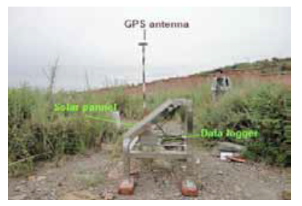
Hardware
A GPS-based observation system includes at least two GPS observation stations, one of which is the reference point and the other is the measuring point.

Slide 6
Software
Remote Control Center has the task of collecting data from all GPS receivers in the network and post-processing the GPS data from the reference point and the measuring point.

Slide 7
Remote Observation System

Slide 8
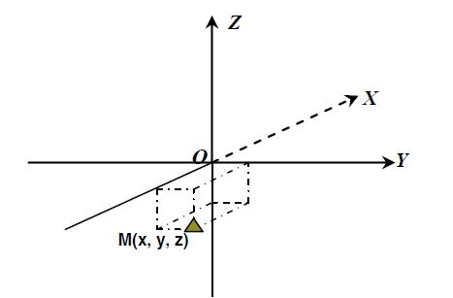
Remote Observation System
The GPS-based displacement observation system is capable of three-dimensional, real-time, and high accuracy (mm level).
高
北
東

Slide 9
Experimental tests
The measuring base-line distance between two GPS stations is 3.7km.
The results show us that this system has a high observation precision with sub-centimeter of about ±8mm.
Generally speaking, because the dynamics associated with geotechnical movements are very slow (mm/year to cm/day) and similar to static measuring, this system can meet the need of landslide movement observation.

Slide 10
Experimental tests

Slide 11
Field Application

Slide 12
Field Application
On the landslide area there is a GPS measuring station at 1662m. The base-line distance between the reference station and the monitoring station was 767.7315m when the observation stations were installed.

Slide 13
Test results
19th April to 20th July.
The base-line distance from the reference station to the measuring station is 767.7315m on 19th April and 876.9213m on 20th July according to software calculation.
A large-scale destruction on 15th July induced by a rainstorm, so this observation is very important for this landslide research.

Slide 14
Test results

Slide 15
Test results

Slide 16
Conclusion
The system measuring in static mode every 15 minutes, the measurement accuracy is about ±8mm and meets the needs of landslide displacement observation.
The GPS-based system can be used to remote monitor the large-scale deformation of landslides in near-real time. At the same time, we can get the landslide deformation stage from the change trend of displacement curves.

Slide 17
Conclusion
The GPS-based system can record the displacement history at any moment and this is very important to the geohazard prevention and study.

