Slide 1
Investigation of VoIP Quality of Service using SRTP Protocol
ELECTRONICS AND ELECTRICAL ENGINEERING
Author: T. Adomkus, E. Kalvaitis

Slide 2
Outline
Introduction
MIKEY
Simulation Results
Conclusion

Slide 3
Introduction
VoIP has a very special characteristic: it is “time critical”.
The technology requires a very low latency less than 150 ms.
Packet loss cannot exceed the mark of 3% .
The technology is highly sensitive to “unquantifiable disrupting factors such as jitter”.

Slide 4
MIKEY
MIKEY(Multimedia Internet KEYing) is another key exchange protocol for SRTP.
Pre-shared key
Public-Key
Diffie-Hellman

Slide 5
MIKEY
Pre-shared key (PSK)
This is the most efficient way to handle the transport of the Common Secret, since only symmetric encryption is used and only a small amount of data has to be exchanged.

Slide 6
MIKEY Cont.
Public-key
The Common Secret is exchanged with the help of public key encryption. In larger systems, this requires a PKI to handle the secure distribution of public keys.

Slide 7
MIKEY Cont.
Diffie-Hellman
A Diffie-Hellman key exchange is used to set up the Common Secret. This method has a higher resource consumption (both computation time and bandwidth) than the previous ones, but has the advantage of providing perfect forward secrecy. Also, it can be used without any PKI.

Slide 8
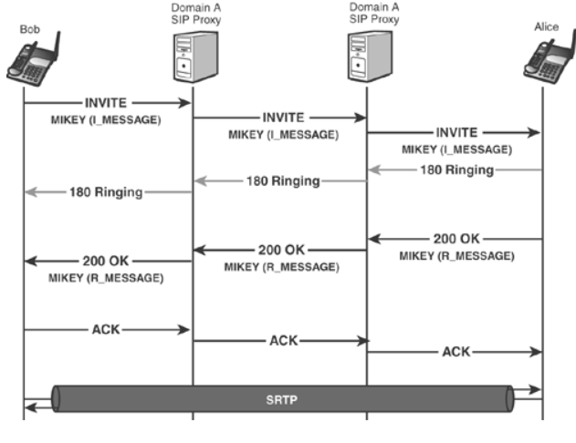
MIKEY Cont.

Slide 9
MIKEY Cont.

Slide 10
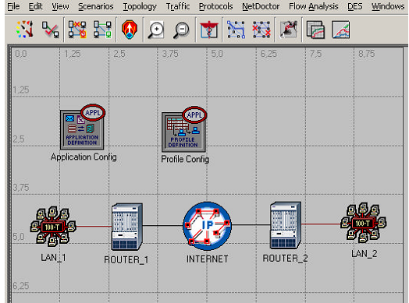
Simulation Results
SRTP protocol uses AES algorithm, and DIffie-Hellman algorithm to securely exchange encryption keys.

Slide 11
Simulation Results Cont.
SRTP at the beginning delay 63ms
RTP only delay 43 ms

Slide 12
Conclusion
Accordingly to modeling results we see that in any case the delay of voice packets doesn’t exceed critical150 ms value. So, we can certainly propose, that we can ensure the quality of service for encrypting voice packets.

