Slide 1
Steganalysis of Recorded Speech
SPIE, vol. 5681, Mar. 2005
Author(s): Micah K. Johnson, Siwei Lyu, and Hany Farid

Slide 2
Outline
Introduction
Methods
STFT
PCA
RMS
SVM
Results
Conclusion
Reference

Slide 3
Introduction
Digital audio is a cover medium capable of supporting high-throughput steganography.
In addition, audio is often transient and unpredictable, facilitating the hiding of messages.

Slide 4
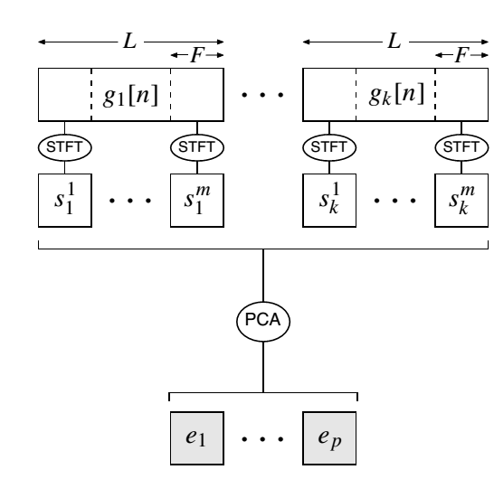
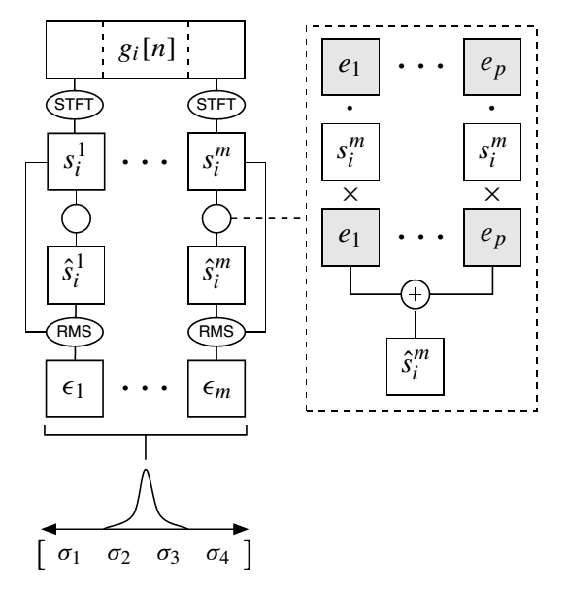
Methods
System diagram

Slide 5
Methods
STFT(Short-time Fourier transform)
The short-time Fourier transform (STFT) is perhaps the most common time/frequency decomposition for audio signals.
Fourier transform:
Short-time Fourier transform

Slide 6
Methods
PCA(principal component analysis)
PCA is a form of dimensionality reduction
our spectrograms are represented by vectors in an F-dimensional space, but are possibly well explained by a low-dimensional subspace.

Slide 7
Methods
RMS (root mean square )
The RMS errors for all the frames of an audio signal yield an error distribution which can be characterized by the first four statistical moments: mean, variance, skewness, and kurtosis. These four statistics form the feature vector used for differentiating between clean and stego audio.

Slide 8
Methods
SVM(support vector machine)
Having collected the statistical feature vectors from both clean and stego audio signals, a classifier is required that can differentiate between these two classes of signals
We find that non-linear classifiers offer significant improvements in detection accuracy over linear techniques.

Slide 9
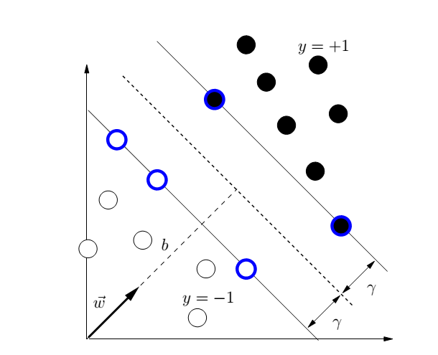
Methods
For linearly separable data, SVM classification seeks the surface (dashed line) that maximizes the classification margin γ

Slide 10
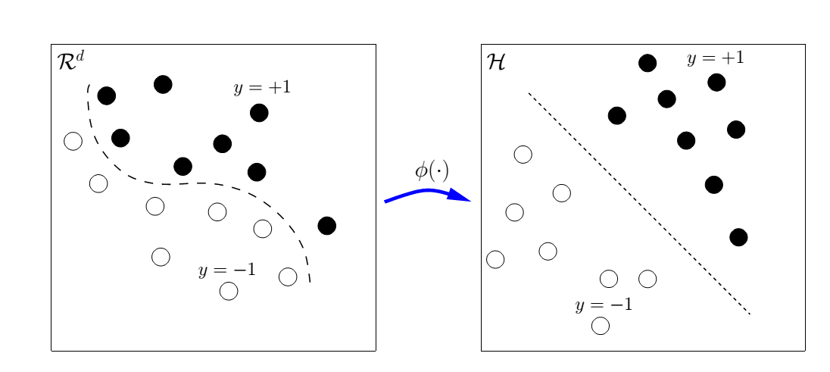
Methods
Non-linear SVM classification

Slide 11
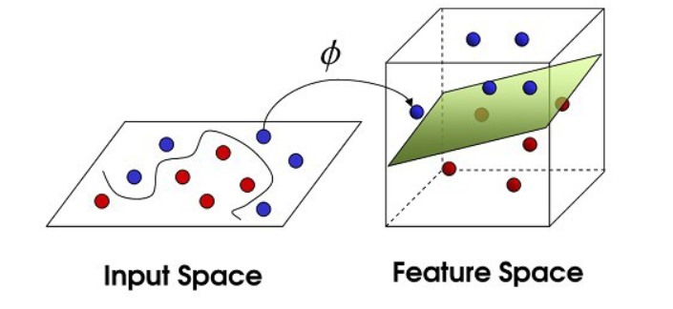
Methods
Non-linear SVM classification

Slide 12
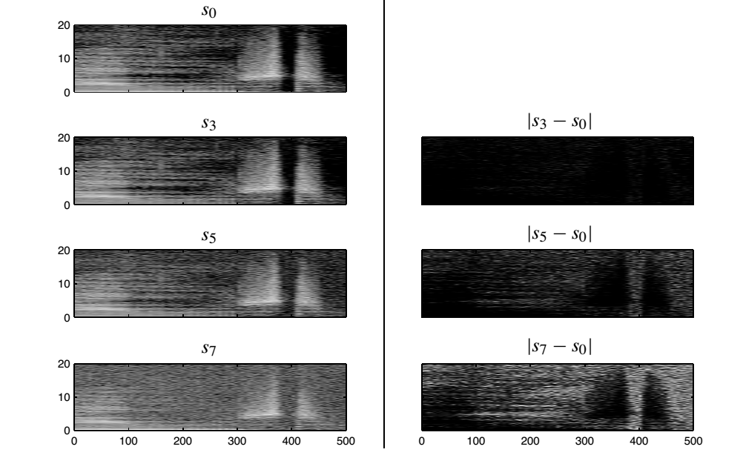
Results
Shown are the effects of LSB steganography on the time/frequency representation of the audio signal

Slide 13
Results
Percent of signals classified as containing hidden messages for LSB (1 to 8 bits) and Hide4PGP (25% to 100% capacity)embeddings.

Slide 14
Conclusion
We have described a universal steganalysis algorithm that exploits the inherent statistical regularities of recorded speech.
We do not expect this technique to immediately generalize to, for example, recorded music. The reason is that the inherentstatistics of music are likely to be quite different from speech, and the wide variability in quality is likely to add further.

Slide 15
Reference
1.F. A. P. Petitcolas, R. J. Anderson, and M. G. Kuhn, “Information hiding—a survey,”Proceedings of the IEEE87,
pp. 1062–1078, July 1999.
2. N. F. Johnson and S. Jajodia, “Exploring steganography: Seeing the unseen,”IEEE Computer31(2), pp. 26–34, 1998.
3. R. J. Anderson and F. A. P. Petitcolas, “On the limits of steganography,”IEEE Journal on Selected Areas in Communications16, pp. 474–481, May 1998.
4. J. Fridrich and M. Goljan, “Practical steganalysis of digital images—state of the art,”Proceedings of the SPIE Photonics West4675, pp. 1–13, 2002.
5. N. F. Johnson and S. Jajodia, “Steganalysis: The investigation of hidden information,”Proceedings of the 1998 IEEE
Information Technology Conference, pp. 113–116, 1998.
6. J. Fridrich, M. Goljan, and D. Hogea, “Steganalysis of JPEG images: Breaking the F5 algorithm,”5th International
Workshop on Information Hiding, 2002.
7. S. Lyu and H. Farid, “Detecting hidden messages using higher-order statistics and support vector machines,”5th
International Workshop on Information Hiding, 2002.
8. A. Westfeld, “Detecting low embedding rates,”5th International Workshop on Information Hiding, 2002.
9. S. Dumitrescu, X. Wu, and Z. Wang, “Detection of LSB steganography via sample pair analysis,”IEEE Transactions
on Signal Processing51, pp. 1995–2007, July 2003.
10. H.¨
Ozer,˙I. Avcıbas¸, B. Sankur, and N. Memon, “Steganalysis of audio based on audio quality metrics,”Proceedings
of SPIE5020, pp. 55–66, June 2003.
11. H. Farid, “Detecting hidden messages using higher-order statistical models,”International Conference on Image
Processing, 2002.
12. H. Repp, “Hide4PGP,” 2000.http://www.heinz-repp.onlinehome.de/Hide4PGP.htm.
13. M. Bosi and R. E. Goldberg,Introduction to Digital Audio Coding and Standards, Kluwer Academic Publishers,
2003.
14. J. E. Jackson,A User’s Guide to Principal Components, John Wiley & Sons, 2003.
15. V. N. Vapnik,The Nature of Statistical Learning Theory, Springer-Verlag, 2nd ed., 2000.
16. C. J. Burges, “A tutorial on support vector machines for pattern recognition,”Data Mining and Knowledge Discovery
2(2), pp. 121–167, 1998.

