Slide 1
LNMP- Management Architecture for IPv6 based low- power Wireless Personal Area Networks (6LoWPAN)
Hamid Mukhtar, Kim Kang-Myo, Shafique Ahmad Chaudhry, Ali Hammad Akbar, Kim Ki-Hyung, Seung-Wha Yoo
Network Operations and Management Symposium, 2008. NOMS 2008. IEEE

Slide 2
Outline
Introduction
6LoWPAN Network Model
LNMP Architecture
Evaluation
Conclusion
References

Slide 3
Introduction
6LoWPANs are a suitable choice for an infrastructure to provide ubiquitous and robust connectivity to users. To keep such networks always operational, robust network management architecture is needed.

Slide 4
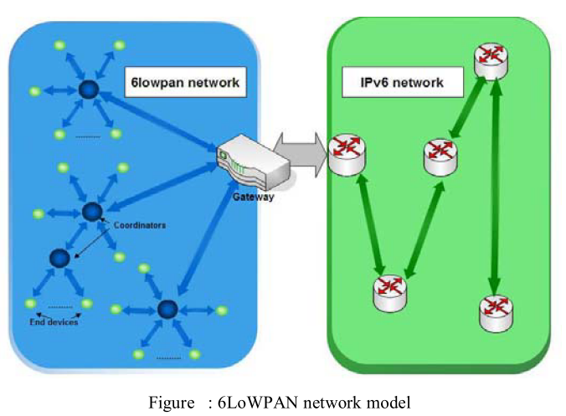
6LoWPAN Network Model
6LoWPAN Devices
Full function devices (FFD)
Reduced Function Device (RFD)
Gateway

Slide 5
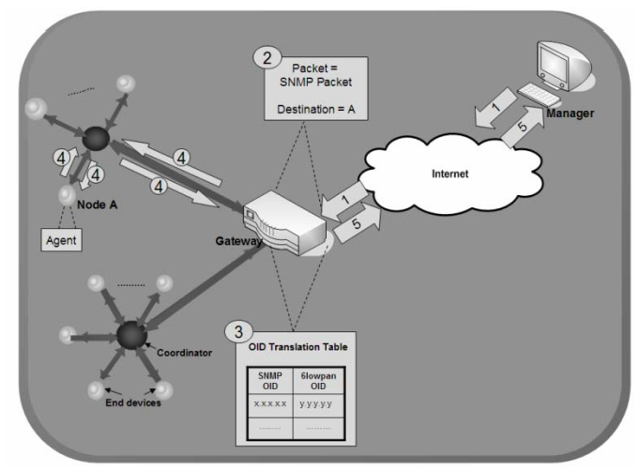
LNMP Architecture
Operational Architecture

Slide 6
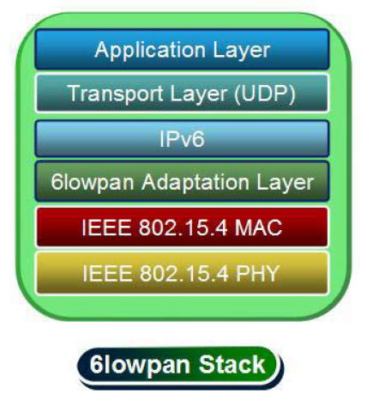
LNMP Architecture(cont.)
Informational Architecture

Slide 8
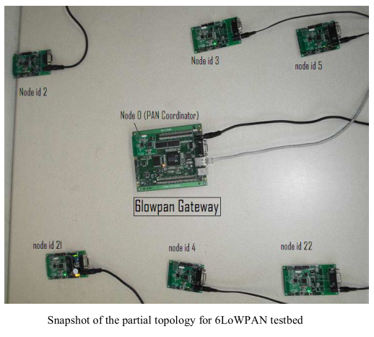
Implementation
Atmel ATmega128L microcontroller,
with a single-chip
2.4 GHz
IEEE 802.15.4
compliant
RF transceiver 421
(CC2420DB chipset).

Slide 9
Implementation(cont.)

Slide 10
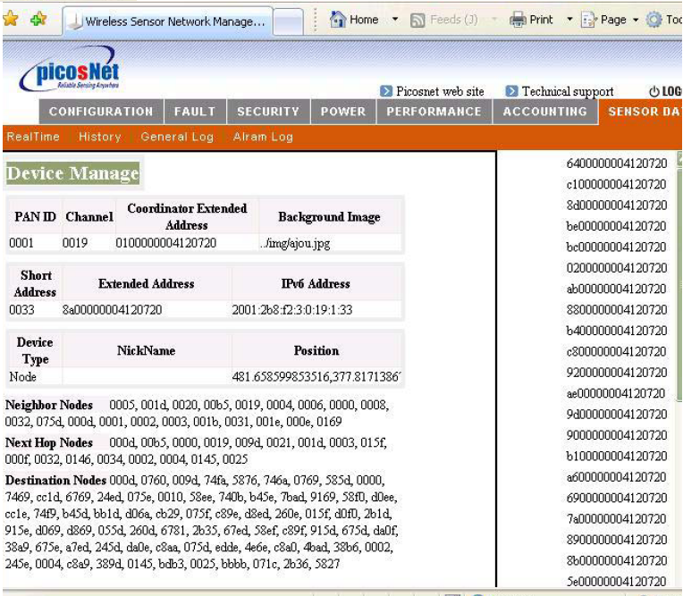
Implementation(cont.)
Network Organization
Information
Device Capability
Information
Broadcast Related
Information
General

Slide 11
Evaluation

Slide 12
Evaluation(cont.)

Slide 13
Conclusion
This paper presents LNMP that is composed of an operationaland an informational architecture for the management of 6LoWPANs.The operational architecture emphasizes on reduction of communication cost in order to increase the network lifetime.

Slide 14
References
Hamid Mukhtar, Kim Kang-Myo, Shafique Ahmad Chaudhry, Ali Hammad Akbar, Kim Ki-Hyung, Seung-Wha Yoo , LNMP- Management Architecture for IPv6 based low-power Wireless Personal Area Networks (6LoWPAN),Network Operations and Management Symposium, 2008. NOMS 2008. IEEE

