Slide 1
Audio Steganography Using LSB Encoding Technique with Increased Capacity and Bit Error Rate Optimization CCSEIT ‘ 12 October 2012 Sangita Roy, Jyotirmayee Parida, Avinash Kumar Singh, Ashok Singh Sairam
Proceedings of the Second International Conference on Computational Science, Engineering and Information Technology
Student:陳奕君
Presentation Date:2013/12/10

Slide 2
Outline
Introduction
LSB Encoding
Proposed LSB Technique with Increased Capacity
Experimental Details
Results and Analysis
Conclusion
Reference

Slide 3
Introduction
We design a high bit rate LSB audio watermarking method that reduces embedding distortion of the host audio with increased capacity of secret text.
The scientific study began in 1983 when Simmons stated the problem in terms of communication in a prison.

Slide 4
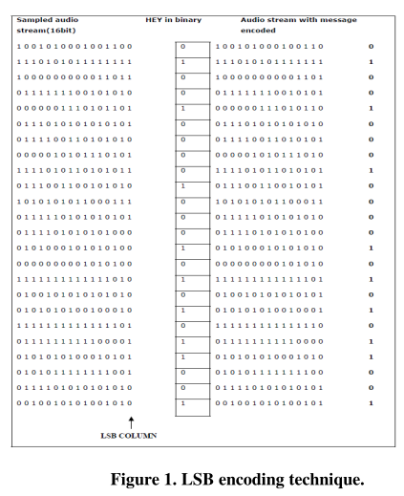
LSB Encoding (1/2)

Slide 5
LSB Encoding(2/2) Proposed LSB Technique with Increased Capacity(1/2)
LSB coding is explained in the following procedure:
Read one sample from the wave stream.
Get the next bit from the current message byte.
Place it in the current 4th bit of the sample.
Flip the rest 3 bits accordingly.
Copy the rest of the wave without changes.
Our proposed LSB technique is explained in the following procedure:
Read one sample from the wave stream.
Get the next two bits from the current message byte.
Place it in the current 4th and 3rd bit of the sample.
Flip the rest 2 bits accordingly.
Copy the rest of the wave without changes.

Slide 6
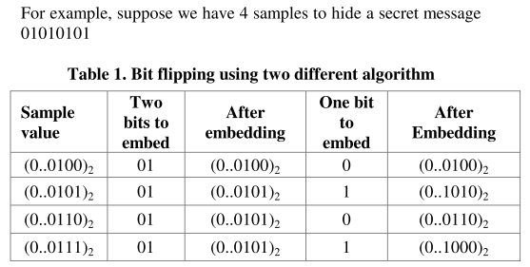
Proposed LSB Technique with Increased Capacity(2/2)

Slide 7
Experimental Details

Slide 8
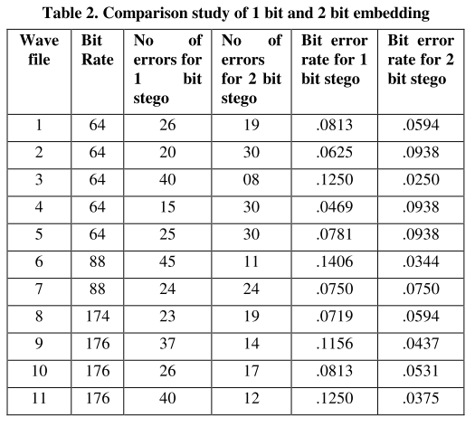
Results and Analysis(1/2)

Slide 9
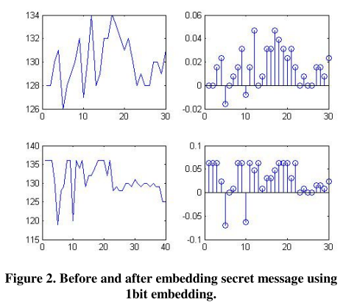
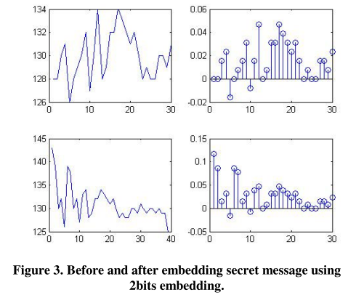
Results and Analysis(2/2)

Slide 10
Conclusion

Slide 11
Reference
Anderson, R, Bowman, Petticolas,F. On the limits of Steganography. IEEE Journal selected areas in Communication,16, 4, 474-481
Bassia, P., Pitas I., Nikolaidis N. Robust audio watermarking in the time domain, IEEE Transactions on Multimedia 3, 2, 232-241.
Brian, J., Yuliya K. and Andrew, L.Fröhlich.2006. audio Steganography Dec 13.
Cedric, T., Adi, R.,Mcloughlin, I.: Data concealment in audio using a nonlinear frequency distribution of PRBS coded data and frequency domain LSB insertion, Proc. IEEE Region 10 International Conference on Electrical and Electronic Technology, Kuala Lumpur, Malaysia, 275-278.

Slide 12
Reference
Fridrich, J., Goljan, M., Du, R.: 2002 Lossless Data Embedding – New Paradigm in Digital Watermarking, Applied Signal Processing, 2002, 2, 185-196.
I. Cox, M. Miller and J. Bloom, 2003.Digital Watermarking Morgan Kaufmann Publishers, San Francisco, CA, 2003
Krista, B., 2004. Linguistic steganography: survey, analysis and robustness concerns for hiding information in text, Center for Education and Research in Information Assurance and Security, Tech report 2004.

Slide 13
Reference
Mobasseri, B. Direct sequence watermarking of digital video using m-frames Proc. International Conference on Image Processing, Chicago, IL, 399-403
Roy, S., Manasmita M., 2011. A novel approach to format based test stegonography, International conference on communication computing and security, ICCCS 2011,Procidings by ACM with ISBN-978-1-4503- 0464-rourkela,Odisha,India.
“Steganography FAQ” Aelphaeis Mangarae, march 18 2006

