Slide 1
Data Transmission Mechanism for Multiple Gateway System
Xuan He, Yuanchen Ma and Mika Mizutani,
6th International Conference on New Trends in Information Science and Service Science and Data Mining (ISSDM)

Slide 2
Outline
Introduction
Multiple Gateway System
Data Transmission Mechanism
Evaluation
Conclusion

Slide 3
Introduction
In various Internet of Things (IoT) application scenarios, such as environment monitoring, smart city, etc.
Regular method is that the data will be sent to the gateway, and then to data center or/and control platform.

Slide 4
Introduction
Maybe this method is enough for normal sensor networks, but in environment monitoring and Smart City applications, the number of sensor nodes will be huge, the regular method cannot match the increasingly complex situation.

Slide 5
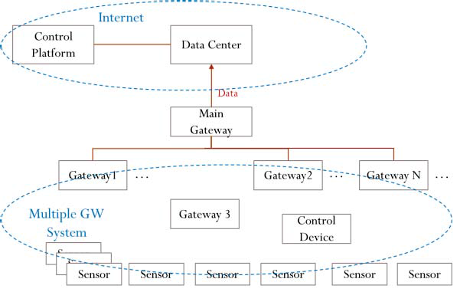
Multiple Gateway System

Slide 6
Multiple Gateway System
Control device
  The control device can receive the signal strength value from terminal gateway, and periodically measure terminal gateway buffer situation.
  Using the information of signal strength and buffer size, the control device can choose best route and send it to terminal gateway.

Slide 7
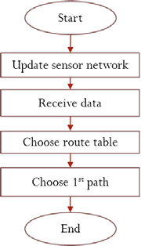
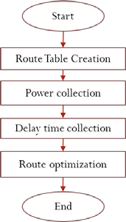
Data Transmission Mechanism
Main Process of Terminal Gateway
Main Process of Control Device

Slide 8
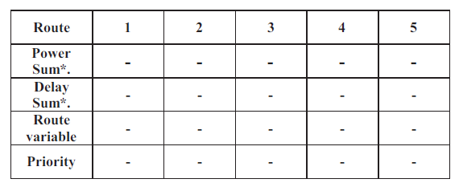

Control Device
The route table includes parameters of power consumption, delay time, the route optimization variable, and finally the route priority.
k is the unit constant.
To is the basic delay time including wireless
communication or basic process time.

Slide 9
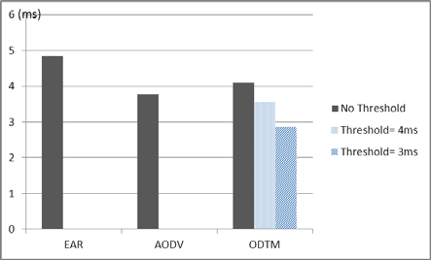
Evaluation
ODTM(Optimized data transmission mechanism)
AODV (Ad hoc on-demand distance vector)
EAR(Energy Aware Routing)
Delay Time Evaluation Results

Slide 10
EAR(Energy Aware Routing)
EAR provides multiple routing, and occasionally uses suboptimal paths rather than always using the best path.
This mechanism selects multiple paths between source node and object nodes.
The selection depends on communication power consumption and the rest energy of nodes situation. Thus every path has a certain rate to be chosen, and the whole network lifetime will be enhanced.

Slide 11
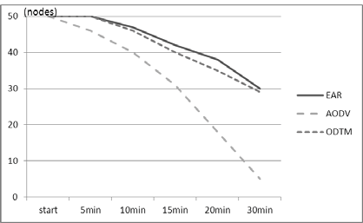
Evaluation
Active Nodes Numbers

Slide 12
Conclusion
Using this method, the network power consumption and data delay can be both controlled in a reasonable value, thereby promoting the system working efficiency and saving energy.
The evaluation result verified the flexible performance of proposed optimized data transmission mechanism.

Slide 13
Route table
The first level should be normal data without high priority requirements
The second should be alarm data with higher priority requirements
The third level can be a supplement level with flexible threshold.

