Slide 1
OpenFlow-Based Server Load Balancing Gone Wild
Richard Wang, Dana Butnariu, and Jennifer Rexford
Princeton University; Princeton, NJ
USENIX Association Berkeley, CA, USA ©2011
Author: Jennifer Rexford
Speaker : Nillson

Slide 2
Outline
Load Balancing
Software LB
Dedicated HW
Openflow Load Balancing
Naive Solution
Proactively Install Rules
Wildcard Rules on Client IPs
Minimizing Wildcard Rules
Connection Affinity
Evaluation
Conclusion
Reference

Slide 3
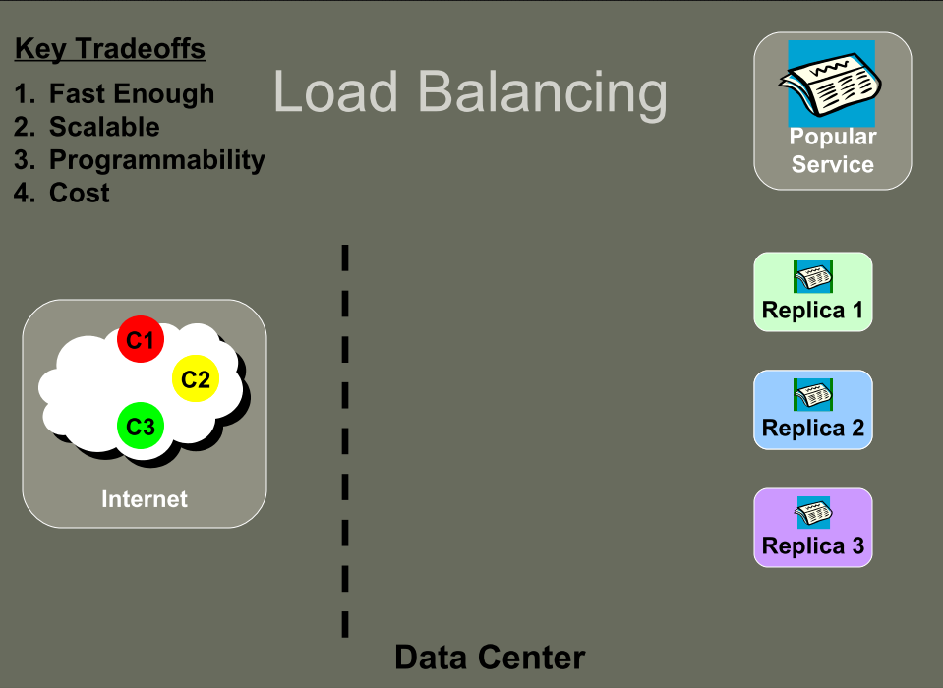

Slide 4
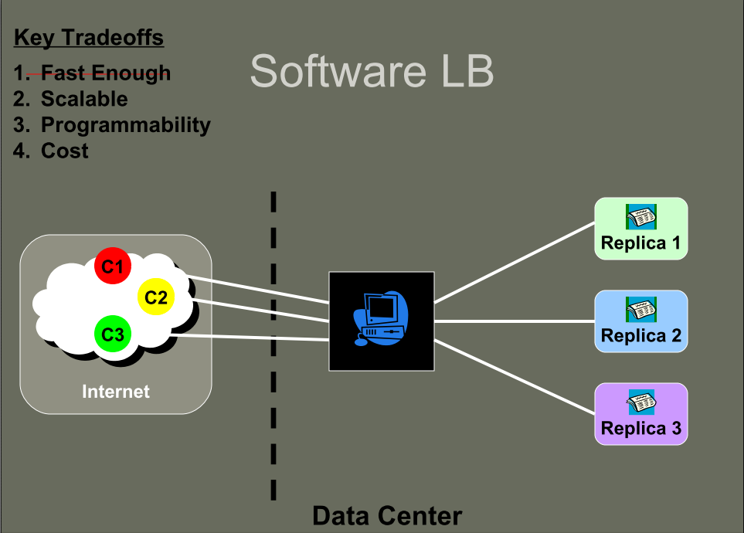

Slide 5
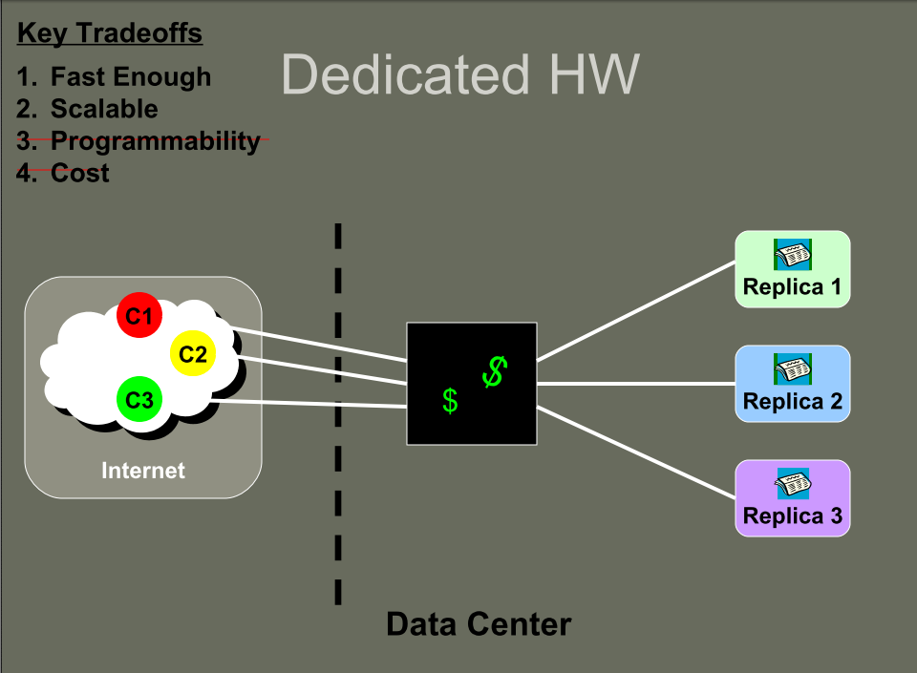

Slide 6
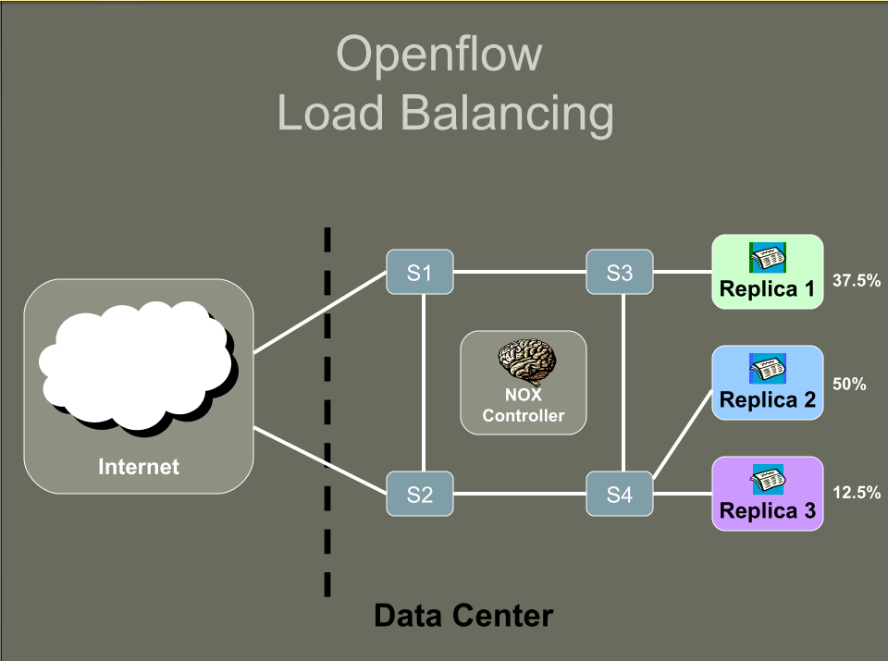

Slide 7
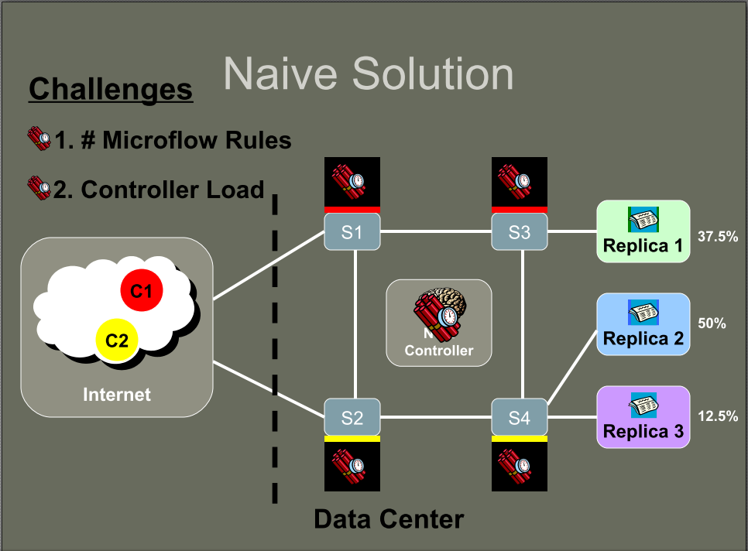

Slide 8
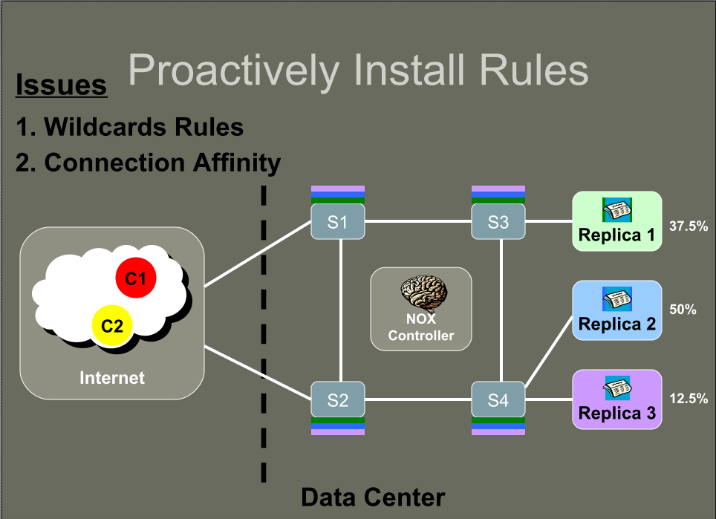

Slide 9
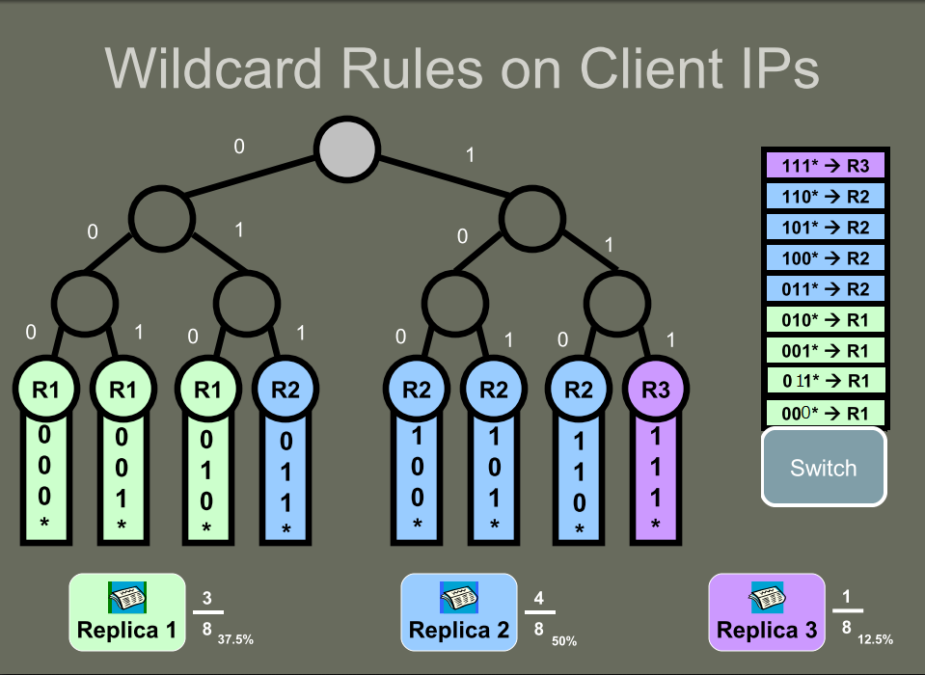

Slide 10
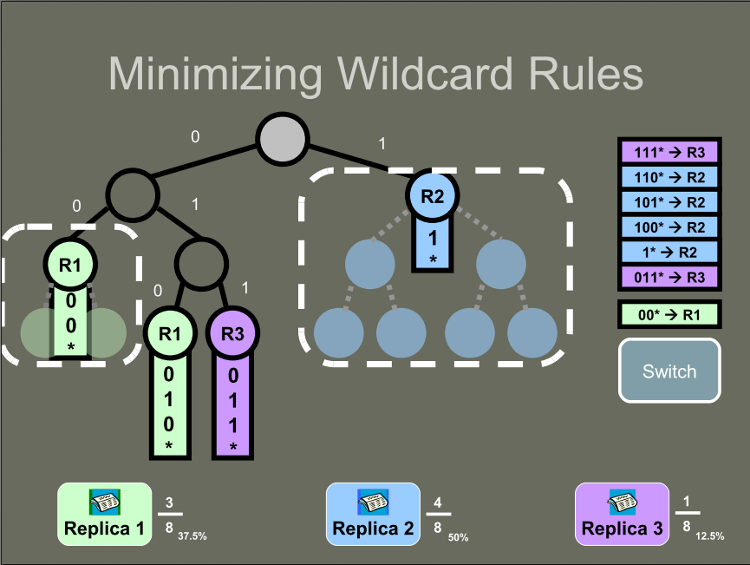

Slide 11
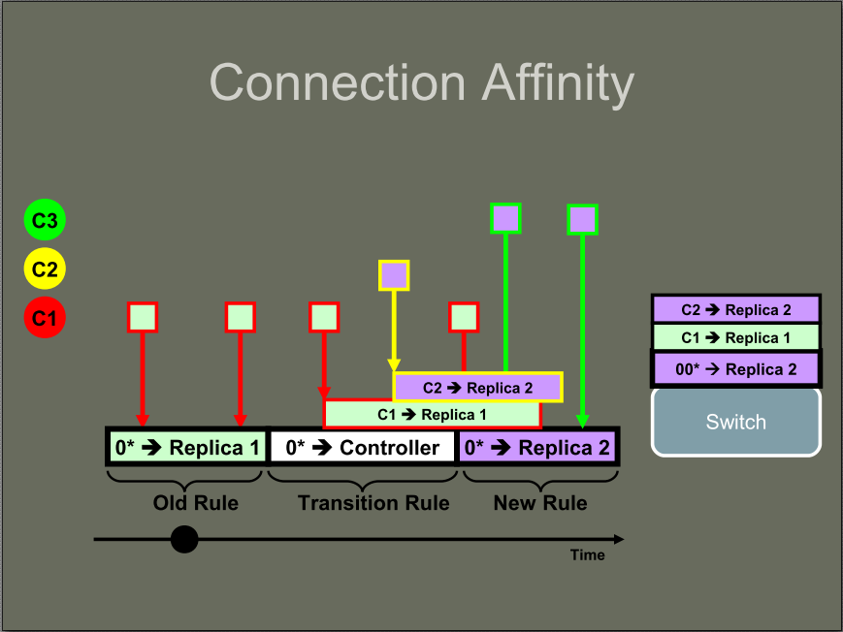

Slide 12
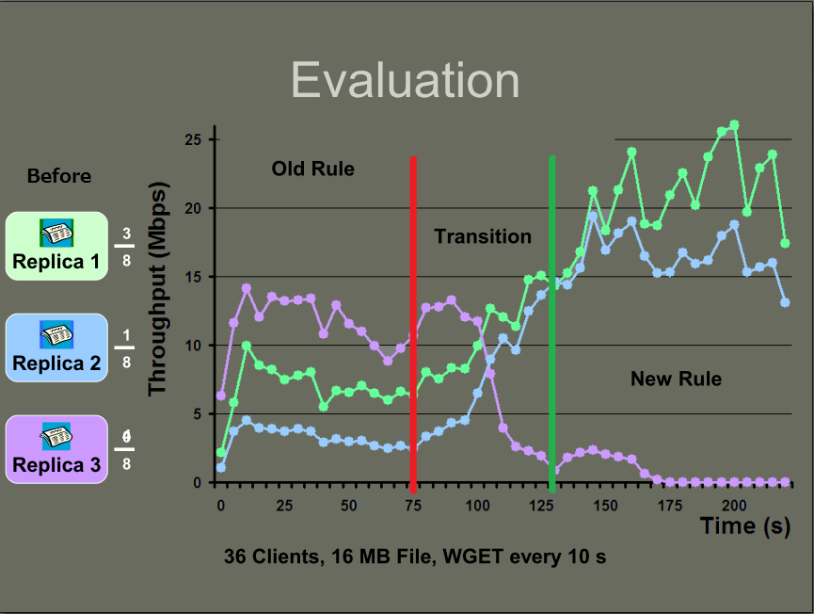

Slide 13
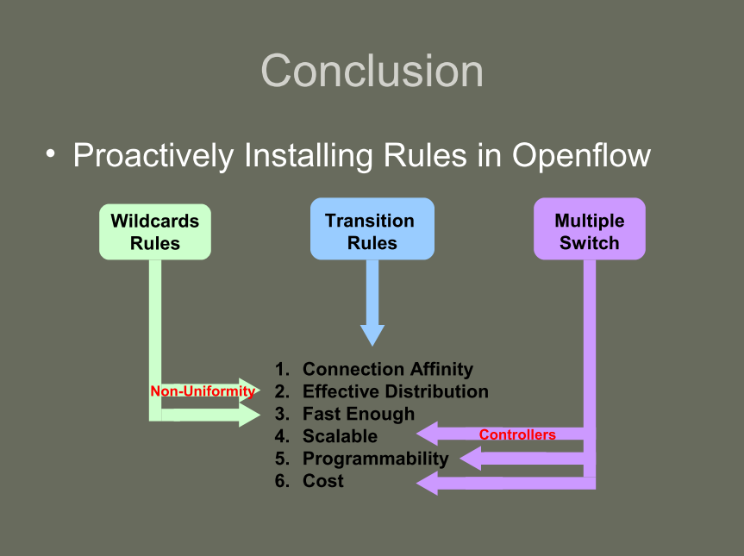

Slide 14
Reference
http://www.cs.princeton.edu/~jrex/talks/lb-hotice11.pdf

