Slide 1
CDTS: Coordinator Data Traffic Shunt model for Zigbee networks
International Computer Symposium (ICS 2012), Hualien, Taiwan.
Authors : Chinyang Henry Tseng*, Shaiuhuey Wang**, Bor-Shing Lin*,
Tong-Ying Juang*, Xiao-Ru Ji*
*National Taipei University
**Chung Yuan Christian University

Slide 2
Outline
Introduction
CDTS Group
CDTS Layer
Evaluation
Conclusion

Slide 3
Introduction
Zigbee is applied to more emerging applications, scalability becomes a critical issue: all sensor data is sent to the coordinator before forwarding to the sink node, and obviously the coordinator becomes the bottleneck.

Slide 4
Introduction
This paper proposes Coordinator Data Traffic Shunt (CDTS) performing data traffic shunt feature to reduce Coordinator’s traffic.
CDTS group consists of CDTS routes and forwards data directly to Sink instead of to the coordinator.

Slide 5
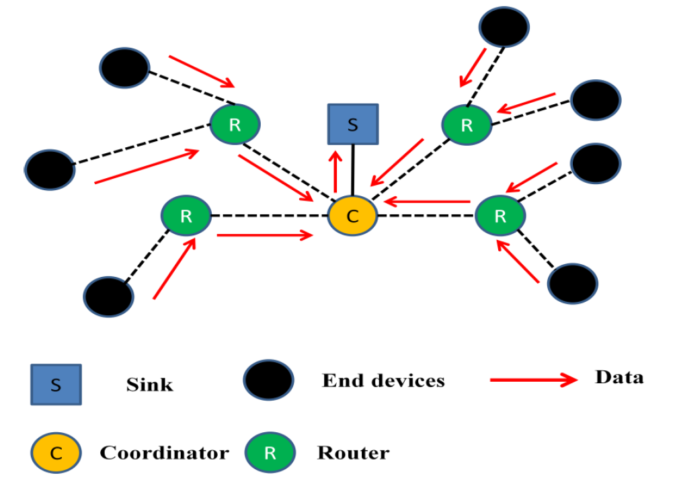

Slide 6
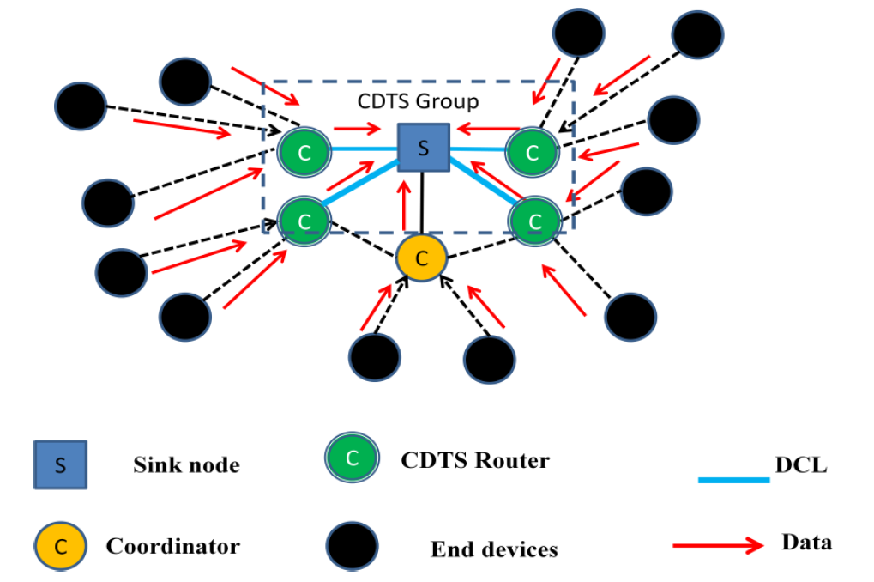
CDTS Group

Slide 7
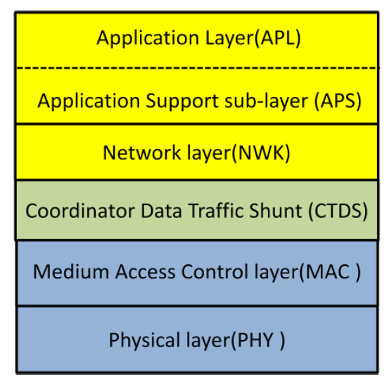
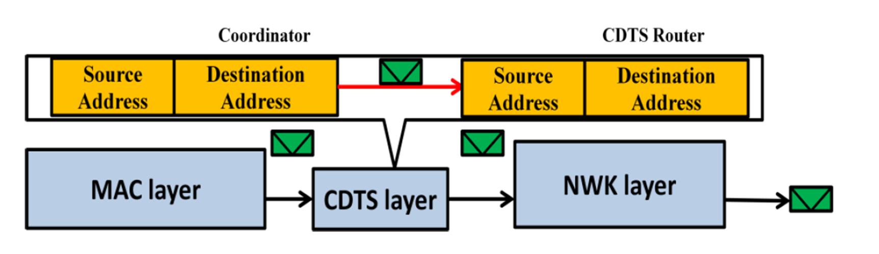
CDTS Layer
To ease CDTS router implementation without modifying Zigbee standard, CDTS layer is added between Media Access Control (MAC) and network (NWK) layers in Zigbee stack.
CDTS layer intercepts packets and redirect them to the Sink node without involving the coordinator.

Slide 8
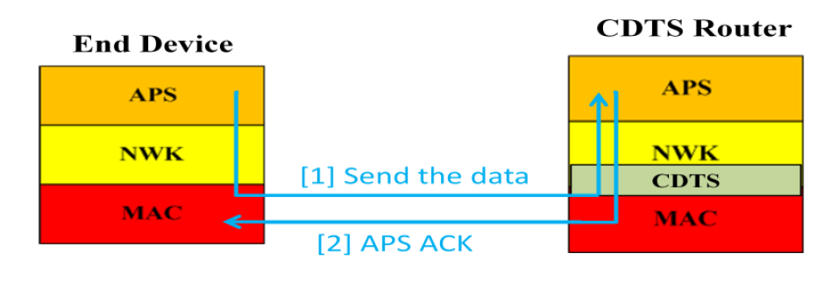
CDTS Layer

Slide 9
Evaluation
Packet Deliver Ratio (%):
packets sent from Zigbee sensor nodes
packets received at the sink node
Coordinator Loading (bps): packets processed at the coordinator in bps.
Sink Throughput (bps): packets received at the sink node in bps.

Slide 10
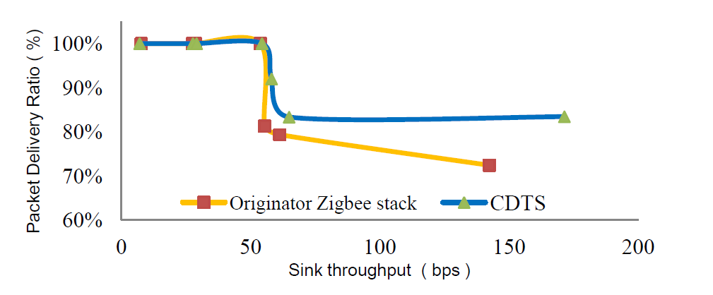
Evaluation(Packets Delivery Ratio)

Slide 11
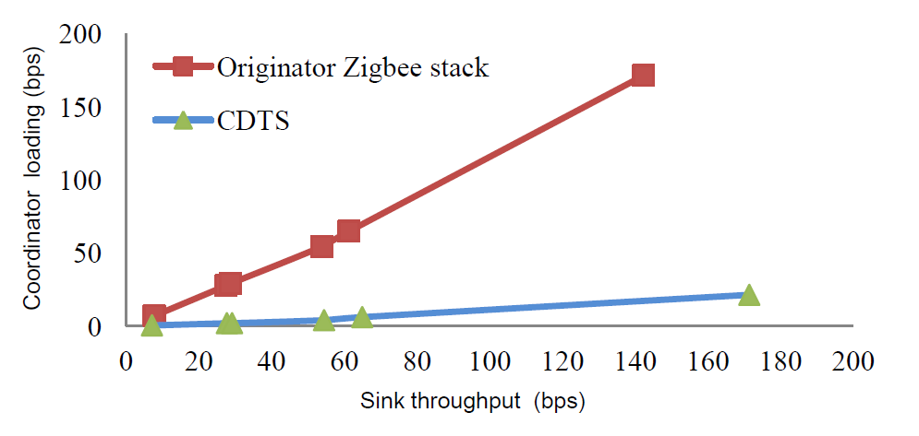
Evaluation(Coordinator loading)

Slide 12
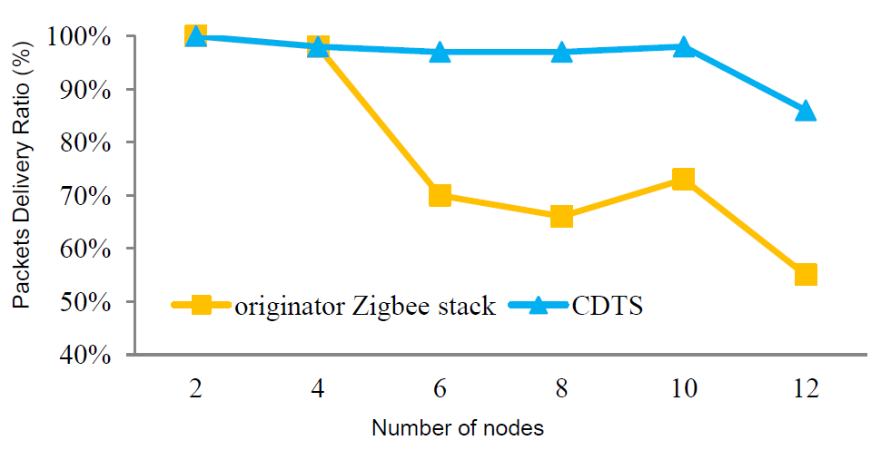
Evaluation(Packets Delivery Ratio with 3 CDTS routers)

Slide 13
Conclusion
Zigbee has lots of emerging sensor application because it has the advantages of low cost and easy deployment. Scalability becomes its major problem due to its coordinator design.
We analyze Zigbee stack design and identify two groups of requirements for the desirable solution.
Experiment results show CDTS provides better packet deliver ratio and scalability as well as lower coordinator loading than original Zigbee stack while increasing the throughput at the sink node. Thus, CDTS successfully resolves Zigbee bottleneck problem and is fully compatible with current Zigbee stack design.

