Slide 1
Detecting Hidden Messages Using Higher-Order Statistics and Support Vector Machines
Siwei Lyu and Hany Farid
Department of Computer Science, Dartmouth College, Hanover, NH 03755, USA
IEEE International Conference on Image Processing,2002

Slide 2
Outline
Introduction
Image Statistics
Classification
Results
Conclusion
References

Slide 3
Introduction
Although the presence of embedded messages is often imperceptible to the human eye, it may nevertheless disturb the statistics of an image.
The embedding of a message significantly alters these statistics and thus becomes detectable. Support vector machines (linear and non-linear) are employed to detect these statistical deviations.

Slide 4
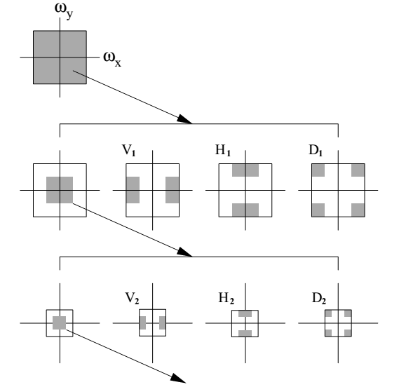
Image Statistics
The decomposition employed here is based on separable quadrature mirror filters (QMFs)

Slide 5
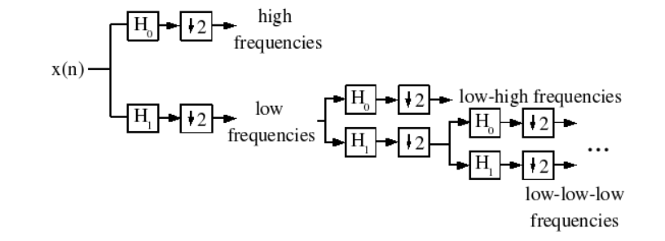
Image Statistics
This is accomplished by applying separable lowpass and highpass filters along the image axes generating a vertical, horizontal, diagonal and lowpass subband.

Slide 6
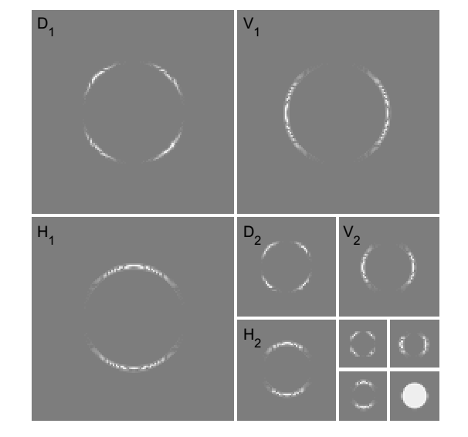
Image Statistics
The vertical, horizontal, and diagonal sub bands at scale i = 1, ..., n are denoted as V_{i}(x, y), H_{i}(x,y), and D_{i}(x,y), respectively

Slide 7
Image Statistics
The second set of statistics is based on the errors in an optimal linear predictor of coefficient magnitude

Slide 8
Image Statistics
Where denotes scalar weighting values. This linear relationship is expressed more compactly in matrix form as
The coefficients are determined by minimizing the quadratic error function:

Slide 9
Image Statistics
This error function is minimized by differentiating with respect to W:
Setting the result equal to zero, and solving for w to yield:

Slide 10
The log error in the linear predictor is then given by:
It is from this error that additional statistics are collected, namely the mean, variance, skewness and kurtosis.

Slide 11
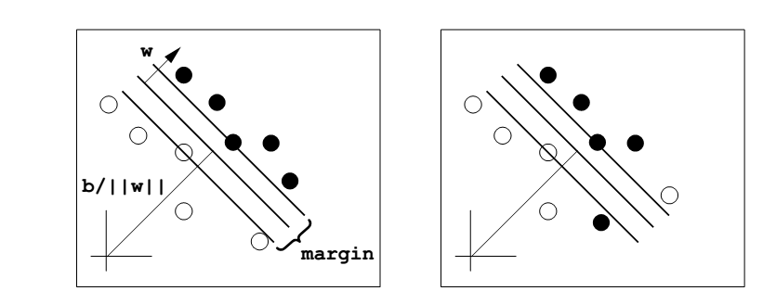
Classification
Linear Separable SVM
Linear Non-Separable SVM

Slide 12
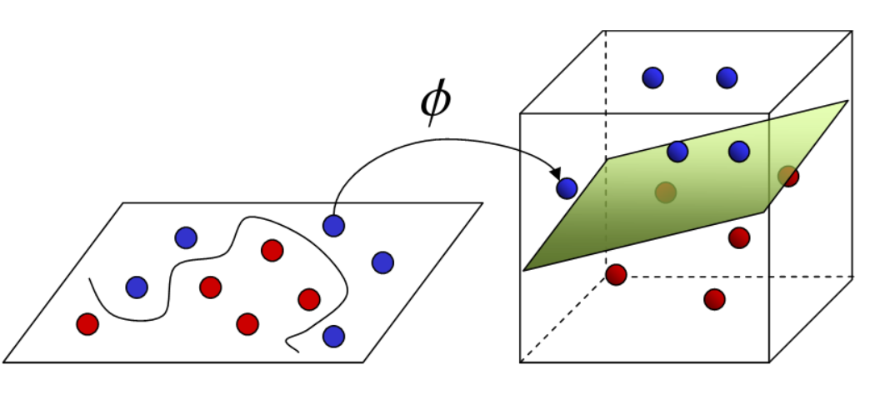
Classification
Non-Linear SVM

Slide 13
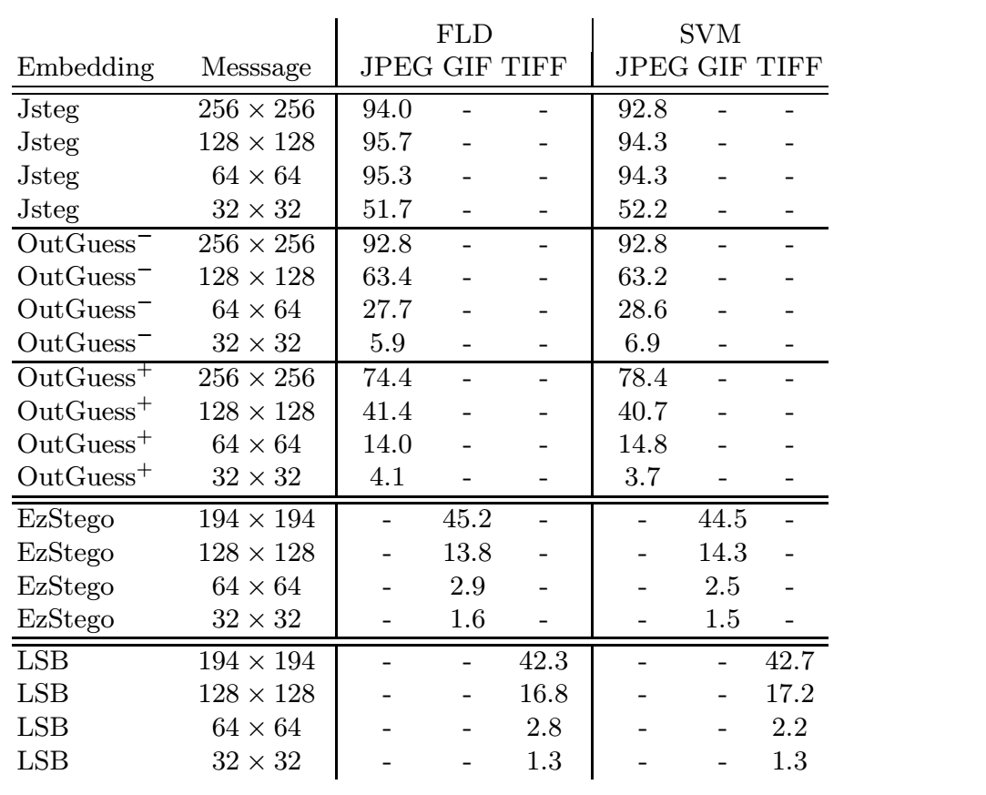
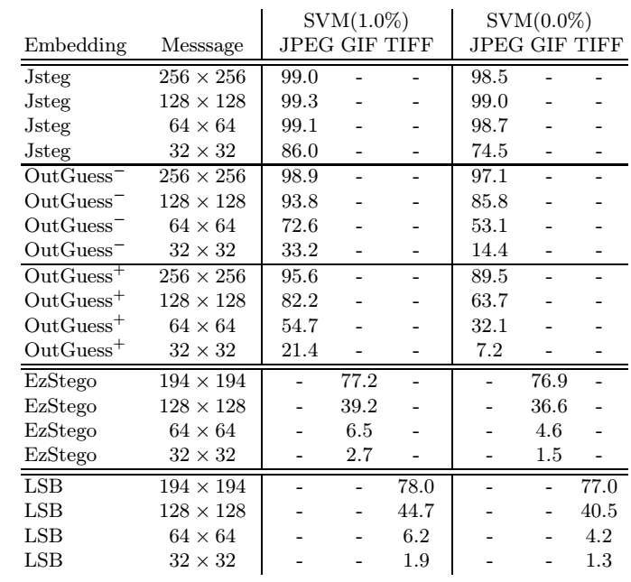
Results
Use 640*480 pixel, message consists of a n*n pixel n= {32,64,128,256} ,pixel range [0,255].

Slide 14
Conclusion
These higher-order statistics appear to capture certain properties of “natural" images, and more importantly ,these statistics are significantly altered when a message is embedded within an image.
To avoid detection, of course, one need only embed a small enough message that does not significantly disturb the image statistics.

Slide 15
References
H. Farid. Detecting hidden messages using higher-order statistical models. In International Conference on Image Processing, page (to appear), Rochester, New York, 2002.
M. Vetterli. A theory of multirate filter banks. IEEE Tr ansactions on ASSP,

