Slide 1
A Lightweight SOAP over CoAP Transport Binding for Resource Constraint Networks
Guido Moritz. Frank Golatowski, Dirk Timmermann
University of Rostock
Institute of Applied Microelectronics and Computer Engineering
2011 Eighth IEEE International Conference on Mobile Ad-Hoc and Sensor Systems

Slide 2
A CoAP based SOAP Transport Binding
Guido Moritz. Frank Golatowski, Dirk Timmermann
University of Rostock
Institute of Applied Microelectronics and Computer Engineering
2011 IEEE 16th Conference on Emerging Technologies & Factory Automation (ETFA)

Slide 3
Outline
Background Knowledge
Network Topology and Architecture
Messaging Patterns
Implementation
Conclusion
Reference
Share

Slide 4
Background Knowledge
SOAP(Simple Object Access Protocol)
HTTP/SMTP
Envelop
Message Format : XML
Binding
TCP/UDP/HTTP
WS-* (Web Service-)
WS-Address
EXI(Efficient XML Interchange)
Fast Infoset
MEP(message exchange pattern)

Slide 5
Background Knowledge(Cont.)
CoAP(Constrained Application Protocol)
Constrained
Low-power
Lossy , high packet error rates.
Low throughput of 10s of kbps
Designed to easily translate to HTTP
Support multicast
Low overhead
Simplicity
UDP

Slide 6
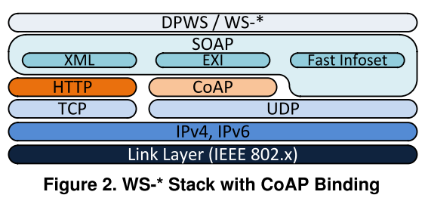
Network Topology and Architecture

Slide 7
Messaging Patterns
NON(non-conﬁrmable) request and response
CON(Conﬁrmable) request and response
Separated CON request and response
CON request and NON response
NON request and CON response

Slide 8
Implementation

Slide 9
Conclusion
The CoAP protocol developed by the IETF CoRE working group is leaned to HTTP, but designed to ﬁt better in 6LoWPAN limitations.
Combined with the mentioned binary encodings like for example EXI, SOAP Web services can also be deployed in bandwidth limited environments like WSNs.

Slide 10
Reference
Guido Moritz. Frank Golatowski, Dirk Timmermann,A Lightweight SOAP over CoAP Transport Binding for Resource Constraint Networks,2011 Eighth IEEE International Conference on Mobile Ad-Hoc and Sensor Systems

Slide 11
Share
The Internet of Things is more than just IP communication.
It also means creation , deployment and management of distributed applications.
It means “things” sharing their resources, data and knowledge.

