Slide 1
Steganalysis of audio: attacking the Steghide
Ru, Xue-Min, Hong-Juan Zhang, and Xiao Huang
College of Computer Science, Zhejiang University, Hangzhou
Machine Learning and Cybernetics, 2005. Proceedings of 2005 International Conference on. IEEE

Slide 2
Outline
Description of the Attack
  Discrete Wavelet Transform
  Linear predictive coding
  Support Vector Machine
Experimental Results
Conclusion
References

Slide 3
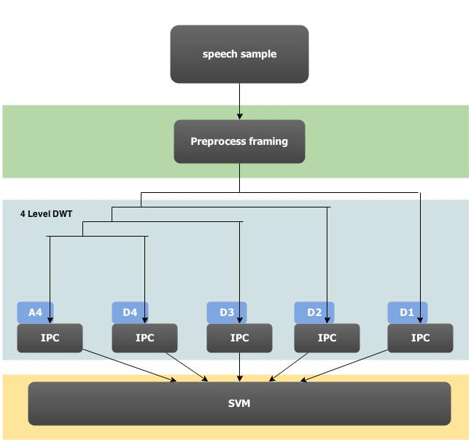
Description of the Attack
The schematic of this paper

Slide 4
Description of the Attack
Discrete Wavelet Transform (DWT)
L-points
lowpass filter
down sampling
x_{L}[n]
g[n]
↓ 2
x_{1,L}[n]
N-points
L-points
x[n]
highpass filter
down sampling
x_{H}[n]
↓ 2
x_{1,H}[n]
h[n]

Slide 5
Description of the Attack
Haar wavelet(2-point Haar wavelet)
g[n] = 1/2 for n = −1, 0
g[n] = 0 otherwise
h[0] = 1/2, h[−1] = −1/2,
h[n] = 0 otherwise
h[n]
½
½ ½
g[n]
-3 -2 -1 0 1 2 3
n
-3 -2 -1 0 1 2 3
n
-½

Slide 6




Description of the Attack
Linear predictive coding (LPC)
is the predicted wavelet coefficients
the previous values
the predictor coefficients

Slide 7



Description of the Attack
can be calculated using the efficient Levinson-Durbin recursive procedure.
We extract mean, variance, skewness and kurtosis of
is the true wavelet coefficient value

Slide 8
Description of the Attack
In our work, we used the freely available package LIBSVM. We selected a non-linear with 40 input features consisting of two set of statistical features extracted from above steps

Slide 9
Experimental Results
Embedded messages by steghide at five different capacities:5%,10%, 20%, 40%, and 60% steganographic capacity.
Half files in each type are for training the SVM, and the files left for test.

Slide 10
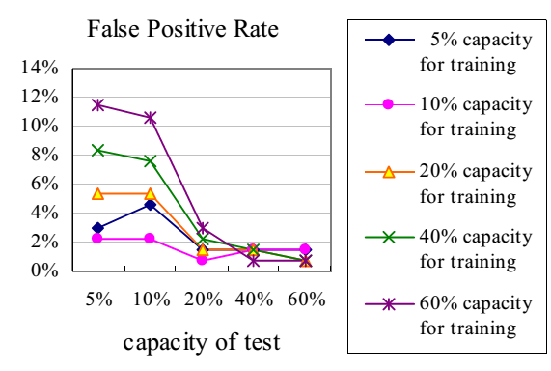
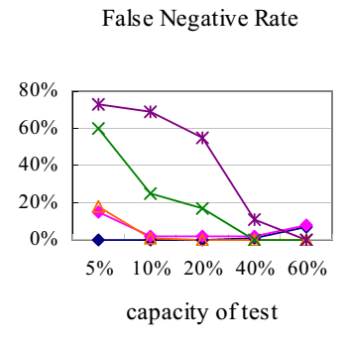
Experimental Results

Slide 11
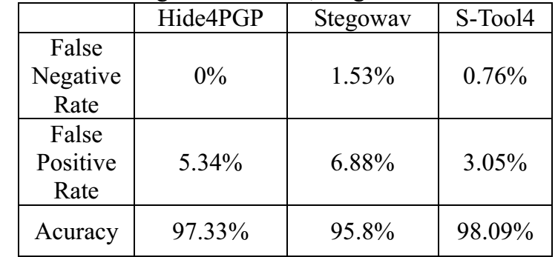
Experimental Results
60% steganographic capacity
Trained at20% steganographic capacity.

Slide 12
Conclusion
Experimental results indicate that the messages embedded as small as 5%of the steganographic capacity can be reliably detected.

Slide 13
References
Nehe, Navnath S., and Raghunath S. Holambe. "DWT and LPC based feature extraction methods for isolated word recognition." EURASIP Journal on Audio, Speech, and Music Processing 2012.1 (2012): 1-7.
Johnson, Micah K., Siwei Lyu, and Hany Farid. "Steganalysis of recorded speech." Electronic Imaging 2005. International Society for Optics and Photonics, 2005.

