Slide 1
Using SigComp and ROHC in Wireless Networks
Priyanka Rawat, Laurent Toutain, and Ana Minaburo
GET/ENST Bretagne, Rue de la Chˆataigneraie, CS 17607, 35576 Cesson S´evign´e cedex, France
Email:{priyanka.rawat, laurent.toutain}@enst-bretagne.fr and anaminaburo@gmail.com

Slide 2
Introduction
A typical SIP message may range from a few hundred bytes up to two thousand bytes or more.
Use of SigComp (SIP signaling compression mechanism) and ROHC (Robust Header Compression mechanism) schemes reduces the signaling and the protocol header overhead, respectively.

Slide 3
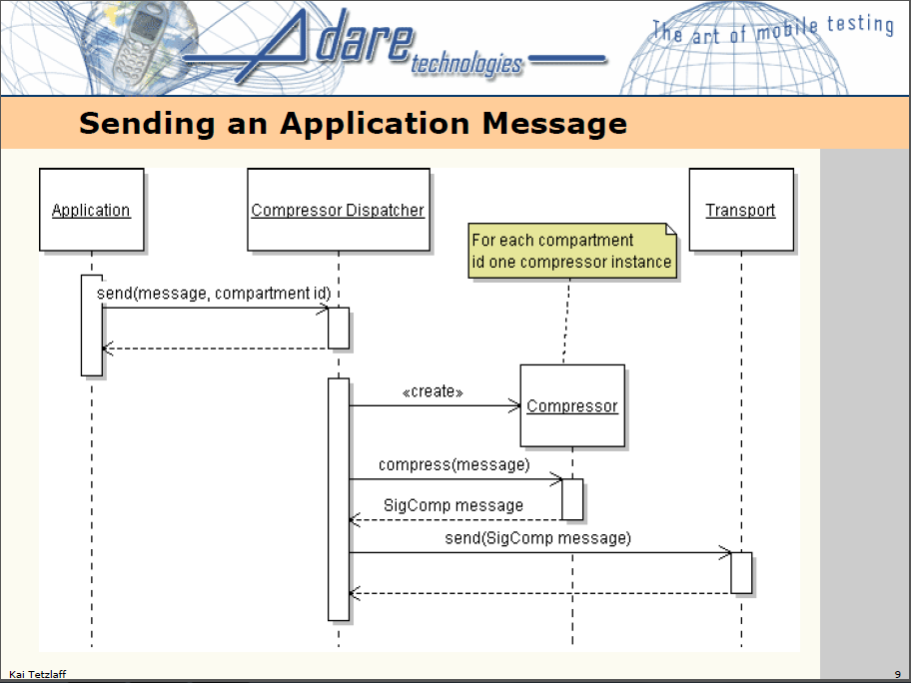

Slide 4
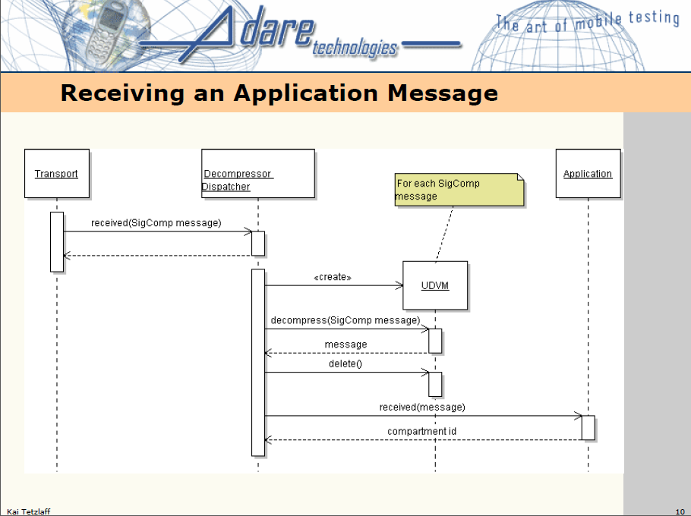

Slide 5
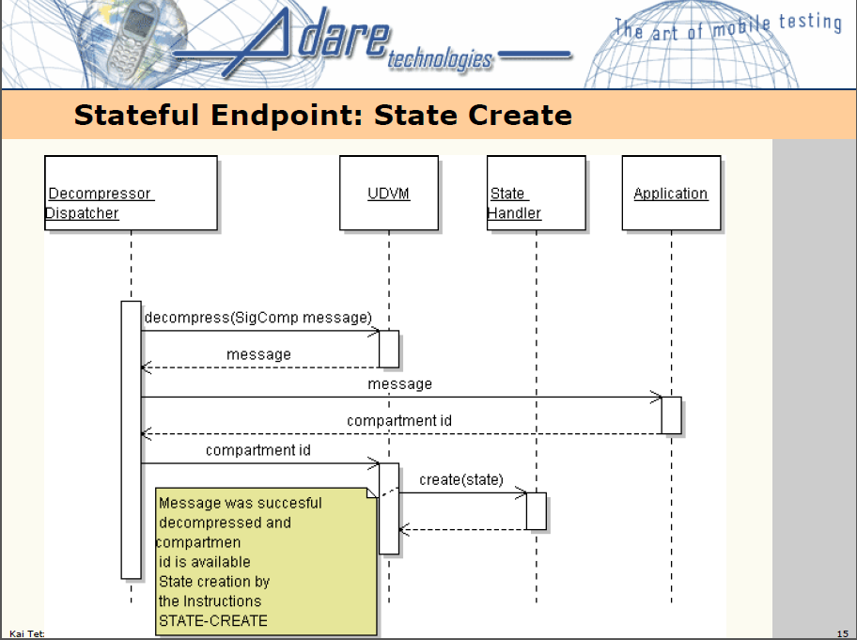

Slide 6
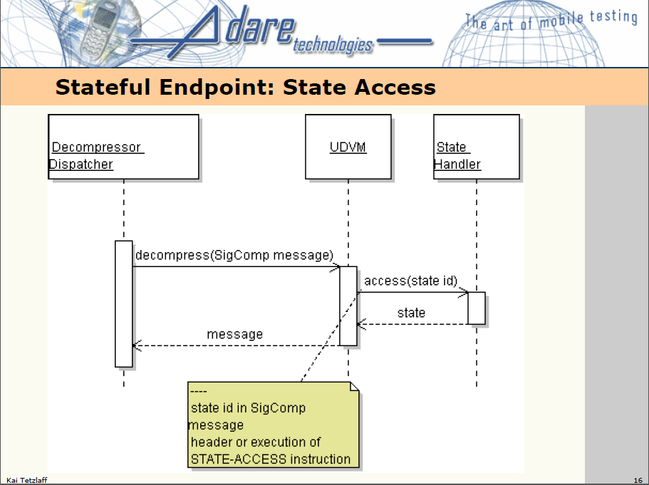

Slide 7
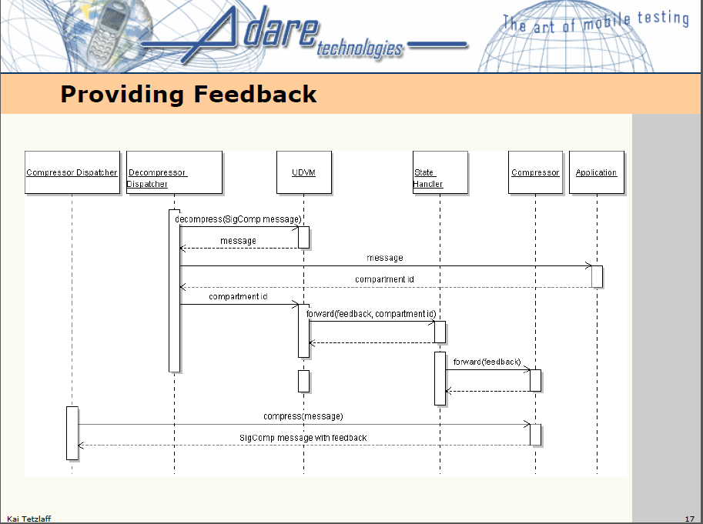

Slide 8
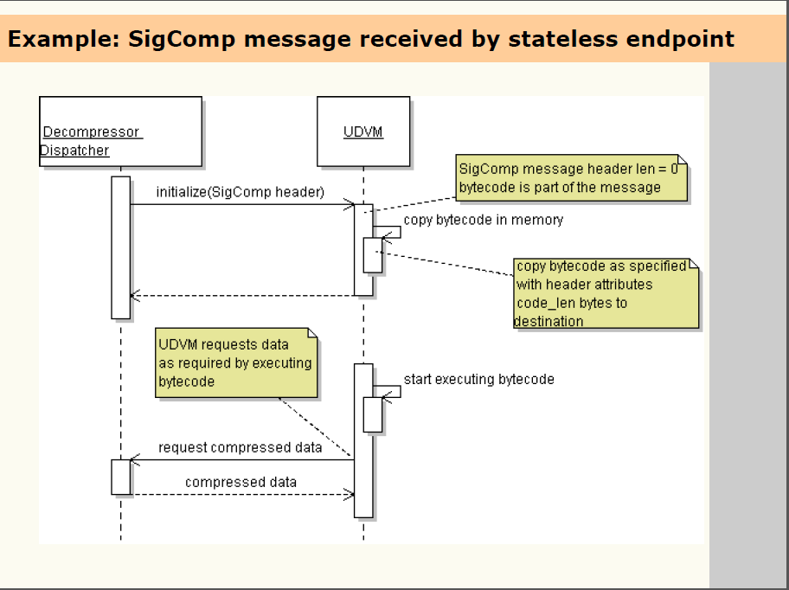

Slide 9
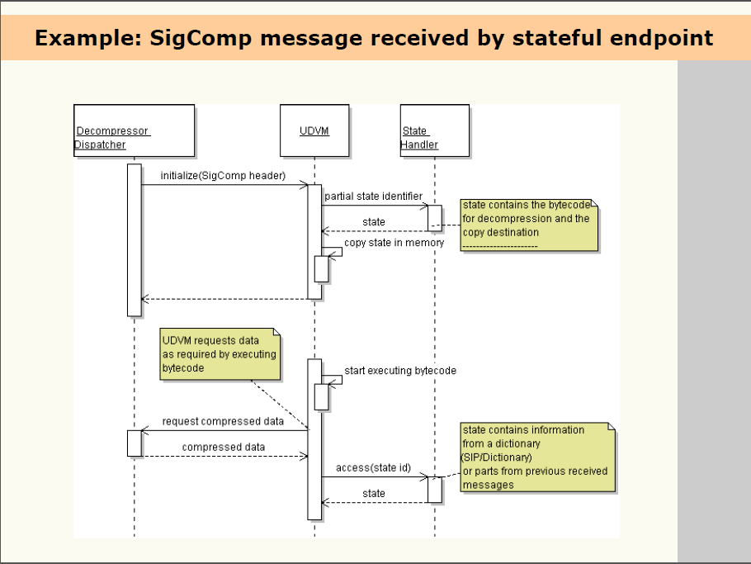

Slide 10
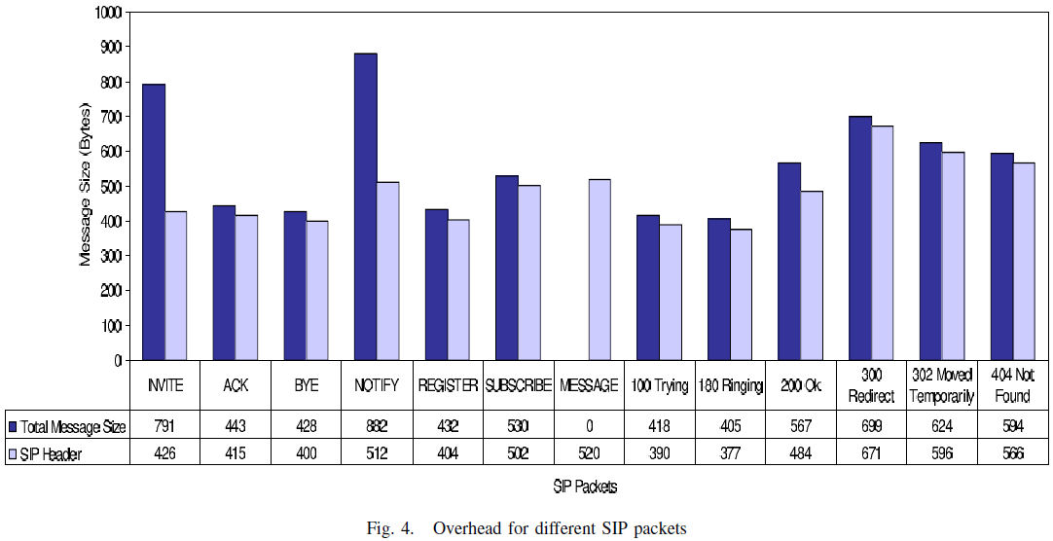
Overhead for different SIP packets

Slide 11
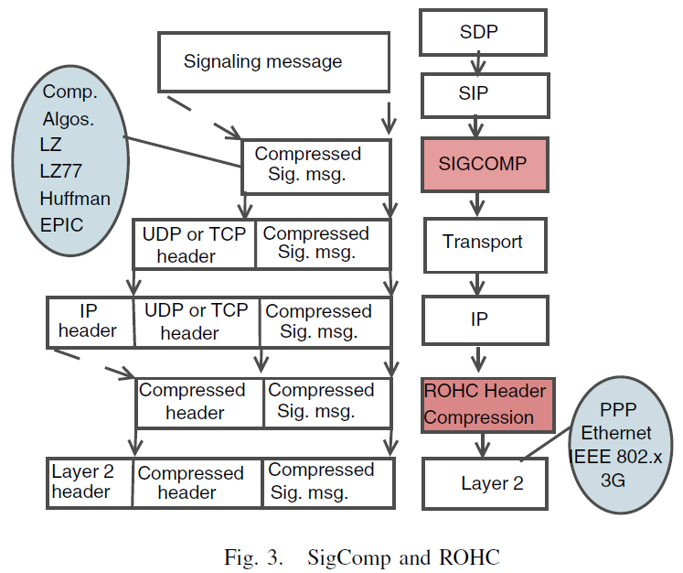
SigComp and ROHC

Slide 12
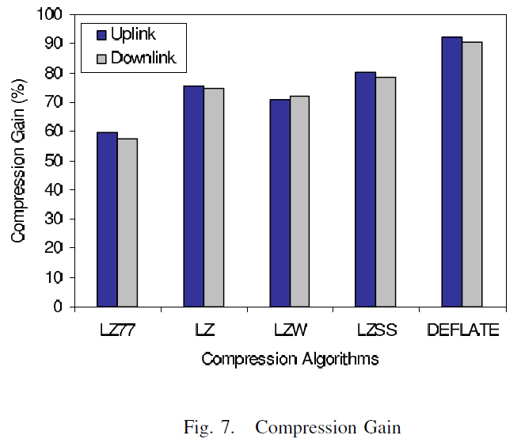
Compare different compression algorithms

