Slide 1
Resource-Aware Video
Multicasting via Access Gateways in Wireless Mesh Networks
IEEE Transactions on Mobile Computing,Volume 11,Number 6,June 2012
Authors : Wanqing Tu
Sch. of Comput. & Commun. Technol., Glyndwr Univ., Wrexham, UK
IEEE Member
Sreenan, C.J. ; Chun Tung Chou ; Misra, A. ; Jha, S.K.

Slide 2
Outline
Introduction
Wireless Mesh Networks
Problem
Two-tier integrated architecture
Link-controlled routing tree
Conclusion

Slide 3
Introduction
Video streaming represents one of the fastest growing segments of traffic in the Internet today.
Multicasting of video over wireless networks is a challenging problem, due to the combination of high data rates (relative to wireless capacity) and low-latency constraints and the need to support multiple receivers with time-varying link quality.

Slide 4
Wireless Mesh Networks
Wireless mesh networks (WMNs) offer an attractive solution for low-cost connectivity over large urban areas.
A WMN consists of a set of mesh nodes offering connectivity to end user devices; the mesh nodes form a relatively static, multi-hop wireless backbone.

Slide 5
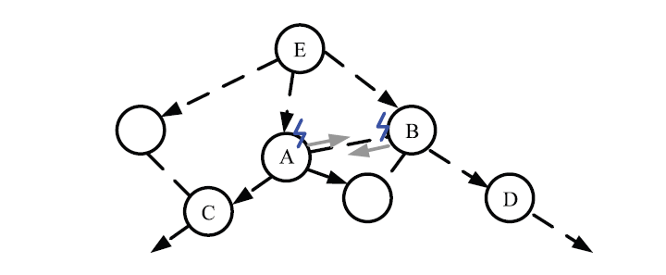
Problem

Slide 6
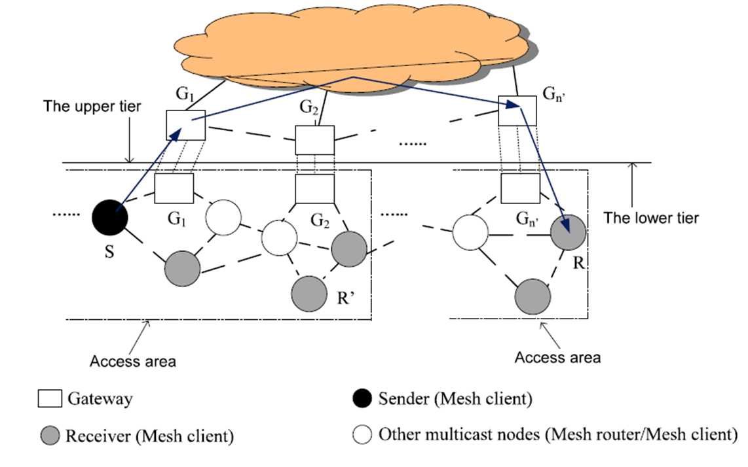
Problem

Slide 7

Two-tier integrated architecture

Slide 8
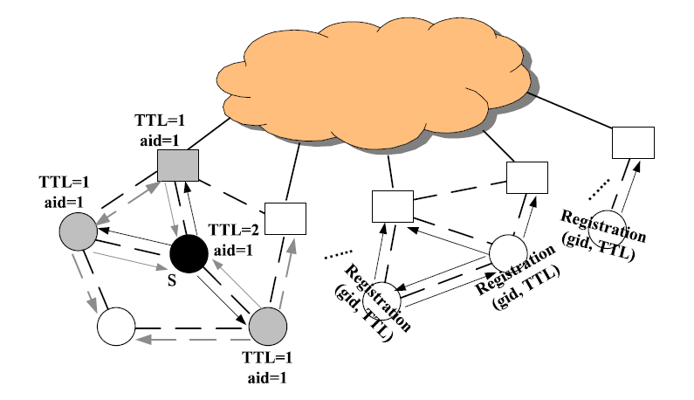
Two-tier integrated architecture

Slide 9
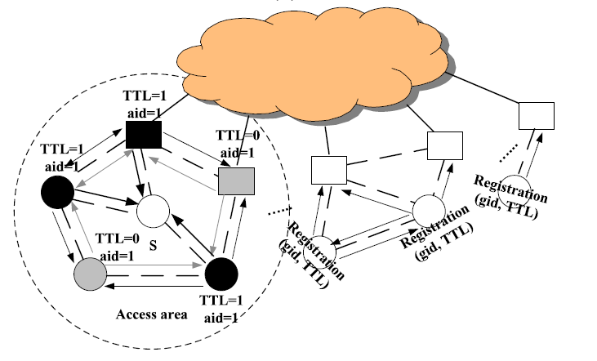
Two-tier integrated architecture
Uploading Gateway

Slide 10
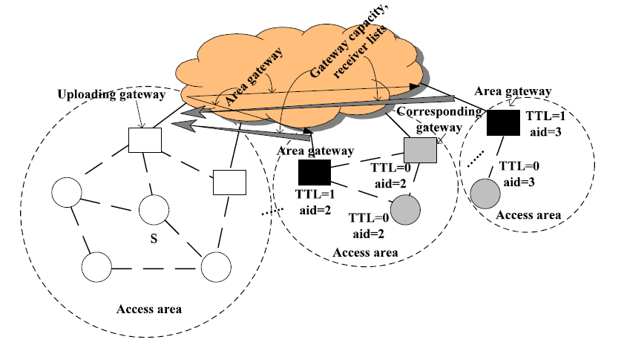
Two-tier integrated architecture

Slide 11
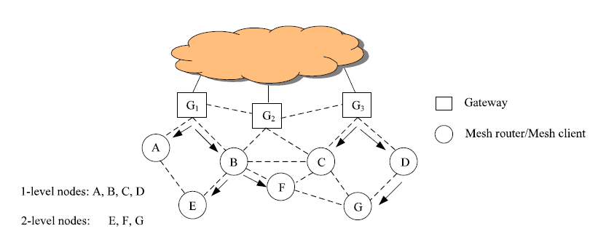
Link-controlled routing tree

Slide 12
Conclusion
The paper described and studied a resource-aware multi gateway video multicasting framework for WMNs that reduces the negative impacts of multiple wireless hops by judiciously employing high-capacity wired Internet shortcuts.
The two-tier integrated architecture algorithm chooses communication paths—intramesh paths or integrated paths—between nodes by organizing them into a clustered and layered architecture.

Slide 13
Conclusion
Link-controlled routing tree algorithm decreases interference from parallel multicasting by constructing a multicast tree with the least number of forwarders in each access area

