Slide 1
F5 ─ A Steganographic Algorithm High Capacity Despite Better Steganalysis Andreas Westfeld, University at Dresden, Institute for System Architecture D-01062 Dresden, Germany
Student:陳奕君 Presentation date:2014/05/07

Slide 2
Outline
Introduction
JPEG File Interchange Format
F5 Algorithm
Conclusion
Reference

Slide 3
Introduction
Lossy compressed carrier media (JEPG, MP3, …) are originally adaptive and immune against visual attacks.
The steganographic tool Jsteg embeds messages in JEPG file.
MP3Stego
IVS-Steg

Slide 4
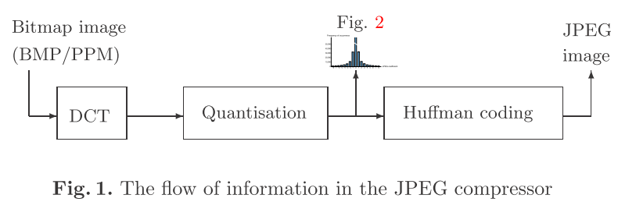
JPEG File Interchange Format
The file format defined by the Joint Photographic Expert Group (JEPG) stores image data in lossy compressed form as quantised frequency coefficients.
JEPG原理與應用 資料壓縮課程 JPEG講義

Slide 5
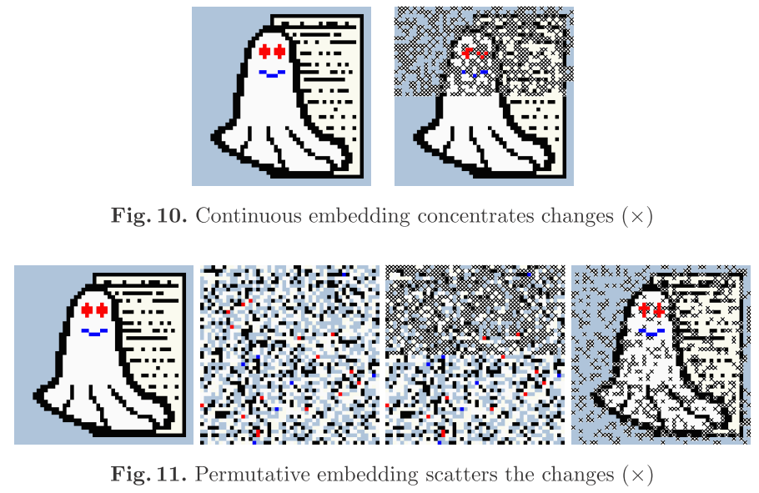
F5 Algorithm
To prevent attacks, the embedding density should be the same everywhere.

Slide 6
F5 Algorithm
Embed two bits x₁, x₂ in three modiﬁable bit places a₁, a₂, a₃ changing one place at most. We may encounter these four cases: Matrix encoding enables us to ﬁnd a suitable modiﬁed code word a' for every a and x with x = f(a' )

Slide 7
F5 Algorithm
For (1, n, k), the code words have the length n = 2^{k} − 1. Neglecting shrinkage, we get a change density
an embedding rate
the embedding eﬃciency W (k). It indicates the average number of bits we can embed per change:

Slide 8
F5 Algorithm
We ﬁnd the bit place s = x ⊕ f(a) that we have to change.
The changed code word results in

Slide 9
F5 Algorithm ─ implementation
Implementation detail

Slide 10
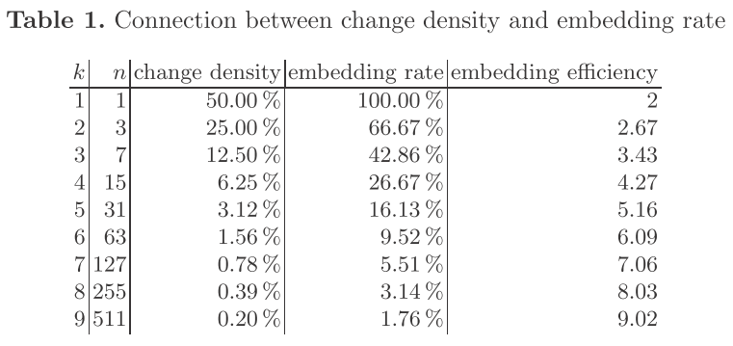
Conclusion

Slide 11
Reference
Ron Crandall: Some Notes on Steganography. Posted on Steganography Mailing List, 1998. http://os.inf.tu-dresden.de/˜westfeld/crandall.pdf 297
Andy C. Hung: PVRG-JPEG Codec 1.1, Stanford University, 1993. http://archiv.leo.org/pub/comp/os/unix/graphics/jpeg/PVRG 291
Fabien Petitcolas: MP3Stego, 1998. http://www.cl.cam.ac.uk/˜fapp2/steganography/mp3stego 289
Derek Upham: Jsteg, 1997, e. g. http://www.tiac.net/users/korejwa/jsteg.htm 289
Andreas Westfeld, Andreas Pﬁtzmann: Attacks on Steganographic Systems, in Andreas Pﬁtzmann (Ed.): Information Hiding. Third International Workshop, LNCS 1768, Springer-Verlag Berlin Heidelberg 2000. pp. 61–76. 289, 291, 293, 299
Andreas Westfeld, Gritta Wolf: Steganography in a Video Conferencing System, in David Aucsmith (Ed.): Information Hiding, LNCS 1525, Springer-Verlag Berlin Heidelberg 1998. pp. 32–47. 289
Andreas Westfeld: The Steganographic Algorithm F5, 1999. http://wwwrn.inf.tudresden.de/˜westfeld/f5.html 301
Jan Z¨ollner, Hannes Federrath, Herbert Klimant, Andreas Pﬁtzmann, Rudi Piotraschke, Andreas Westfeld, Guntram Wicke, Gritta Wolf: Modeling the Security of Steganographic Systems, in David Aucsmith (Ed.): Information Hiding, LNCS 1525, Springer-Verlag Berlin Heidelberg 1998. pp. 344–354. 289

