Slide 1
Mel-Cepstrum Based Steganalysis for VoIP-Steganography
Christian Kraetzer and Jana Dittmann
Electronic Imaging 2007. International Society for Optics and Photonics, 2007
Research Group Multimedia and Security, Department of Computer Science,
Otto-von-Guericke-University of Magdeburg, Germany

Slide 2
Outline
The proposed steganalyser
The cepstrum
Mel-frequency cepstrum
Test scenario
Conclusion
References

Slide 3
The proposed steganalyser
pre-processing of the audio/speech data
feature extraction from the signal
post-processing of the resulting feature vectors
analysis (classification for steganalysis)

Slide 4
The cepstrum
Basically a cepstrum is the result of taking the Fourier transform (FT) or short-time Fourier Analysis of the decibel spectrum as if it were a signal.
It was originally invented for characterising seismic echoes resulting from earthquakes and bomb explosions.
FT → abs() → log → IFT

Slide 5
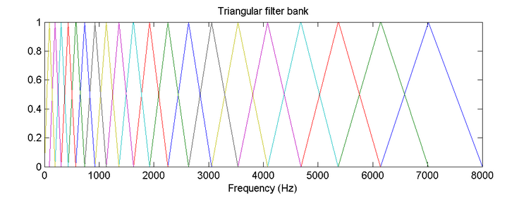
Mel-frequency cepstrum
Mel-cepstrum can be used in speaker identification and the general description of the Human Auditory System.

Slide 6
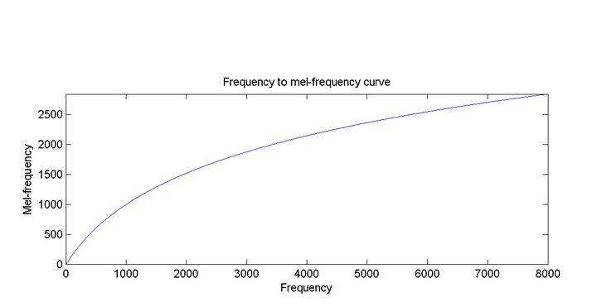
Mel-frequency cepstral coefficients

Slide 7
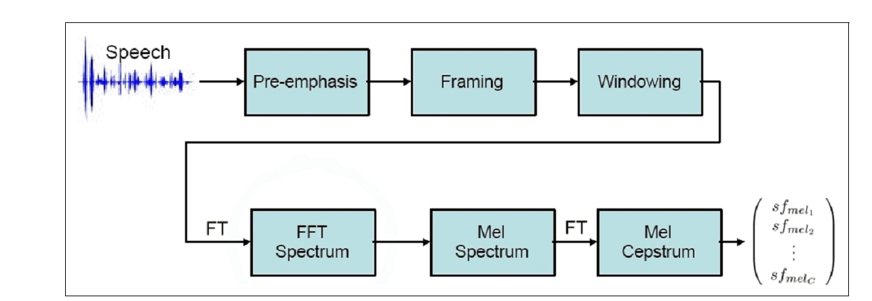
Mel-frequency cepstrum

Slide 8
Mel-frequency cepstrum
Modification of the Mel-cepstral based signal analysis
led to the idea of removing the speech relevant frequency bands in the spectral representation of a signal before computing the cepstral.

Slide 9
Test scenario
LSB in VOIP
sampling rate 44.1 kHz
PCM

Slide 10
Test scenario
Aw1- Spread Spectrum
Aw2- 2A2W
Aw3- Least Significant Bit
Aw4- VAWW
As1- LSB
AS2- Publima
AS3- WaSpStego
AS4- Steghide
AS5- Steghide

Slide 11
Conclusion
first a reliable detection of a hidden channel constructed using LSB within the defined application scenario of VoIP steganography,
second the demonstration of the general applicability of our approach and the Mel-cepstral based features in speech and audio steganalysis have been successfully reached.

Slide 12
References
J. Dittmann, D. Hesse, and R. Hillert, “Steganography and steganalysis in Voice-over IP scenarios: operational aspects and firstexperiences with a new steganalysis tool set,” in Security, Steganography, and Watermarking of Multimedia Contents VII, SPIE Vol.5681, P. W. Wong and E. J. Delp, eds., SPIE and IS&T Proceedings, pp. 607–618, (San Jose, California USA), Jan. 2005.
M. K. Johnson, S. Lyu, and H. Farid, “Steganalysis of recorded speech,” in in Proc. SPIE, vol. 5681, Mar. 2005, pp. 664–672, 2005.
王小川 ,語音訊號處理,修訂二版,2009

