Slide 1
Targeted Cyberattacks: A Superset of Advanced Persistent Threats
Published in: Security & Privacy, IEEE (Volume:11 , Issue: 1 ), Jan.-Feb. 2013, 54- 61
Author(s): Sood, A.K. and Enbody, R.J. from Michigan State Univ., East Lansing, MI, USA

Slide 2
Outline
Terms
  Cyberattack
  Advanced persistent threat
APT events ( 2009-2010 )
The targeted attack model
  Intelligence gathering
  Threat modeling
  Attacking and Exploiting targets
Conclusion
Reference

Slide 3
Terms
  Cyberattack
    A cyberattack is deliberate exploitation of computer systems, technology-dependent enterprises and networks.
  Advanced persistent threat
    These attacks aren’t necessarily more advanced than others.
    Persist in the face of adversity instead of moving on to weaker targets

Slide 4
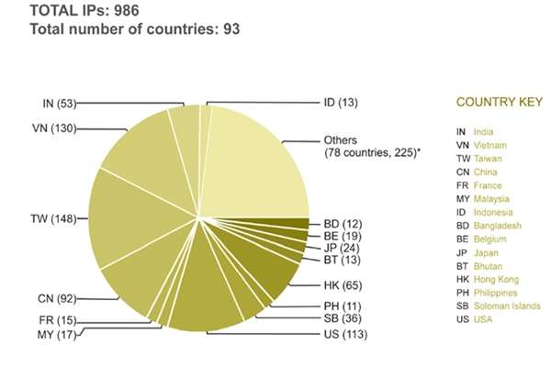
APT events - 2009
GhostNet was found by SecDev Group.
  gh0st RAT
Operation Aurora.
  “Use after free” vulnerability in IE, which resulted in HTML object memory corruption. (code is injected in the free memory without any reallocation by creating a new object, and the object executes the code to gain shell.)

Slide 5
APT events - 2010
Border Gateway Protocol (BGP) router in China sent erroneous traffic that updated the routing tables of several routers across the world.
Stuxnet:
  A computer worm that was discovered in June 2010.
  Attributed to the US and Israel, was designed to exploit the Siemens Programmable Logic Controllers in SCADA networks with the ultimate goal of destroying centrifuges used to process nuclear material.

Slide 6
The targeted attack model
Intelligence Gathering
  Open source intelligence (OSINT) gathering, which is the process of collecting intelligence from public or openly available resources.
  In passive mode, no actual interaction (traffic) takes place with the target.
  In semipassive mode, attackers use generic information-gathering methods that generate normal traffic without suspicion, such as DNS queries or WHOIS lookups.
Threat Modeling
  Map the target environment and categorizing assets based on their importance and value into primary and secondary targets.
  Assessing risks and threats to determine which domains are most likely to reveal the attack and which domains might invite retaliation.

Slide 7
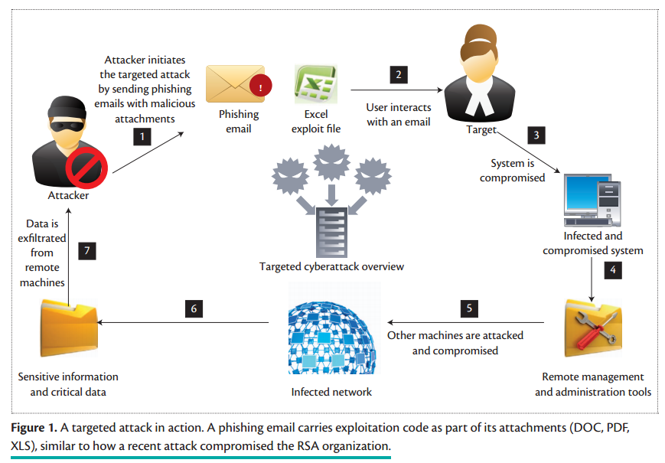
The targeted attack model (cont’d)

Slide 8
The targeted attack model (cont’d)
Attacking and Exploiting Targets
  Drive-by downloads and spear phishing.
  Exploiting Web infrastructure.
  Exploiting co-location services.
  Physical attacks.

Slide 9
Elements of Targeted Attacks
Malware Infection Frameworks
Browser Exploit Packs and Glype Proxies
RATs and Rootkits
Morphing and Obfuscation Toolkits
Interface with an Underground Market

Slide 10
Preventive and Precautionary Measures

Slide 11
Conclusion

Slide 12
Reference
http://en.wikipedia.org/wiki/Cyber-attack
http://en.wikipedia.org/wiki/Advanced_persistent_threat

