Slide 1
Best Current Practices for Third Party Call Control (3pcc) in the Session Initiation Protocol (SIP)
April 2004, RFC3725
Author(s): J. Rosenberg, J. Peterson, H. Schulzrinne, G. Camarillo

Slide 2
Outline
Introduction
3pcc Call Establishment
Example Call Flows
Reference

Slide 3
Introduction
Third party call control (referred to as 3pcc) is often used for operator services (where an operator creates a call that connects two participants together) and conferencing.
These include the traditional ones on the PSTN, but also new ones such as click-to-dial.

Slide 4
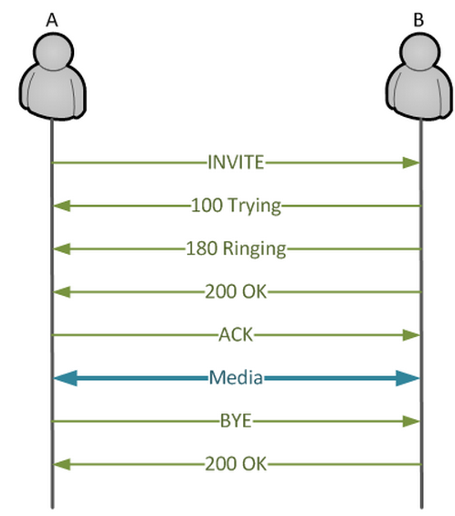
Introduction
A Basic SIP Call Flow

Slide 5
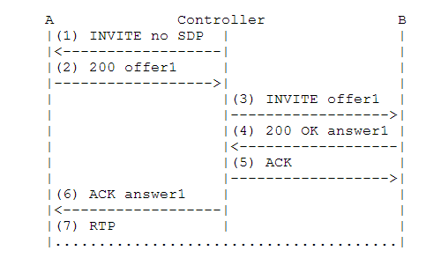
3pcc Call Establishment
Flow I

Slide 6
3pcc Call Establishment
This flow is simple.
Requires no manipulation of the SDP by the controller.
A serious timeout problem.
User B may not answer the call immediately. The controller cannot send the ACK to A right away.
user A may retransmit 200 OK response periodically.

Slide 7
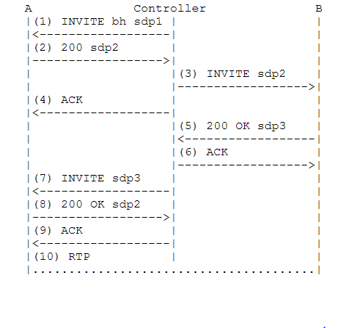
3pcc Call Establishment
Flow II

Slide 8
3pcc Call Establishment
bh: black holed
a connection address of 0.0.0.0.
No timeout problems.
The controller know the media types to be used for the call.
If the message 2 and message 8 with different SDP, the controller needs to re-INVITE A again, and so on. The result is an infinite loop of re-INVITEs.
Notes:
a single audio media line, one codec, a random port number

Slide 9
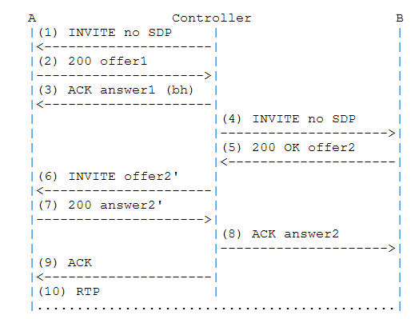
3pcc Call Establishment
Flow III

Slide 10
3pcc Call Establishment
No timeout problems.
The controller doesn't need to assume anything about the media composition of the session.
This flow is far more complicated than the simple and elegant Flow I.

Slide 11
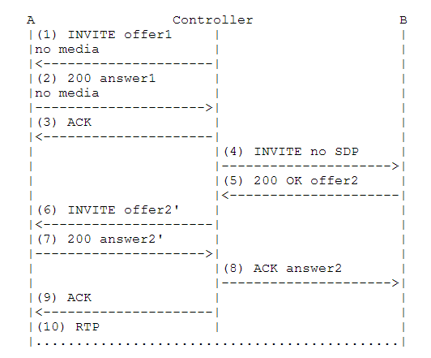
3pcc Call Establishment
Flow IV

Slide 12
3pcc Call Establishment
It’s a variation on Flow III that reduces its complexity.
Both A and B will end up answering the call before it is known whether there is compatible media. If there is no media in common, the call can be terminated later with a BYE.
However, the users will have already been alerted, resulting in user annoyance and possibly resulting in billing events.

Slide 13
Example Call Flows
click-to-dial
The user to click a link on a web page to speak to a customer service representative.
The service is triggered through an HTTP POST request.

Slide 14
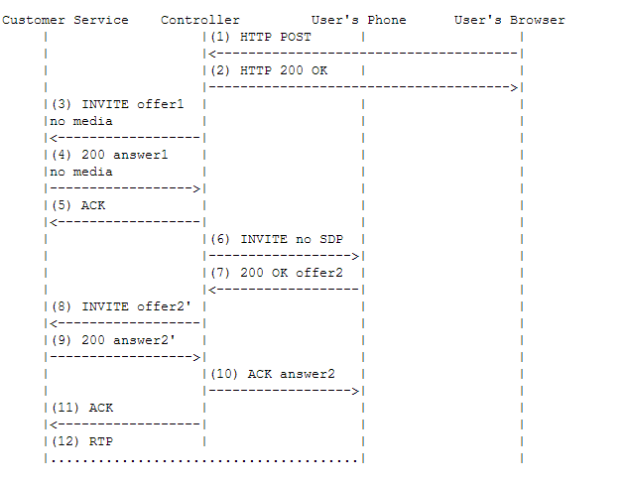
Example Call Flows
click-to-dial

Slide 15
Reference
SIP: Session Initiation Protocol

