Slide 1
Intelligent Route Discovery for ZigBee Mesh Networks
2011 IEEE International Symposium on a World of Wireless, Mobile and Multimedia Networks (WoWMoM) Author: Antonio M. Ortiz, Fernando Royo, Teresa Olivares and Luis Orozco–Barbosa Albacete Research Institute of Informatics – University of Castilla–La Mancha (UCLM)–Albacete, Spain

Slide 2
Introduction
The routing protocol for ZigBee mesh networks is AODV, an on-demand routing protocol which has been extensively used. However, it presents critical problems when it is used in large dense networks, mainly related to the high number of messages necessary to perform routing tasks, which causes a very high overhead.

Slide 3
Introduction
This study proposes the use of a novel fuzzy logic based metric to be used in the decision making process of AODV.
This metric evaluates important node features during route creation and selects, hop by hop, the best option in order to obtain energy and delay efficient routes.

Slide 4
Ad-hoc On Demand Distance Vector (AODV) routing
1
D
4
S
7
2
5
3
RREQ(Route Request)
6

Slide 5
Ad-hoc On Demand Distance Vector (AODV) routing
1
D
4
S
7
2
5
3
RREQ(Route Request)
RREP(Route Reply)
6

Slide 6
AODV drawbacks
Packet overhead
Redundant discovery
High route discovery delay
High memory demand
Duplicated messages
Deficient metric

Slide 7
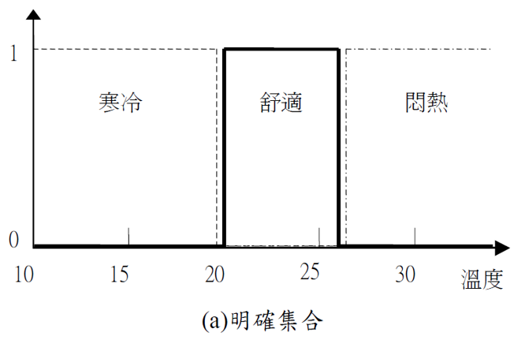
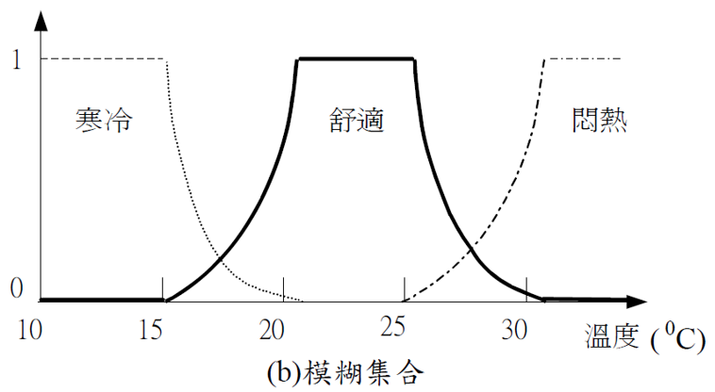
Fuzzy Logic(模糊邏輯)
有些事物我們可以明確的區分辨別，例如男、女兩個性別，然而在大多數的事物、語意表達上通常難以做明確的區分辨別，也就是含有模糊、不明確的敘述。例如:每個人對溫度的感覺。

Slide 8
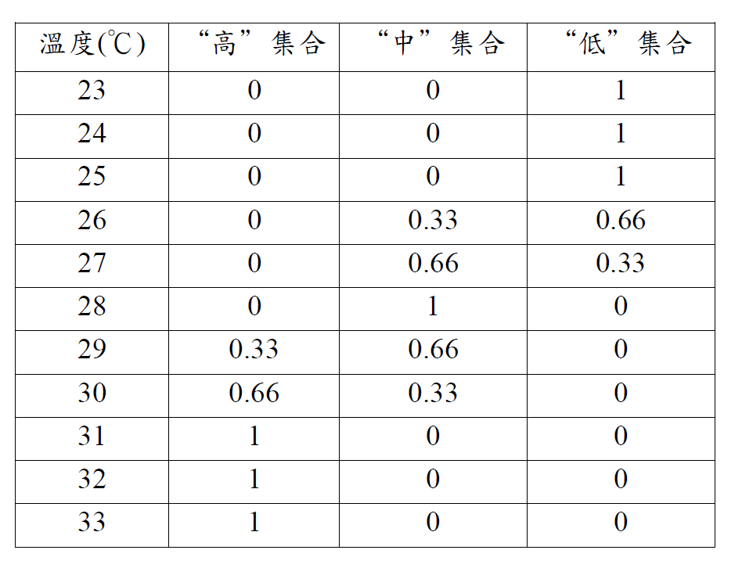
Fuzzy Logic(模糊邏輯) 冷氣機為例

Slide 9
Fuzzy Logic(模糊邏輯) 冷氣機為例
規則： 相加取最高，相同直接高轉速。
狀態： 設定溫度 26度(低0.66 中0.33) 且 室溫 28度(中) 相加(低0.66 中1.33) 動作： 壓縮機轉速狀態中轉速
狀態： 設定溫度 23度(低) 且 室溫 28度(中) 相同(低1 中1) 動作： 壓縮機轉速狀態高轉速
狀態： 設定溫度 29度(中0.66 高0.33) 且 室溫 31度(高) 相加(中0.66 高1.33) 動作： 壓縮機轉速狀態低轉速

Slide 10
AODV-FL(AODV with Fuzzy Logic)

Slide 11
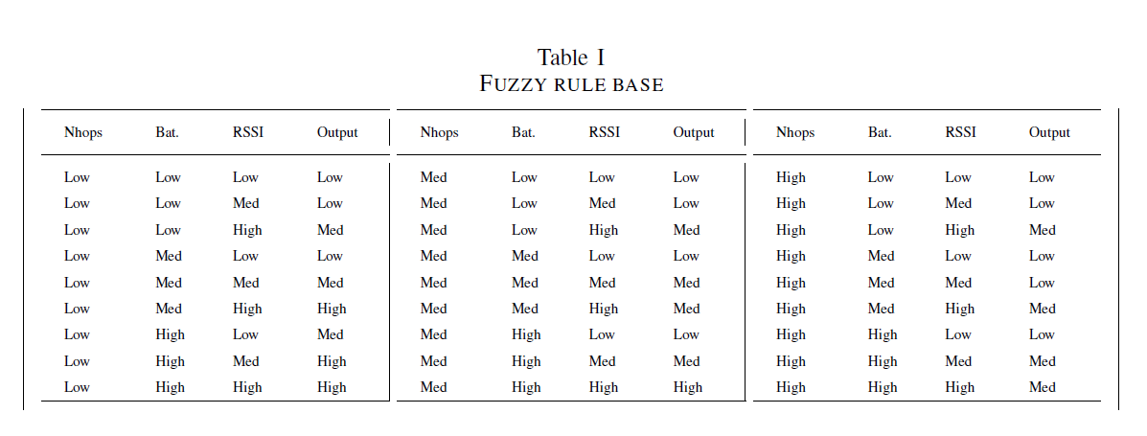
AODV-FL(AODV with Fuzzy Logic)

Slide 12
AODV-FL(AODV with Fuzzy Logic)
1.Low High Med
1
D
4
2.Med Med High
S
7
2
5
3
RREQ(Route Request)
6

Slide 13
AODV-FL(AODV with Fuzzy Logic)
1
D
4
S
7
2
5
3
RREQ(Route Request)
RREP(Route Reply)
6

Slide 14
Experiment(Energy)

Slide 15
Experiment(Total Packets)

Slide 16
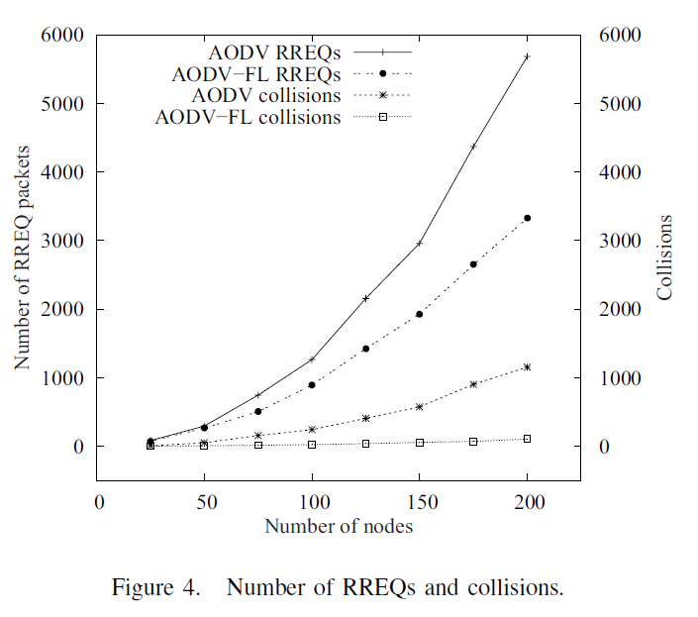
Experiment(RREQ Packet)

Slide 17
Experiment(End-to-End Delay)

Slide 18
Experiment(Hops)

Slide 19
Conclusions
This paper proposes the use of a fuzzy-logic-based metric to evaluate node conditions in AODV protocol in order to select better-state nodes to be part of routes.
Moreover, in contrast to other proposals, the fuzzy-logic-based system does not require additional memory or computational costs, and does not imply an extra load for network nodes, allowing a global performance improvement of the route discovery process in mesh WSNs.

Slide 20
Future Work
All these results endorse the suitability of AODV-FL to be implemented in a real wireless sensor network.
Our future plans consider the experiments of AODV-FL in networks with mobile nodes, where we aim to obtain similar improvements in network performance.

Slide 21
Reference
陳嘉文(1999-07-23)，模糊邏輯理論簡介，元智大學最佳化設計實驗室。

