Slide 1
Cisco Architecture for Lawful Intercept in IP Networks
October 2004,rfc3924
Author(s): F. Baker,B. Foster,C. Sharp

Slide 2
Outline
Introduction
Reference Model
Interfaces
Reference

Slide 3
Introduction
Lawful interception is a common practice for monitoring a telecommunication network by law enforcement agencies all over the world.
This document describes Cisco's Architecture for supporting lawful intercept in IP networks. It provides a general solution that has a minimum set of common interfaces.

Slide 4
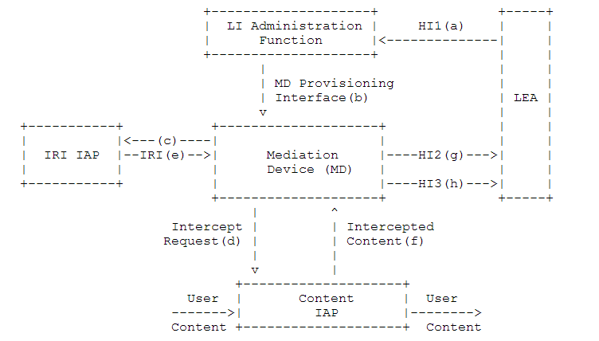
Reference Model

Slide 5
Reference Model
Lawful Intercept (LI) Administration Function
Intercept Access Point (IAP)
Content IAP
IRI IAP
Law Enforcement Agency
Mediation Device

Slide 6
Location and Address Information for Content Intercepts
Content Encryption
Detection by the Intercept Subject
Unauthorized Creation and Detection
Capacity

Slide 7
Interfaces
Content Intercept Request Interface
A Filter specification for classifying the packets to be intercepted.
The destination address of the MD (where to send the packets).
Encapsulation and Transport parameters.

Slide 8
Interfaces
Intercept Content Interface
Source and destination addresses
Payload
An identifier for correlating the packets with the IRI

Slide 9
Reference
RFC3924

