Slide 1
Estinet open flow network simulator and emulator.
IEEE Communications Magazine 51.9 (2013): 110-117.
Wang, Shie-Yuan, Chih-Liang Chou, and Chun-Ming Yang from National Chiao Tung University, Taiwan

Slide 2
Outline
The approaches of evaluation:
Testbed
Simulation
Emulation
The TCP/IP simulator with kernel re-entering
OpenFlow
EstiNet
Comparison with related tools.
Evaluation
Conclusion
Reference

Slide 3
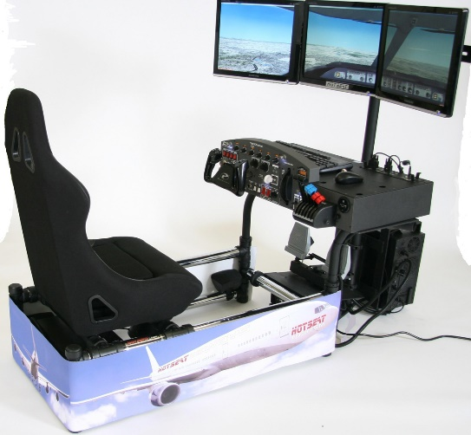
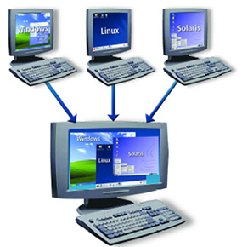
The approaches of evaluation
Testbed
Use real devices, run real operating systems and applications.
Can generate more realistic testing results.
Huge cost of building a large experimental.
Simulation
A simulator is a model for analysis.
Ex: Flight-simulator
A simulator is low cost, and being flexible, controllable, scalable, repeatable, accessible to many users, and faster than real time in many cases.
The experimental results depends on the accuracy of model.
Emulation
An emulator can replace the original for 'real' use.
Ex: Virtual machine
An emulator must be executed in real time.

Slide 4
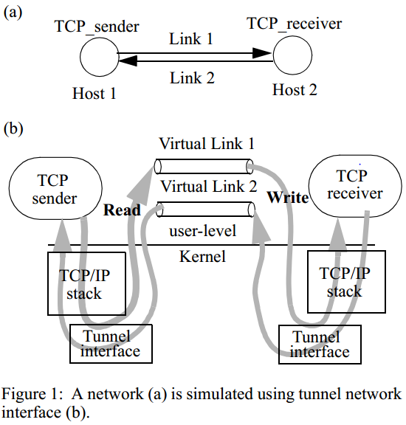
The TCP/IP simulator with kernel re-entering
Combines the advantages of both the simulation (non real-time process) and emulation ( High capability with real network application ) approaches.

Slide 5
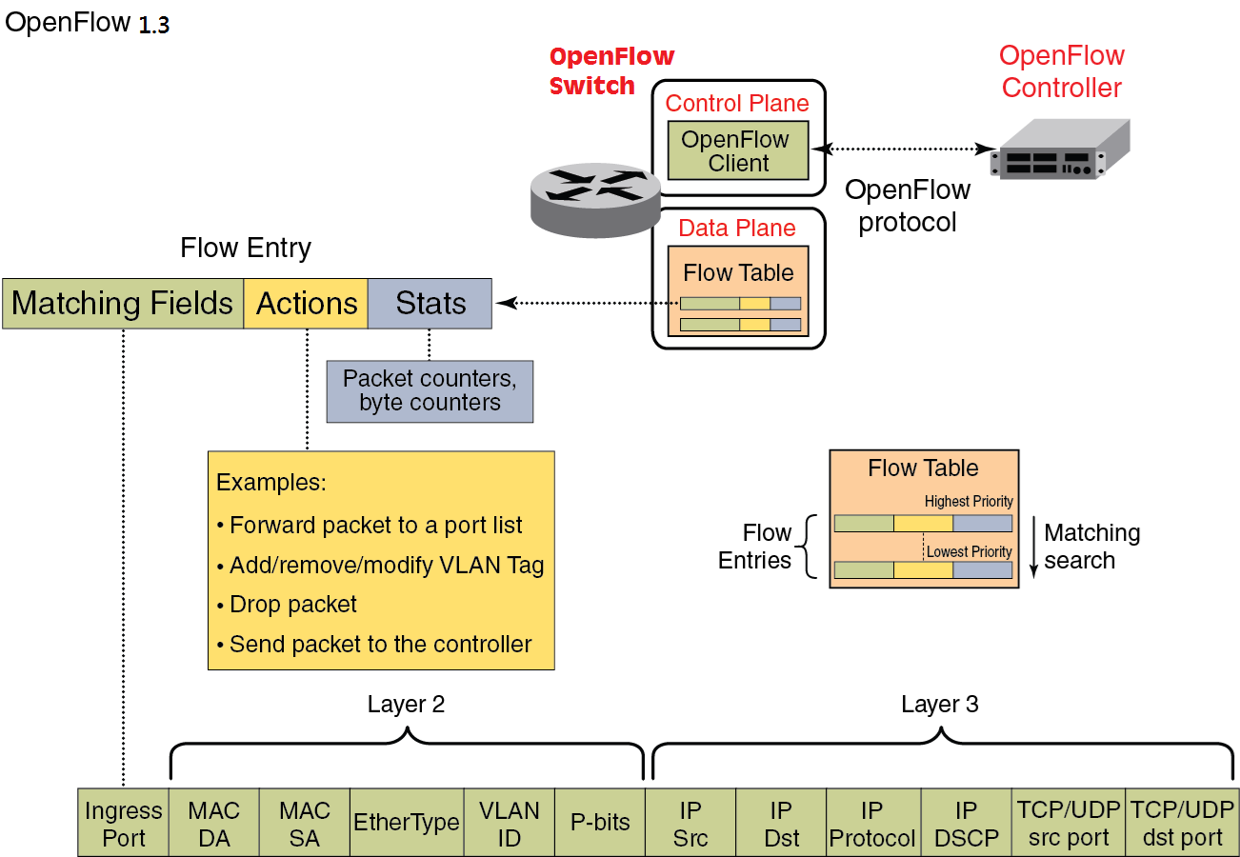
OpenFlow

Slide 6
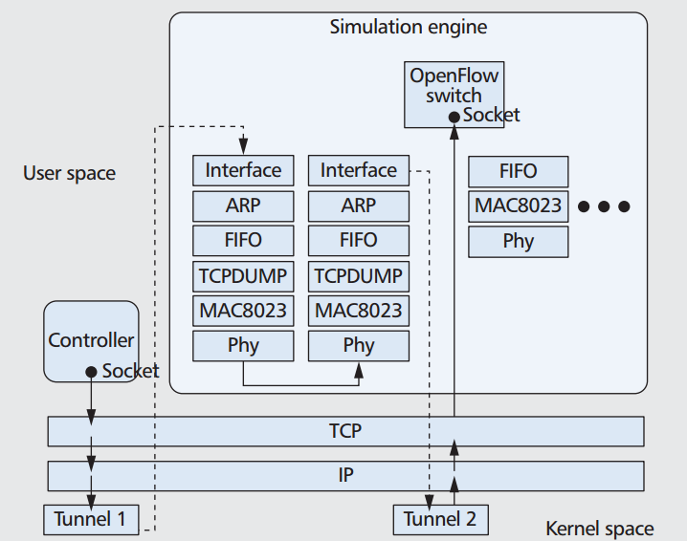
EstiNet
EstiNet uses tunnel network interfaces to automatically intercept the packets exchanged by two real applications.
Support running a real OpenFlow controller on EstiNet.
In EstiNet, a simulated OpenFlow switch can set up a real TCP connection to a real OpenFlow controller to receive its messages.

Slide 7
Capability comparison with related tools.
Ns-3:
Ns-3 simulates the operations of an OpenFlow switch by compiling and linking an OpenFlow switch C++ module with its simulation engine code.
A real OpenFlow controller cannot readily run without modification on a node in a network simulated by ns-3.
Mininet
Lack of performance fidelity.
Provides no guarantee that an emulated host in Mininet that is ready to send a packetwill be scheduled promptly by the operating system.
Mininet can only be used to study the behavior of an OpenFlow controller but cannot be used to study any timerelated network/application performance.

Slide 8
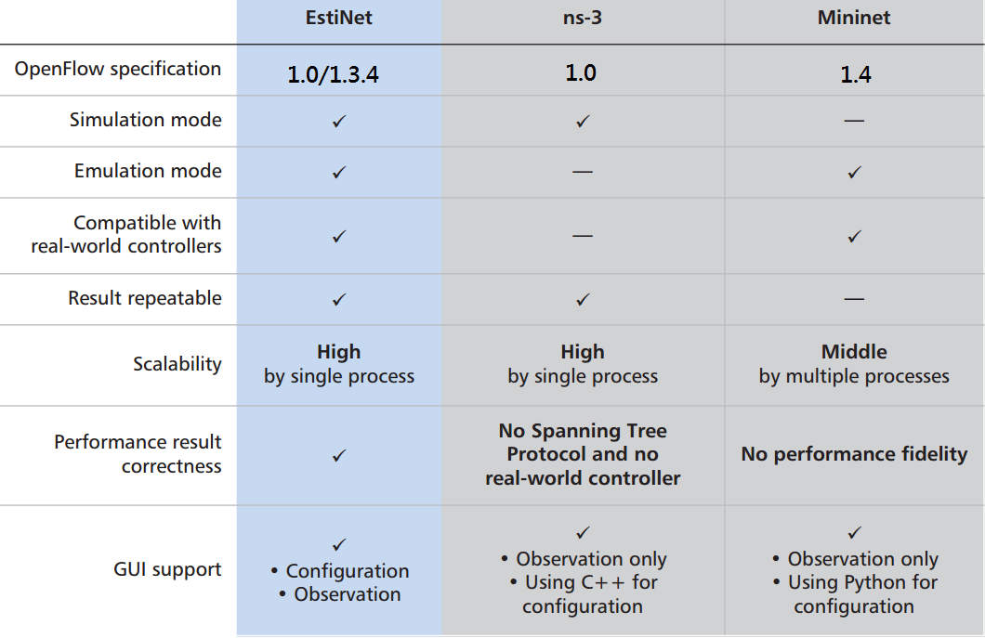
Comparison with related tools.

Slide 9
Evaluation
Testbed:
Operation system:
Fedora 17 with Linux kernel v. 2.6.35.
The TCP version used in this kernel version is TCP cubic.
Hardware:
Intel Core i5 CPU at 2.67 GHz and 4 Gbytes of main memory.
OpenFlow:
IP protocol version used in the simulation study is IPv4.
Controller receive all Link Layer Discovery Protocol (LLDP) on the Network to know the whole topology.
Parameter:
Set the bandwidth and delay of all links in the network to 10 Mb/s and 1 ms.

Slide 10
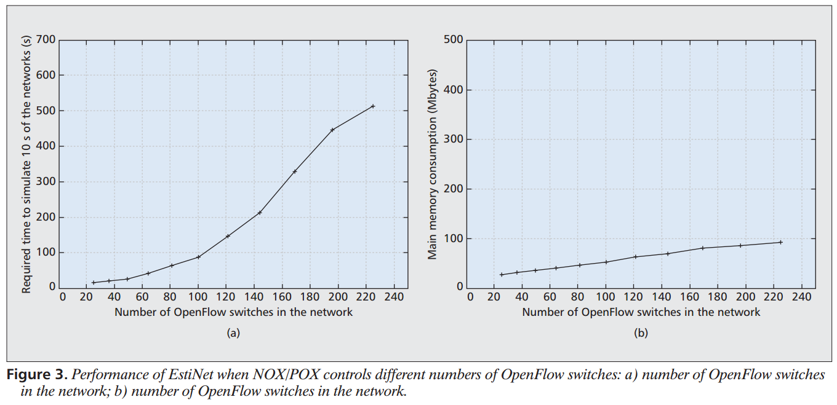
Evaluation (cont’d)
Estinet:

Slide 11
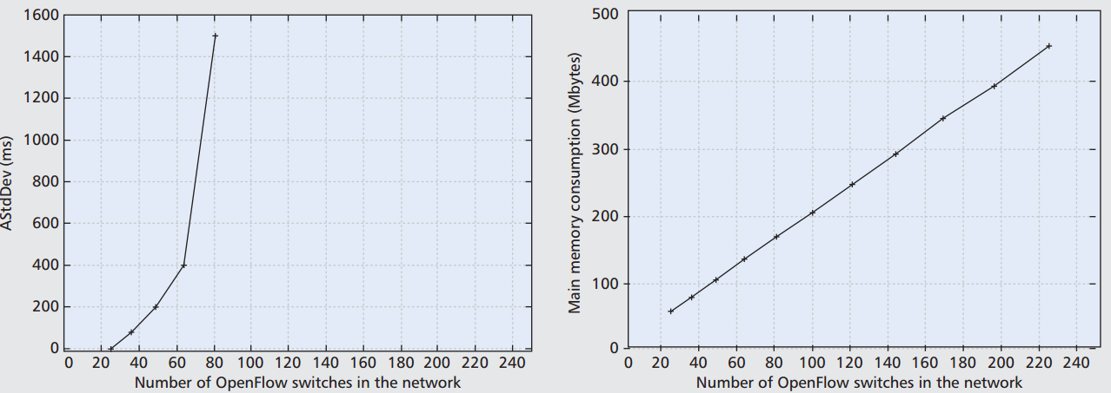
Evaluation (cont’d)
Mininet:
StdDev: standard deviation of the 100 ping reply.

Slide 12
Conclusion
EstiNet generates correct performance results, while Mininet’s performance results are untrustworthy.
EstiNet is much more scalable than Mininet when studying large OpenFlow networks.
Nowadays, Estinet is the best OpenFlow simulator which provide good compatibility and good performance.
My question: Why the tunneling mechanism does not impact the performance a lot?

Slide 13
Reference
http://en.wikipedia.org/wiki/Computer_simulation
http://en.wikipedia.org/wiki/Emulator
S. Y. Wang and H. T. Kung, “A Simple Methodology for Constructing Extensible and High-Fidelity TCP/IP Network Simulators,” IEEE INFOCOM ’99, New York, Mar. 21–25, 1999.
T. R. Henderson, M. Lacage, and G. F. Riley, “Network Simulations with the ns-3 Simulator,” ACM SIGCOMM ’08, Seattle, WA, Aug. 17–22, 2008.
B. Lantz, B. Heller, and N. McKeown, “A Network in a Laptop: Rapid Prototyping for Software-Defined Networks,” ACM Hotnets ’10, Monterey, CA, Oct. 20–21, 2010.

