Slide 1
DEFLATE Algorithm
Kent

Slide 2
DEFLATE Algorithm
DEFLATE uses a combination of the LZ77 algorithm and Huffman coding.

Slide 3
LZ77 Algorithm
The LZ77 algorithm compresses data that has already appeared in the past (a sliding window of the last 32 kB of data) by encoding it with a pair (distance, length), where distance is a number in [1, 32768] length is a number in [3, 258]

Slide 4
Examples
abcdefabcd abcdef(6, 4)
<title>Test</title> <title>Test</[6;12]
Blah blah blah blah blah! Blah b[D=5, L=18]!

Slide 5
Huffman Coding
The Huffman coding transforming each 8-b character to a variable-size codeword.
The more frequent the character is, the shorter its corresponding codeword.
The codewords are coded such that No codeword is a prefix of another, so the end of each codeword can be easily determined.

Slide 6
Examples
38
Symbol | Weight
E | 1
x | 1
a | 8
m | 2
p | 2
l | 4
e | 16
s | 4
0
1
22
e
0
1
14
8
0
1
0
1
6
a
4
s
0
1
0
1
2
l
m
p
0
1
E
x

Slide 7
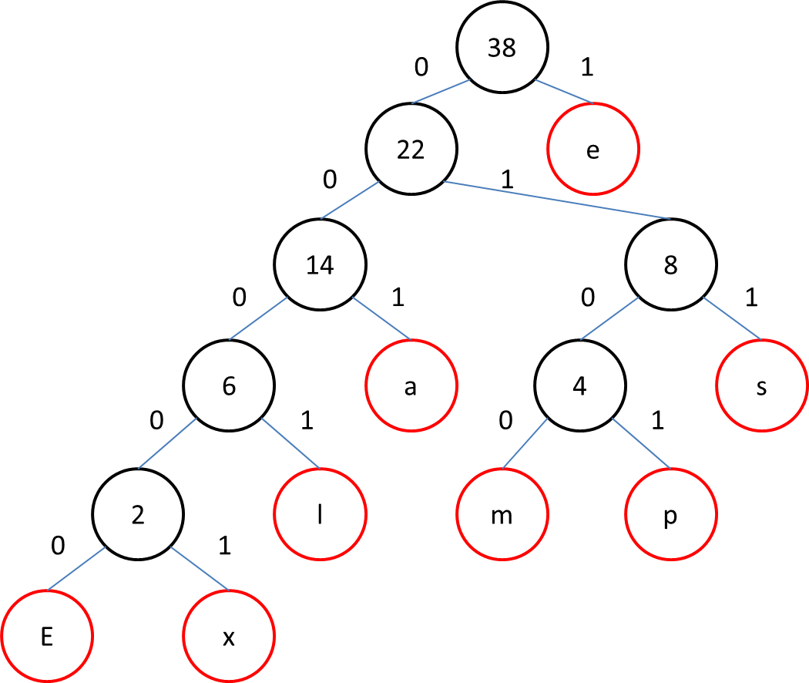
Symbol | Codeword
E | 00000
x | 00001
a | 001
m | 0100
p | 0101
l | 0001
e | 1
s | 011

Slide 8
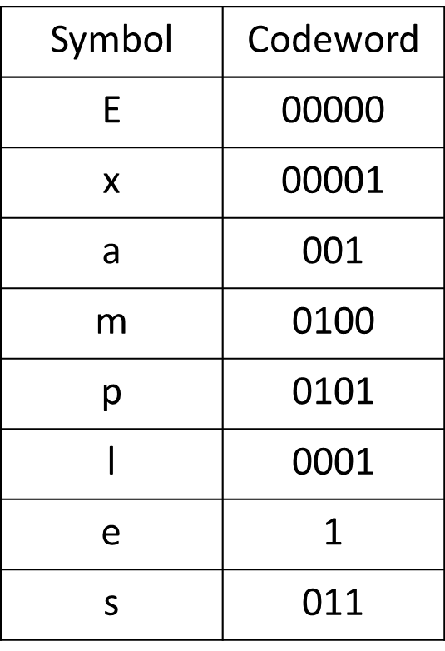
0010101010100011
0110010100010100011

Slide 9
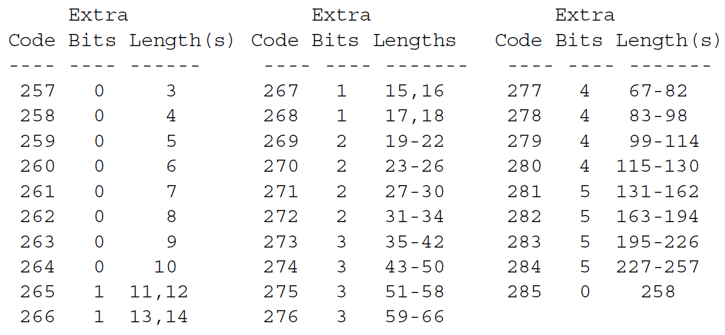
length codes

Slide 10
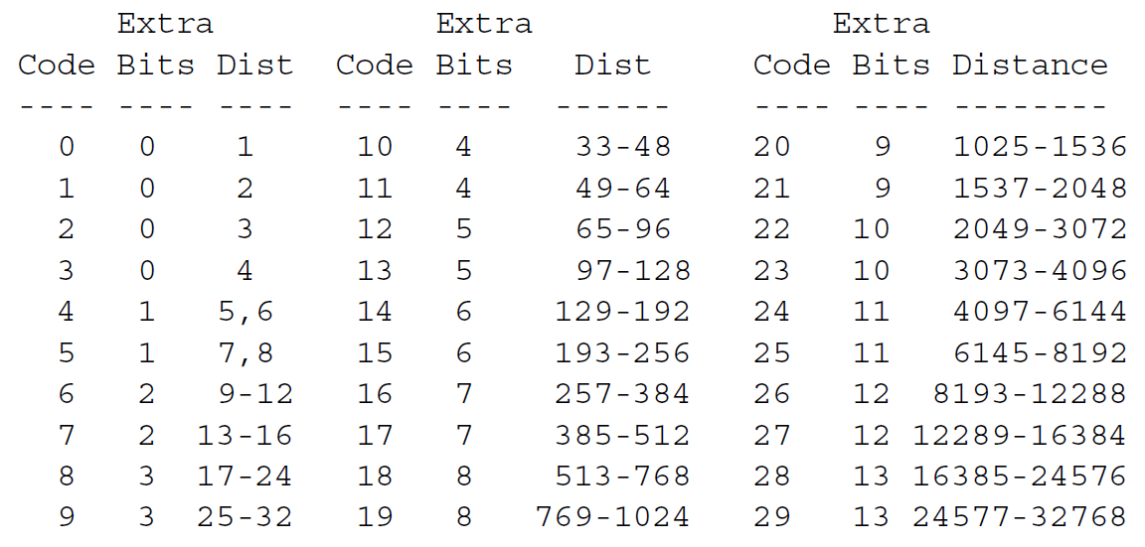
distance codes

Slide 11
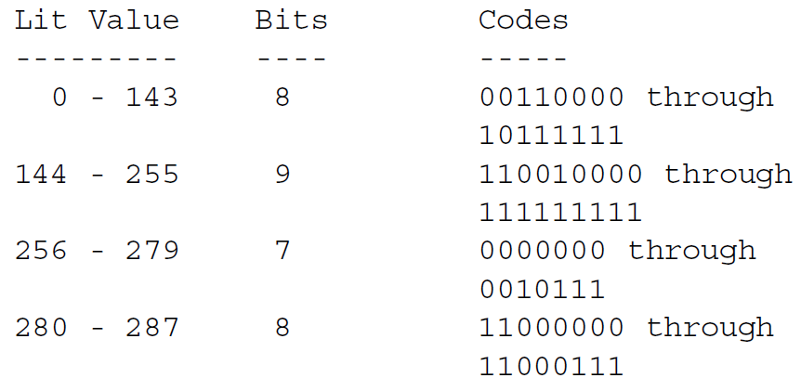
Compression with fixed Huffman codes

Slide 12
Reference
http://www.zlib.net/feldspar.html
https://www.adayinthelifeof.nl/2010/06/02/deflating-the-universe/
http://tools.ietf.org/html/rfc1951
Accelerating Multipattern Matching on Compressed HTTP Traffic Authors : Bremler-Barr, A. Interdiscipl. Center, Efi Arazi Sch. of Comput. Sci., Herzlia, Israel Koral, Y. Publication : IEEE/ACM TRANSACTIONS ON NETWORKING, VOL. 20, NO. 3, JUNE 2012

