Slide 1
Android App Design

Slide 2
Outline
Motivation
Introduction
Development Environment
Implementation Process
Conclusion
References

Slide 3
Motivation
Technology is more developed than past. And
smart phones are becoming more common
now.
With smart phones in general, the mobile app
is also getting diversification.

Slide 4
Introduction
Android is the Linux-based operating system.
And it is the open source operating system.
Profit Source integrate a lot of things.
Example:Gmail,Youtube,Google map,
Android market.
Android provides a complete development
tools and frameworks.

Slide 5
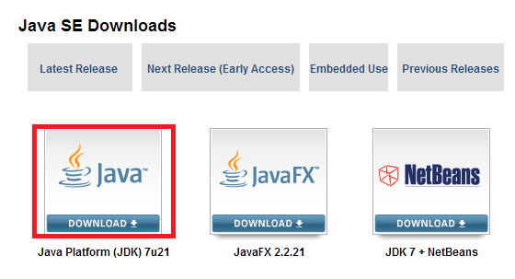
Development Environment
Install the JDK to compile Java language.

Slide 6
Install the Eclipse IDE.
Eclipse is the famous Integrated Development
Environment.
Install the Android SDK.

Slide 7
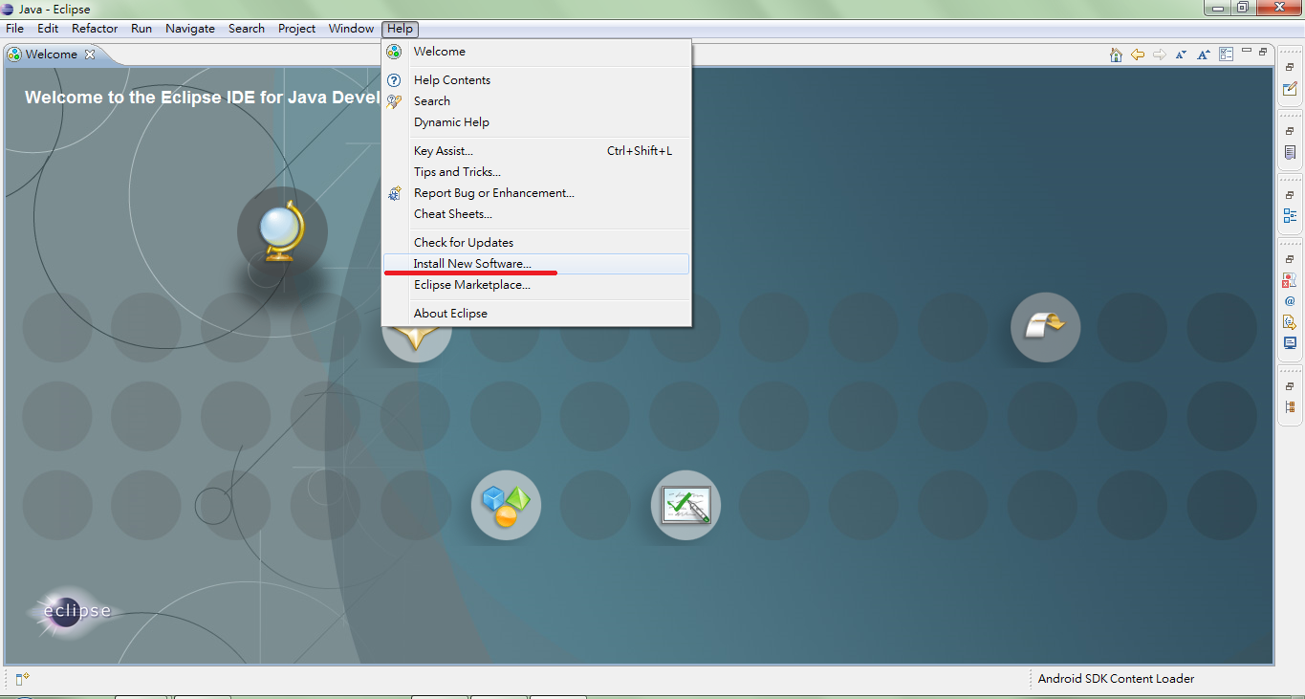
Install the ADT(Android Development Tools).
Help/Install New Software.

Slide 8
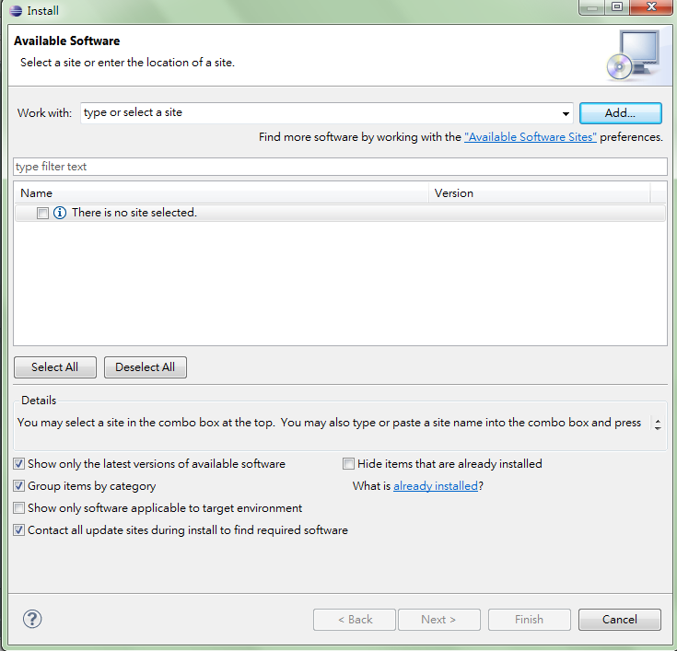
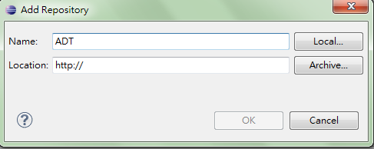
http://dl-ssl.google.com/android/eclipse/
After install the ADT completely , we need to restart the Eclipse IDE.

Slide 9
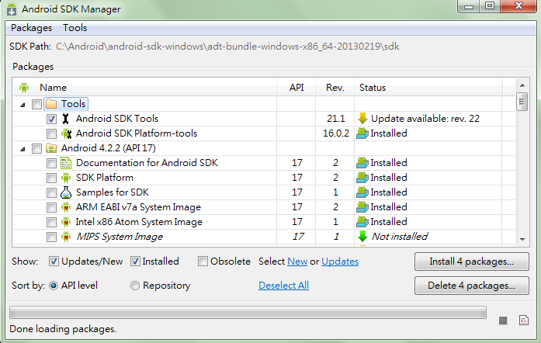
Update and Installing the SDK
Install the SDK platform suite and the API of other
vendors.
Window/Android SDK Manager

Slide 10
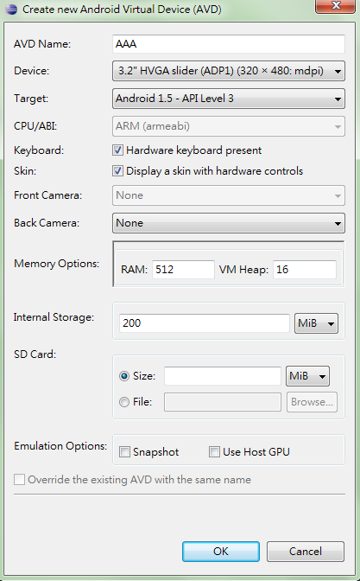
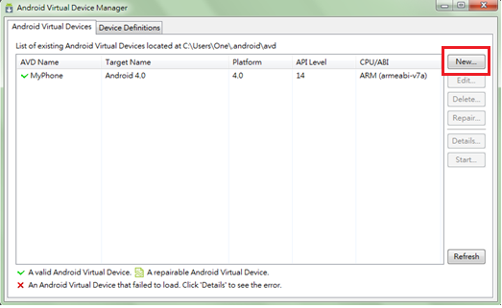
Establishment and start the AVD
Window/AVD Manager

Slide 11
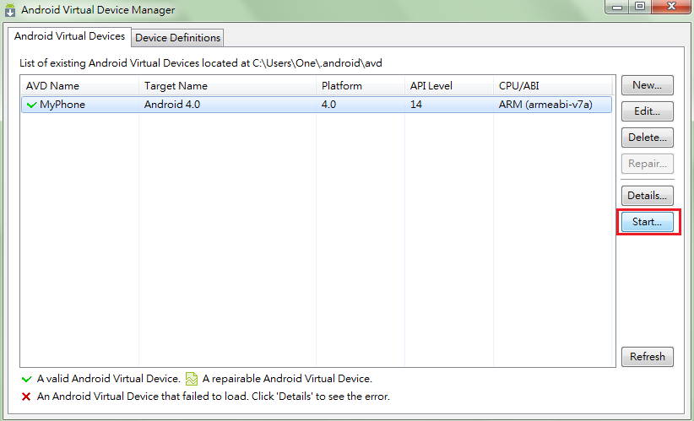
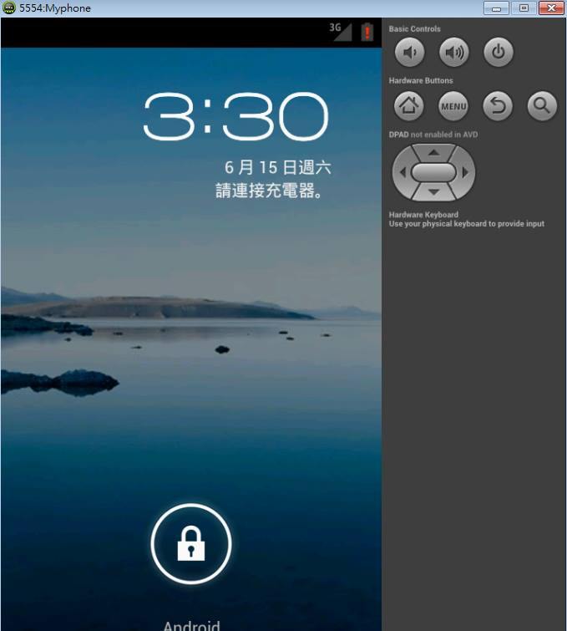
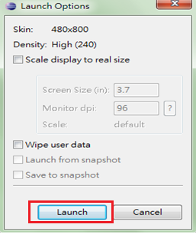

Slide 12
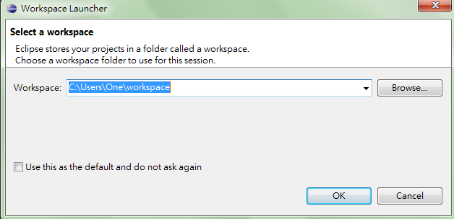
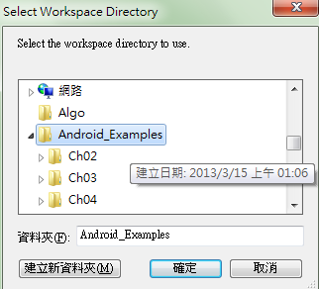
Implementation Process
Open the Eclipse IDE and select workspace directory.

Slide 13
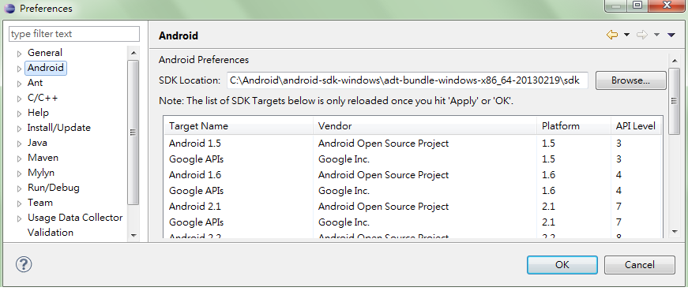
Select the installation path of the Android SDK to complete the workspace set.

Slide 14
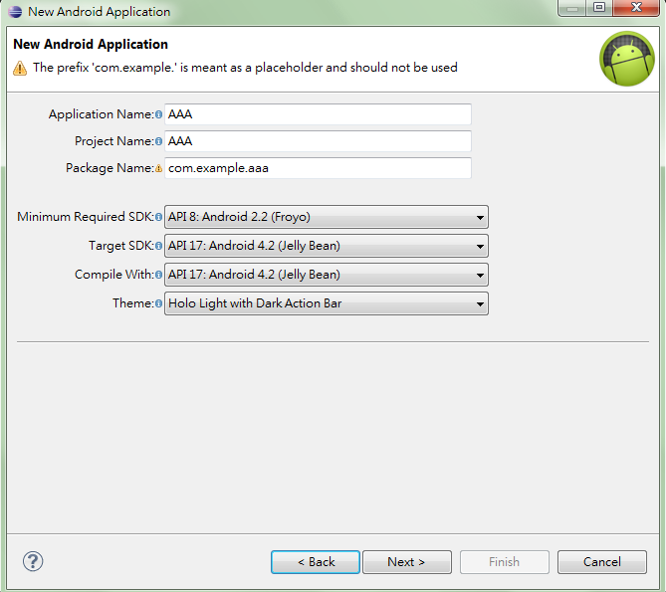
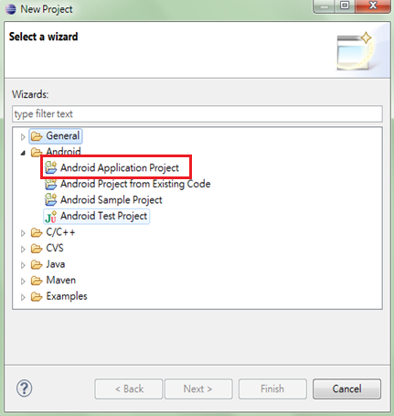
Create a new project.

Slide 15
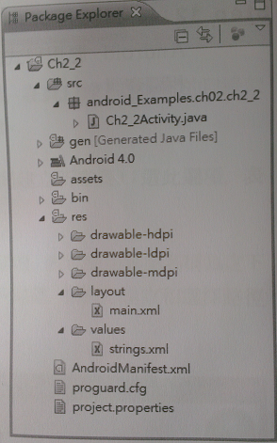
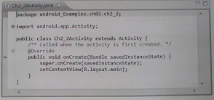
Sample

Slide 16
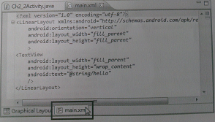

Slide 17
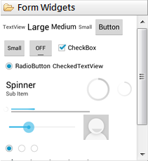
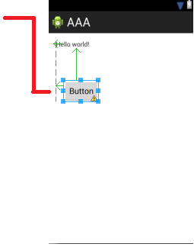
Layout
public void button1_Click(View view)

Slide 18
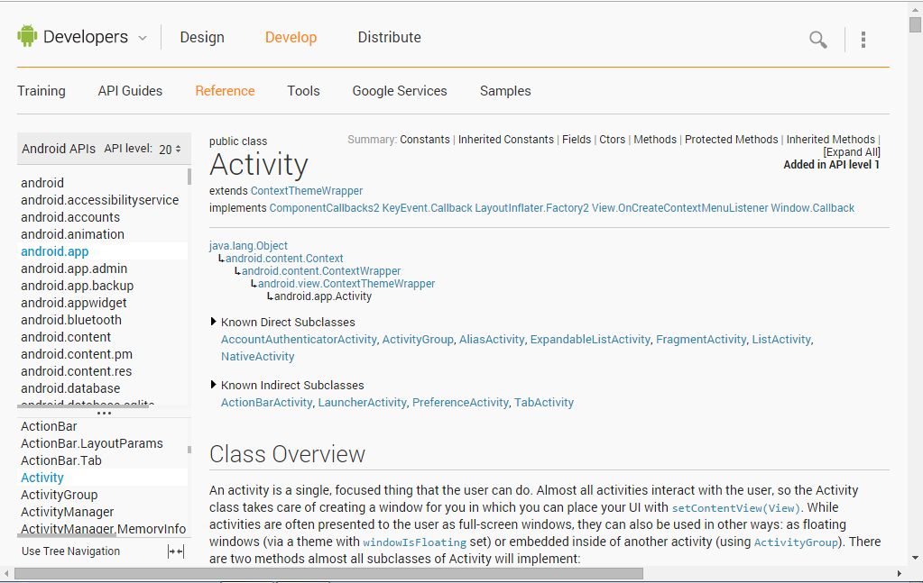
Online documents of Android

Slide 19
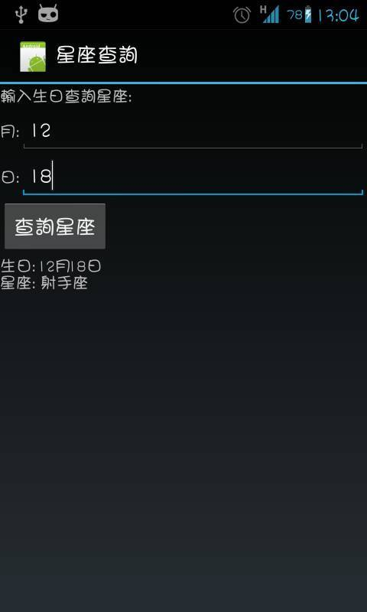
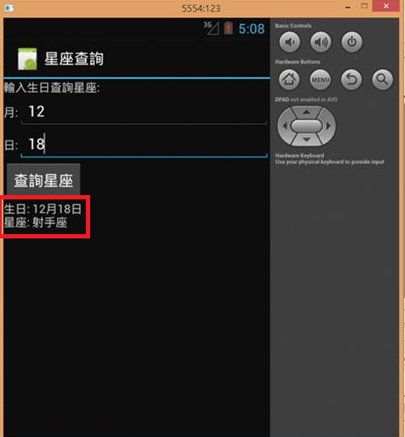
Simple application
Search Constellation

Slide 20
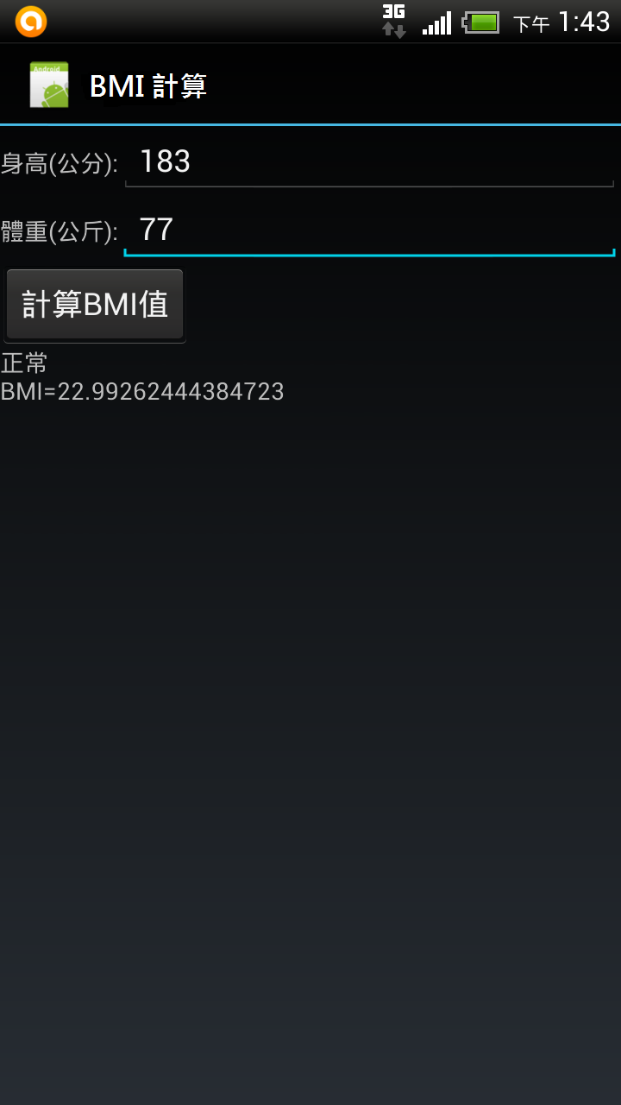
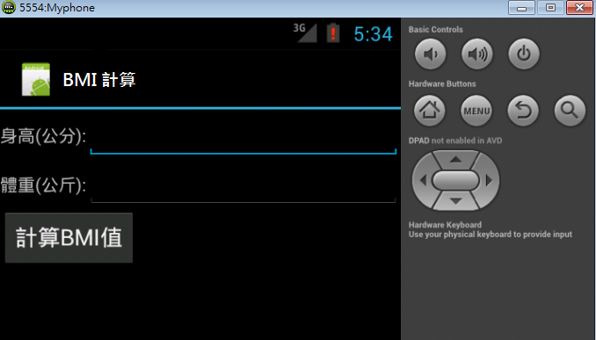
b. BMI calculation

Slide 21
Conclusion
Although the achievements are simple , however , during the production process i can learn about how it is made.
The mobile app is very universal now . Relatively, there are many engineers in this domain.

Slide 22
References
Download Java http://www.oracle.com/technetwork/java/javase/downloads/index.html
Download Eclipse IDE
http://www.eclipse.org/downloads/
Download SDK
http://developer.android.com/sdk/index.html
Online documents of Android
http://developer.android.com/reference/packages.html
5. 新觀念 Android SDK 程式設計範例教本
陳會安 著，旗標出版股份有限公司

