Slide 1
Reducing Traffic Congestion in ZigBee Networks:
Experimental Results
2013 9th International Wireless Communications and Mobile Computing Conference (IWCMC)
Author: Luca Secci, Chiara Buratt
Department of Electrical, Electronic and Information Engineering(DEI), University of Bologna Bologna, Italy

Slide 2
Outline
Introduction
AODV-based ZigBee Routing Protocol
Stream of Packets-ZigBee
New Routing Protocol
Stream of Packets-New
Protocol Implementation
Numerical Results
Conclusion

Slide 3
Introduction
This paper aims at designing and testing a routing protocol, where paths are selected trying to avoid the congestion areas in the network.
The proposed solution aims at reducing traffic congestion, packets losses and unfair use of the energy resources of nodes in the network.
Link costs will depend on, both, the probability that the two nodes are connected (which is a function of the signal-to-noise ratio), and on the probability that packets do not collide (i.e., no losses due to MAC).

Slide 4
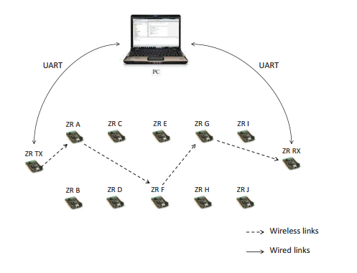
Introduction

Slide 5
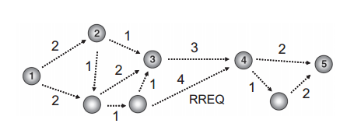
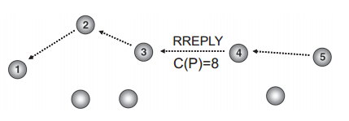
AODV-based ZigBee Routing Protocol
RREQ
RREP
RREQ(Route Request)，RREP(Route Reply)
AODV(Ad hoc On-Demand Distance Vector Routing)

Slide 6
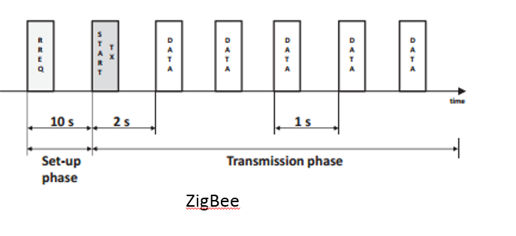
Stream of Packets-ZigBee

Slide 7
New Routing Protocol
The proposed routing protocol exploits at the Network layer and the information coming from the MAC layer. As stated above, according to the ZigBee standard, the link cost is a function of the success probability of the link(P_{li} ).
We modify the AODV protocol, such that nodes at each link may compute losses not only due to link failures, but also to MAC failures.

Slide 8
New Routing Protocol
ZigBee Routing Protocol Cost
  C_{li} = min{7, floor(P_{li}⁻⁴)}
New Routing Protocol Cost
  P_{li} = P_{coni}· P_{maci}
  C_{li} = min{7, floor((P_{coni}· P_{maci}) ⁻⁴)}
  P_{maci} = n of successfully received packets on link i
  n of generated packets on link i

Slide 9
ZigBee Routing Protocol Cost
ZigBee Routing Protocol Cost
  C_{li} = min{7, floor(P_{li}⁻⁴)}
  EX: P_{li}=0.8 P_{li}=0.6
  P_{li}⁴ = 0.8 ^ 4 = 0.4096 P_{li}⁴ = 0.5 ^ 4 = 0.0625
  P_{li}⁻⁴ =1/0.4096=2.441 P_{li}⁻⁴ =1/0.0625=16
  floor(P_{li}⁻⁴)=└2.441┘=2 floor(P_{li}⁻⁴)=└16┘=16
  C_{li} = min{7, 2}=2 C_{li} = min{7, 16}=16

Slide 10
New Routing Protocol Cost
New Routing Protocol Cost
  P_{li} = P_{coni}· P_{maci}
  C_{li} = min{7, floor((P_{coni}· P_{maci}) ⁻⁴)}
  P_{coni}= P_{li}(ZigBee)
  P_{maci} = n of successfully received packets on link i = 4900 = 0.98
  n of generated packets on link i 5000
  EX: P_{li}=0.8*0.98 P_{li}=0.8*0.94
  P_{li}⁻⁴ =2.646 P_{li}⁻⁴ =3.127
  floor(P_{li}⁻⁴)=└2.646┘=2 floor(P_{li}⁻⁴)=└ 3.127┘=3
  C_{li} = min{7, 2}=2 C_{li} = min{7, 3}=3

Slide 11
2
1
2
3
3
4
2
5
1
2
1
4
1
2
2
6
1
7
8

Slide 12
2
1
2
8
3
3
4
2
5
1
2
1
4
1
2
2
6
1
7
8

Slide 13
2
1
2
9
3
3
4
2
5
1
2
1
4
1
2
2
6
1
7
8

Slide 14
2
2
3
12
3
4
4
3
5
1
3
2
5
2
2
2
6
1
7
8

Slide 15
2
2
3
11
3
4
4
3
5
1
3
2
5
2
2
2
6
1
7
8

Slide 16
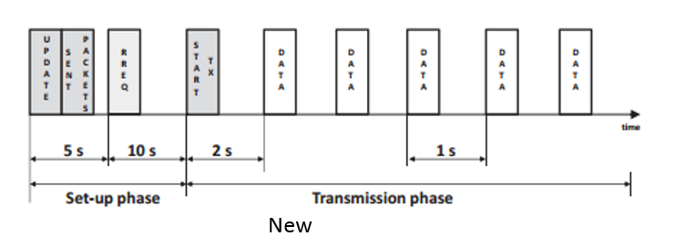
Stream of Packets-New

Slide 17
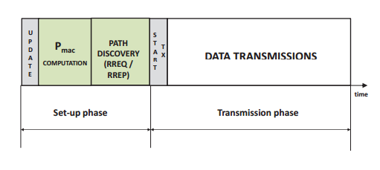
Stream of Packets-New

Slide 18
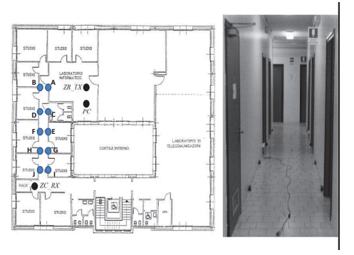
Protocol Implementation

Slide 19
Interference
Uniform
  ZRs generate one data packet in every 2 s.
Non Uniform
  A, C, E, G ,I generate one data packet in every 2s.
  B, D, F, H, J generate one data packet in every 0.5s.

Slide 20
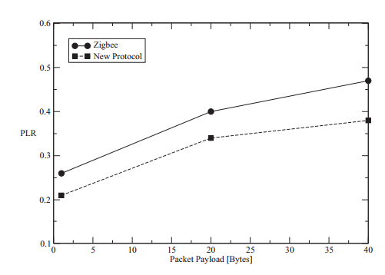
Numerical Results-Uniform
Packet Loss Rate (PLR)

Slide 21
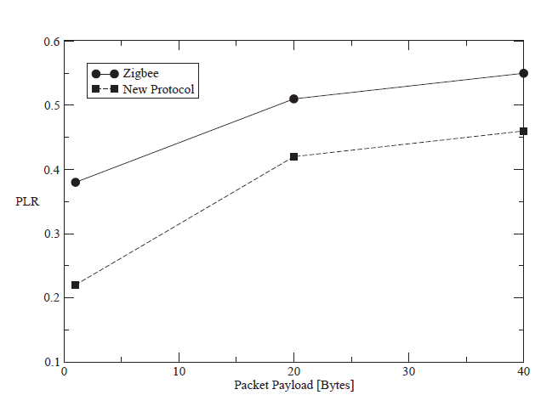
Numerical Results-Non Uniform
Packet Loss Rate (PLR)

Slide 22
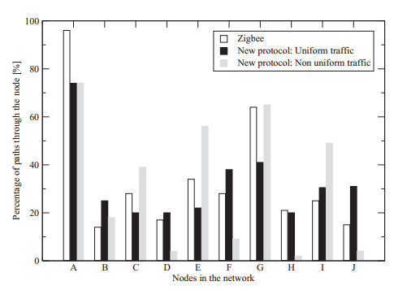
Numerical Results
Percentage of paths through the node

Slide 23
Conclusion
This paper presents a novel routing protocol for multi-hop wireless mesh networks, based on ZigBee standard. The proposed protocol exploits at the network layer, the information coming from the MAC layer, related to MAC losses, to reduce congestion in the network.
It would be useful to underline that it is expected that the proposed protocol improves the performance also in terms of average delay, since the decreasing of packets losses at the different links, will reduce the average number of retransmissions per link, resulting in lower delays.

Slide 24
Reference
IEEE Computer Society, “IEEE Std.802.15.4 2003: part 15.4: Wireless Medium Access Control (MAC) and Physical Layer (PHY) Specifications for Low-Rate Wireless Personal Area Networks (LR-WPANs)”, 2006.
波隆那大學，西方最古老的大學，建立於公元1088年神聖羅馬帝國時期，wiki。

Slide 25
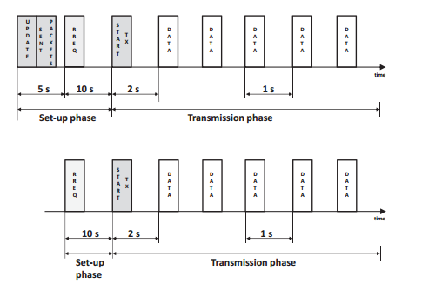
Stream of Packets
New
ZigBee

