Slide 1
OpenFlow-based load balancing for wireless mesh infrastructure
Consumer Communications and Networking Conference (CCNC), 2014 IEEE 11th
Dept. of Electr. & Comput. Eng., Clemson Univ., Clemson, SC, USA
Author(s): Fan Yang, Gondi, V., Hallstrom, J.O., Kuang-Ching Wang, Eidson, G.

Slide 2
Outline
Introduction
Routing protocols in Wireless Mash Networks
OpenFlow vs Traditional forwarding
OpenFlow Technology
Motivation
System architecture
Load Balancing Test Cases
Experimental analysis
Conclusion
Reference

Slide 3
Routing protocols in Wireless Mash Networks
Ad hoc On-Demand Distance Vector (AODV)
Optimized Link State Routing Protocol (OLSR)
link-state routing protocol
Nodes advertise information only about links with neighbors.

Slide 4
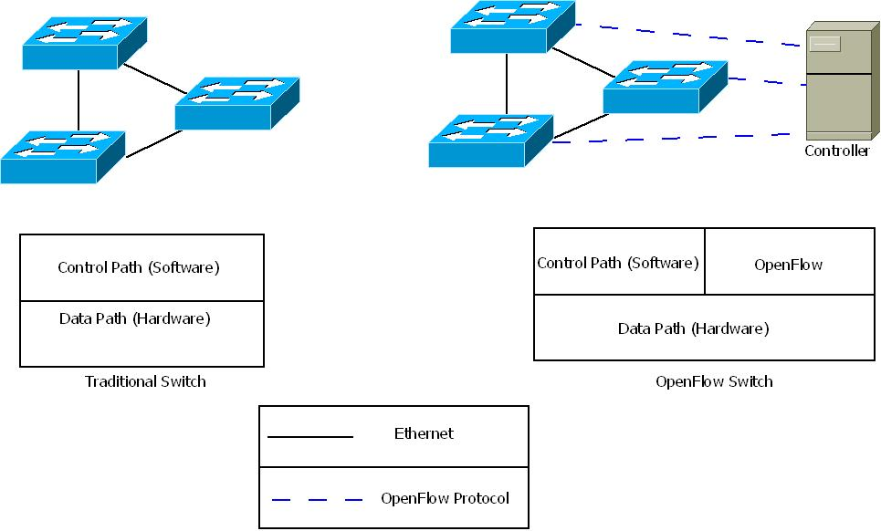
OpenFlow vs Traditional forwarding

Slide 5
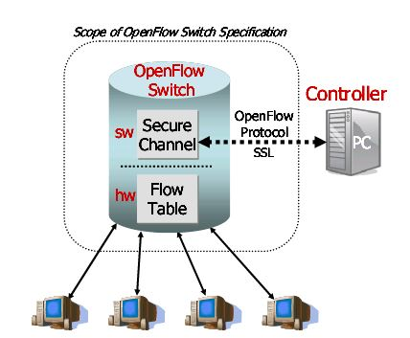
OpenFlow Technology

Slide 6
Motivation
Many routing protocols use pre-selected nodes for relaying traffic, causing those nodes to be heavily used, while leaving other nodes idle.
It ensures that each node has approximately equal traffic to forward, so that optimal network performance is achieved throughout the network.

Slide 7
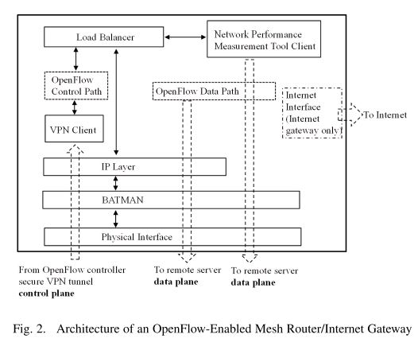
System architecture

Slide 8
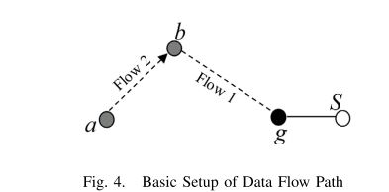
Load Balancing Test Cases
Basic setup of data ﬂow paths

Slide 9
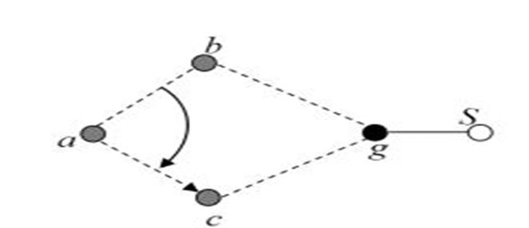
Load Balancing Test Cases(Cont.)
Data ﬂow redirection between mesh nodes

Slide 10
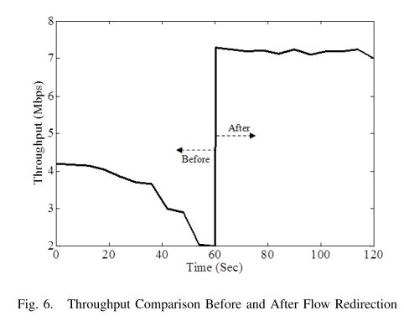
Experimental analysis

Slide 11
Conclusion
Traditional solutions require compute-intensive routing algorithms running at each mesh node.
Presented combines OpenFlow Controller and a performance monitoring tool to enable real time data ﬂow redirection.

Slide 12
References
N, McKeown, T. Anderson, H, Balakrishnan, G. Parulkar, L. Peterson, J. Rexford, ”OpenFlow: Enabling Innovation in Campus Networks” ,Mar. 14, 2008

