Slide 1
SIDD: A Framework for Detecting Sensitive Data Exfiltration by an Insider Attack
42nd Hawaii International Conference on System Sciences, 2009.
Electrical & Computer Engineering
University of California
Author(s):Liu, Y., Corbett, C., Chiang, K., Archibald, R., Mukherjee, B., & Ghosal, D.

Slide 2
Outline
Introduction
Motivating and design space
Structure of SIDD system
Methodology and performance
Conclusion
References

Slide 3
Introduction
In today's widely-connected network environments, a successful insider attack could result in serious damage to the interests of an enterprise
In this paper propose a multilevel system, called SIDD (Sensitive Information Dissemination Detection), to detect the dissemination of sensitive information by an insider.

Slide 4
Motivating and design space
For example , A malicious insider Z create backdoor networks to enable loss or damage of protected exfiltrate sensitive information using the enterprise’s network resources.

Slide 5
Motivating and design space
Communication channel
Overt(HTTP, SSH)
Tunneled(P2P over HTTPS)
Covert(hide data into the header or payloads)
Content type
Original
Modified(compressed, padded, encode)
Hidden(steganography)

Slide 6
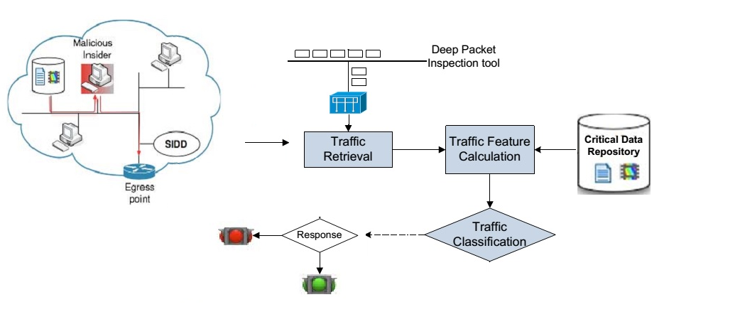
Structure of SIDD system
The captured network traffic is filtered into the application identification system to extract traffic features.

Slide 7
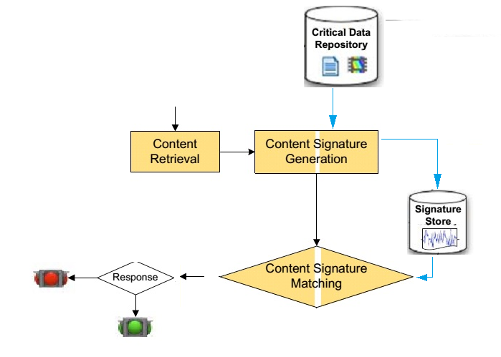
Structure of SIDD system
Generate the signature for content traversing the network to be compared using the matching algorithm with the stored signatures in order to detect dissemination of sensitive content.

Slide 8
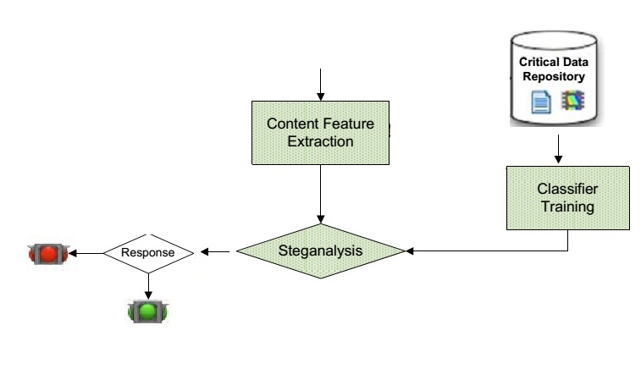
Structure of SIDD system
Perform Steganalysis to determine the presence of hidden information in the target content.

Slide 9
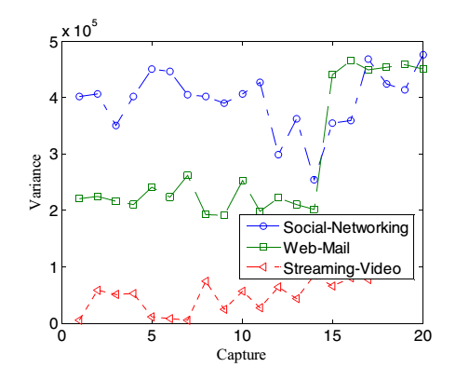
Methodology and performance
Application identification
Use the temporal patterns and sizes of packets, can instantiate a signature with a high degree of confidence.
social networking (MySpace and Facebook)
web-mail (Gmail and Hotmail)
streaming video applications (YouTube and Veoh)

Slide 10
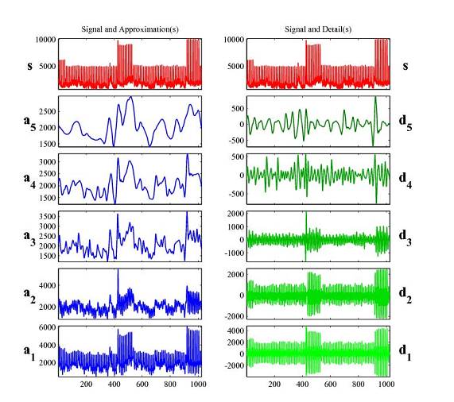
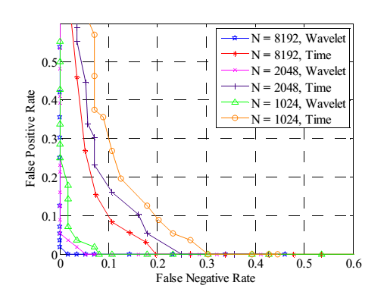
Methodology and performance
Content signature generation and detection
Create network traffic based content signatures.
Compare signatures to detect of sensitive content.
Use wavelets to reduce the size of the signatures.

Slide 11
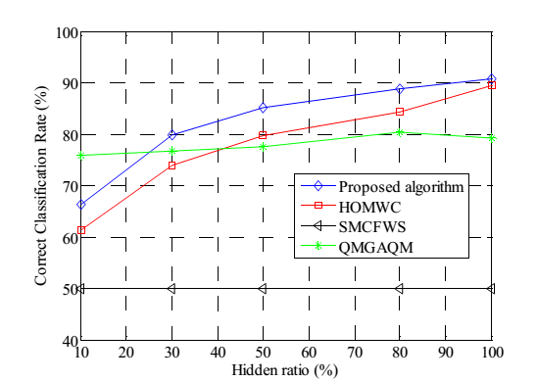
Methodology and performance
Detecting covert communication
measured by some standard audio quality metrics, distortion measures have been shown to be effective to test the presence of hidden messages.
Measures audio content distortion using Hausdorff Distance.

Slide 12
Conclusion
This paper developed a systematic approach to address the key problems of detecting sensitive data exfiltration.
Particularly, a multilevel framework that composed of application detection, content signature generation and detection, and covert channel detection was proposed.

Slide 13
References
D. P. Huttenlocher, D. Klanderman, and W.J. Rucklidge, Comparing images using the Hausdorff distance, IEEE Transactions on Pattern Analysis and Machine Intelligence, vol. 15, pp. 850-863, 1993.
H. Farid, Detecting hidden messages using higherorder statistical models, IEEE International Conference on Image Processing, vol. 2, pp. 905-908, 2002.
Y. Liu, K. Chiang, C. Corbett, R. Archibald, B. Mukherjee, and D. Ghosal, A novel audio Steganalysis based on high order statistics of a distortion measure with Hausdorff distance, 11th Information Security Conference(ISC) 2008, Lecture Notes in Computer Science, Vol. 5222, pp. 487-500.
Y. Q. Shi, G. Xuan, C. Yang, J. Gao, Z. Zhang, P. Chai, D. Zou, C. Chen, and W. Chen, Effective Steganalysis Based on Statistical Moments of Wavelet Characteristic Function, IEEE International Conference on Information Technology, pp. 1195-1198, 2005.

