Slide 1
Software-Defined Networks: Incremental Deployment with Panopticon
Published by the IEEE Computer Society
Marco Canini, Université catholique de Louvain
Anja Feldmann, Dan Levin, and Fabian Schaffert,
Technische Universität Berlin
Stefan Schmid, Telekom Innovation Labs, Technische
Universität Berlin

Slide 2
Outline
Introduction
Panopticon
Architecture
SDN Implementation
Overhead and Feasibility
Conclusion
Reference

Slide 3
Introduction
Automating and radically simplifying computer network management.
Increasingly view hybrid networks.
Transition to an SDN should meet several specific goals:
Provide clear and immediate benefits
Minimize disruption while establishing confidence
Respect budgetary constraints
Abstract a hybrid network into a logical SDN

Slide 4
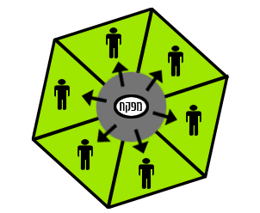
Panopticon
Operate the network as an SDN comprised of SDN-capable switches only.
With careful planning, SDN capability can ultimately be extended to every network switchport.

Slide 5
Architecture
Panopticon’s architecture works on the principle.
Each network packet traversing an SDN switch can be treated according to end-to-end network policies.
Traffic that traverses two or more SDN switches.
Can be controlled at finer levels of granularity to enable further, customized forwarding.

Slide 6
Panopticon extends SDN capabilities to traditional switches.
SDN-controlled(SDNc) port
Waypoint enforcement
Uses virtual LANs to restrict forwarding on traditional network devices and guarantee waypoint enforcement.
VLAN ID space is limited to 4096 values
SCT

Slide 7
Solitary confinement tree (SCT)
Spanning tree
Connects an SDNc port to certain SDN switches
Provide a safe path
VLAN ID Problem
Disjoint SCTs
Simple Network Management Protocol(SNMP)

Slide 8
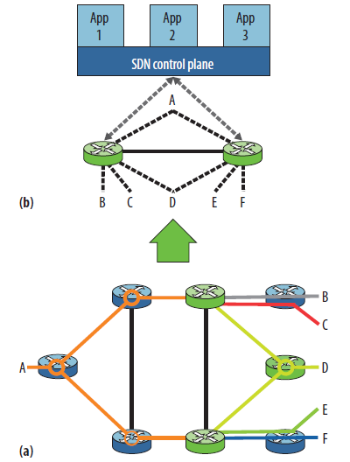

Slide 9
SDN implementation
Not strictly mandate the interaction
envision
All policies governing traffic that originates from or is directed to SDNc ports can be defined exclusively at the SDN switches.
Effectively limit added complexity
In which addressing within the logical SDN maintains compatibility with the existing IP subnet allocation

Slide 10
Overhead and Feasibility
Increased path lengths and require greater link utilization.
Sufficient path diversity exists
Evaluated the approach’s feasibility as follows.
Deployment feasible
VLAN requirements

Slide 11
Simulated various partial SDN deployment scenarios based on－
Different resource constraints
Traffic conditions a large campus network topology of roughly 1700 switches.

Slide 12
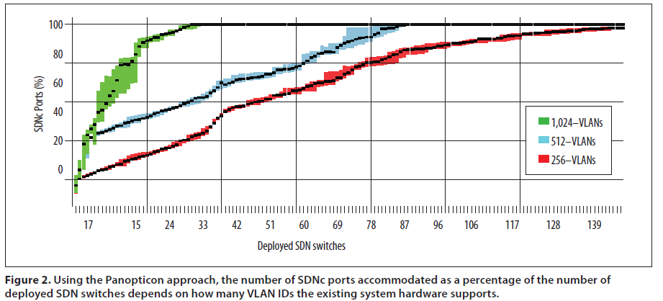

Slide 13
Conclusion
Contributes to a field that is attracting increasing attention from other researchers.
Offer a helpful reference point for practical hybrid software-defined networking and contribute to ongoing standardization efforts.

Slide 14
Reference
D. Levin et al., “Panopticon: Reaping the Benefits ofIncremental SDN Deployment in Enterprise Networks,”Proc. 2014 Usenix Annual Technical Conf., 2014, pp.333–345; www.usenix.org/sites/default/files/atc14_full_proceedings.pdf.
S. Vissicchio, L. Vanbever, and O. Bonaventure, “Opportunities and Research Challenges of Hybrid Software Defined Networks,” ACM Computer Communication Rev.,vol. 44, no. 2, 2014, pp. 70–75.
Migration Use Cases and Methods, Migration Working Group, Open Networking Foundation, 2014; www. opennetworking.org/images/stories/downloads/ sdn-resources/use-cases/Migration-WG-Use-Cases.pdf.

