Slide 1
Design and deployment of IPv6 address management system on research networks
TENCON 2014 - 2014 IEEE Region 10 Conference

Slide 2
Outline
Introduction
Related work
Design
System Architecture
Implementation result
Conclusions

Slide 3
Introduction
SLAAC has drawbacks with respect to security for the network management system. Illegal hosts or unauthorized hosts could access the network and attack critical equipment

Slide 4
Related work
Stateless Address AutoConfiguration(SLAAC)

Slide 5
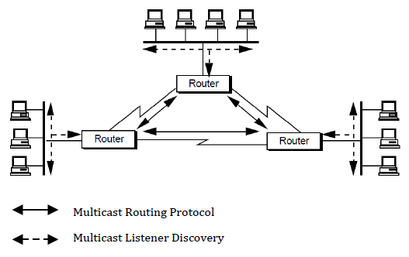
Related work(Conf.)
Multicast Listener Discovery (MLD)
Purpose
Data formate
Multicast Listener Query
Multicast Listener Report
Multicast Listener Done

Slide 6
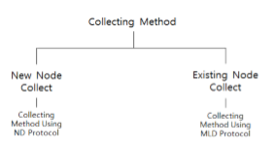
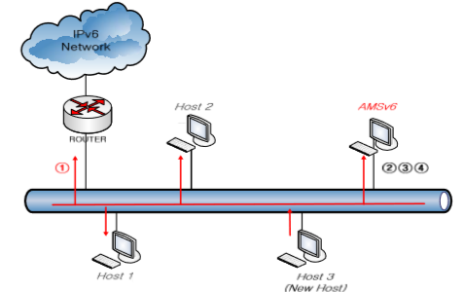
Design

Slide 7
System Architecture

Slide 8
System Architecture(Conf.)

Slide 9
System Architecture(Conf.)

Slide 10
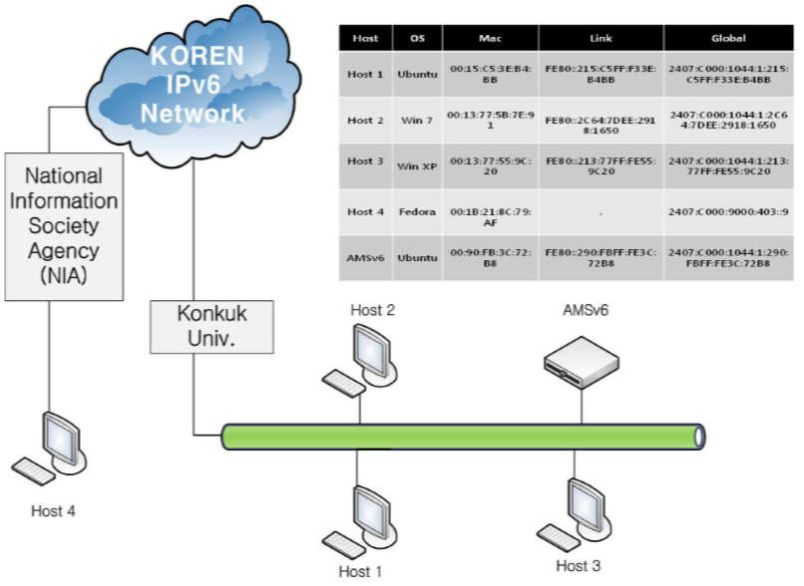
Implementation result
Test environment

Slide 11
Conclusions
The proposed method delivered satisfactory performance and efficacy in controlling IPv6 addresses in the IPv6 SLAAC environment.

