Slide 1
Multipath TCP
ACM Queue, Volume 12 Issue 2, pp. 1-12, February 2014
Christoph Paasch and Olivier Bonaventure
University College London

Slide 2
Outline
Motivation
MPTCP – Design Goals
MPTCP – Establish Connection
MPTCP – Add Subflows
MPTCP – Transmit Data
Congestion Control
Devil of Middleboxes
Conclusion

Slide 3
Motivation
In addition to usual load balancing, such as load balancing between two interfaces and two gateways, my system is going to make one packet sent from different paths.
In order to realize the target, there is a protocol made this target come true.

Slide 4
MPTCP - Design Goals
Using multiple network paths for a single connection.
Must be able to use the available network paths at least as well as regular TCP
Regular TCP is usable as usual for existing applications.
Enabling MPTCP cannot interfere regular TCP work.

Slide 5
MPTCP – Establish Connection
An MPTCP connection is established by using the three-way handshake with TCP options to negotiate its usage.
MP_CAPABLE : supports MPTCP
Key : for security purposes

Slide 6
MPTCP – Add Subflows
Corresponding MPTCP connection must be uniquely identified on each end host.
Use regular TCP option for joining the corresponding MPTCP

Slide 7
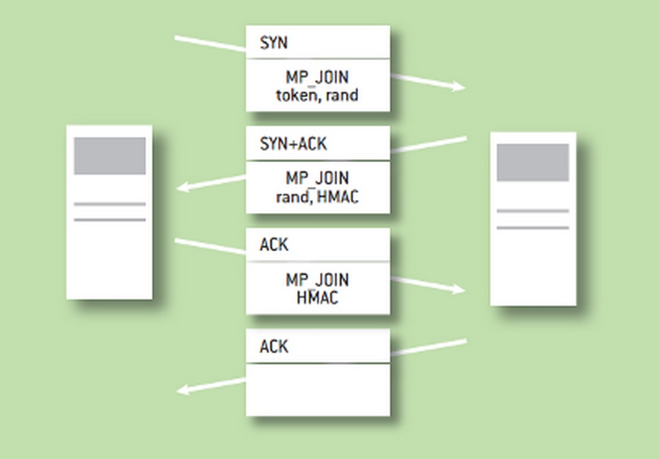
MPTCP – Add Subflows (cont.)
MP_JOIN token : replacing MP_CAPABLE
rand (key) : for security purposes
HMAC (hash-based message authentication code) : for authentication

Slide 8
To reduce the length of the MP_CAPABLE option and avoid using all the limited TCP options space (40 bytes) in the SYN segment, MPTCP derives the token as the result of a truncated hash of the key.

Slide 9
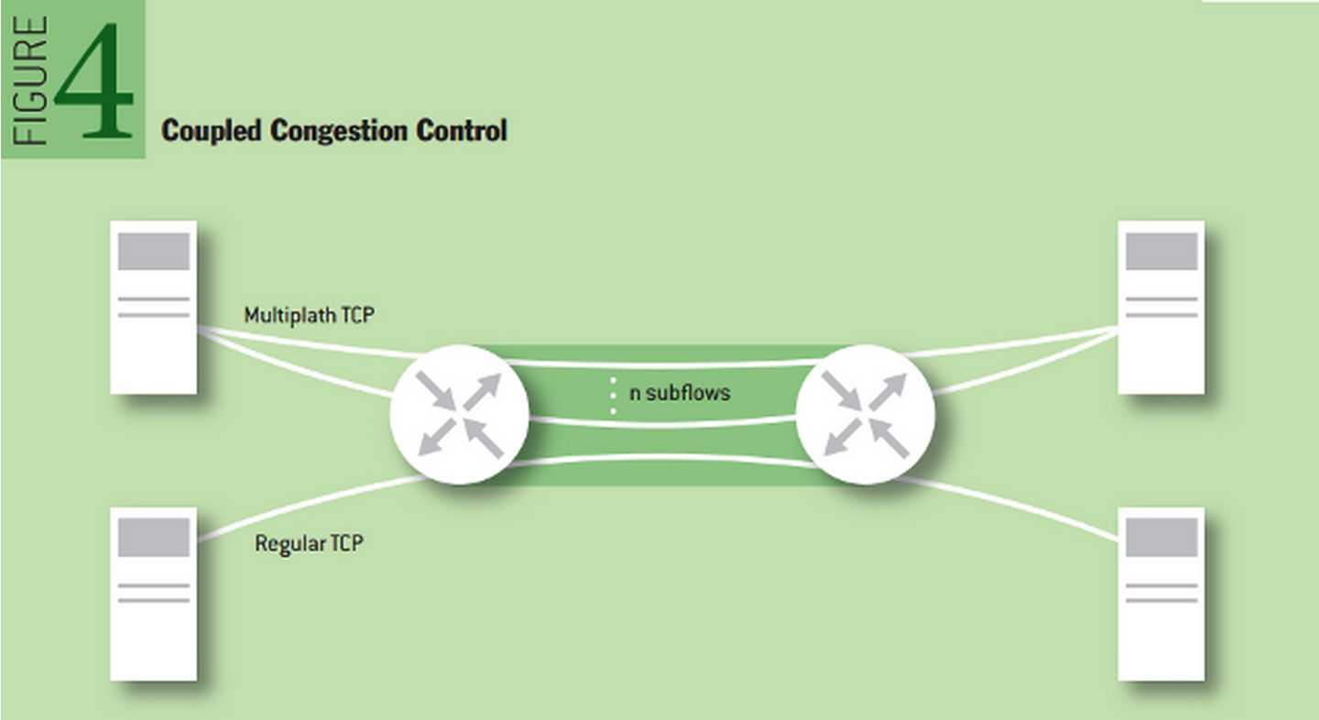
MPTCP – Transmit Data
Data transmitted over one subflow can be retransmitted on another to recover from losses.
From congestion-control viewpoint, if the MPTCP-enabled client uses two subflows, then it will obtain two-thirds of the shared bottleneck.

Slide 10
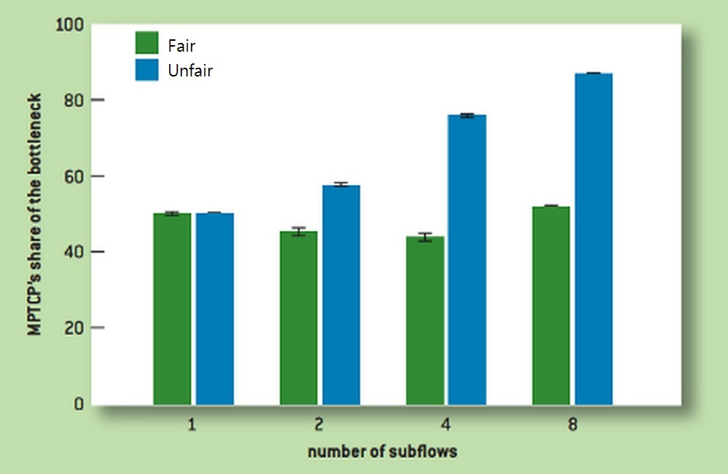
Congestion Control
Adjust the TCP congestion window on each subflow
The aggregation of congestion windows could not grow faster than a single TCP connection

Slide 11
Devil of Middleboxes
The middleboxes, such as firewalls , NATs, and load balancers, would modify the TCP header or the payload of passing TCP segments.
Absolute data sequence number would cause several packets with the same sequence number. This makes the reorder process failed.
Mapping data sequence number is the solution for reconstruct the data stream. It defines the beginning and the end of the data-sequence number.
The beginning : with respect to the subflow sequence number
The end : indicating the length of the mapping

Slide 12
Conclusion
MPTCP is a major extension to TCP. MPTCP makes the transmission more efficient. It considers all the situation that might happen on IP and TCP. MPTCP is more integral than regular TCP.

Slide 13
Reference
Christoph Paasch and Olivier Bonaventure, “Multipath TCP”, ACM Queue, Volume 12 Issue 2, pp. 1-12, February 2014
M. Handley, O. Bonaventure, C. Raiciu, & A. Ford, “TCP extensions for multipath operation with multiple addresses”, IETF RFC 6897, March 2014.

