Slide 1
A Dynamic VPN Architecture for Private Cloud Computing
2011 Fourth IEEE International Conference on Utility and Cloud Computing
Wen-Hwa Liao, Shuo-Chun Su
Tatung University

Slide 2
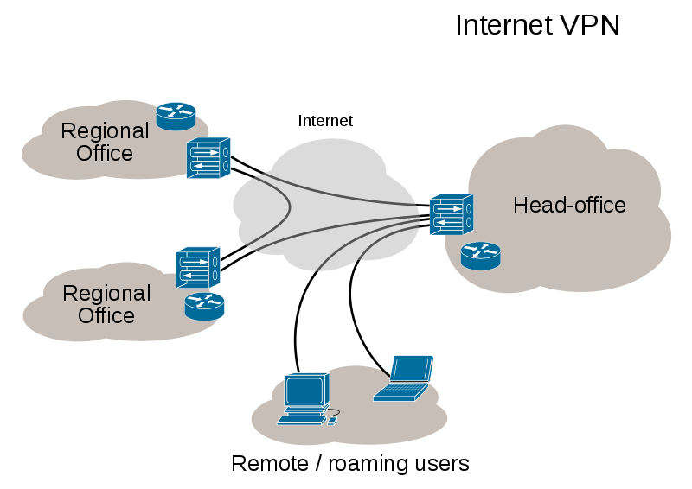
Virtual Private Network(VPN)
A virtual private network extends a private network across a public network, such as the Internet.
Technical
Tunneling
Encryption & Decryption
Key management
Authentication

Slide 3
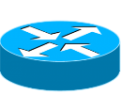
VPN Framework (Full-Mesh)
Every node is connected directly to others.
Advantage
Shortest route
No bottleneck
Disadvantage
Each gateway(GW) must have an Internet key exchange(IKE) policy for each of the other GWs
Can not traffic control
Internet
Gateway
VPN tunnel

Slide 4
VPN Framework (Hub-and-Spoke)
Every GWs connects to Hub-GW.
Advantage
Each GW needs only one IKE policy to communicate with all other GWs.
Traffic control
Disadvantage
Delay
bottleneck
Hub-GW
Internet
Gateway
VPN tunnel

Slide 5
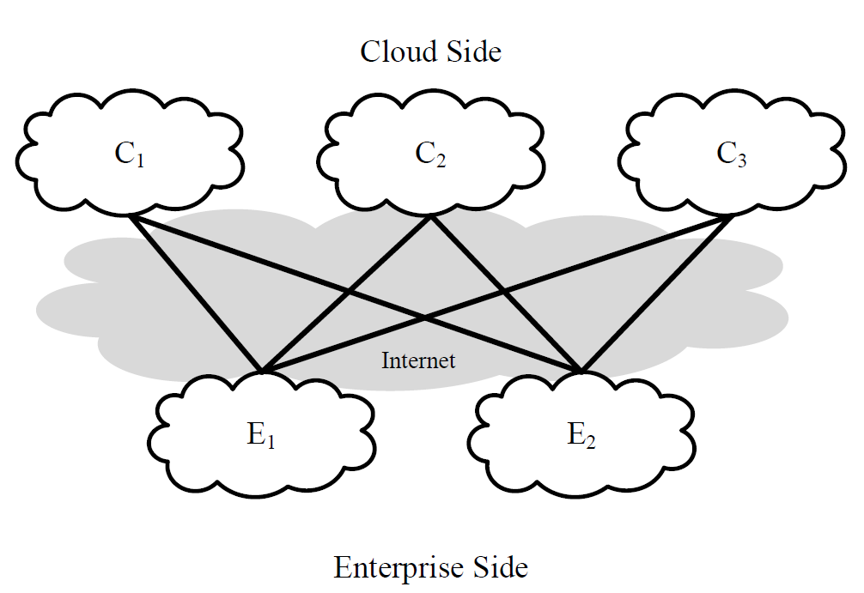
VPN Framework (Bipartite)
Based on hub-and-spoke and full-mesh
The corporation and the cloud service provider can be deemed as spokes under the network management of hub-GW.

Slide 6
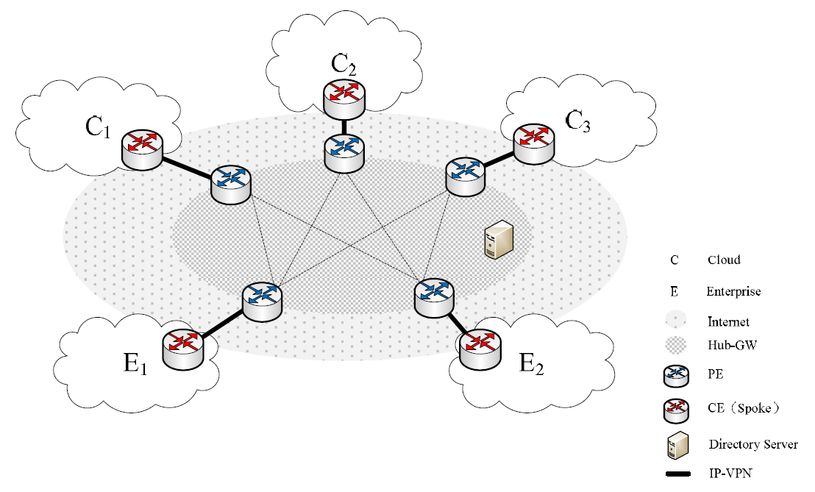
System Architecture
CE：Customer Edge
PE：Provider Edge

Slide 7
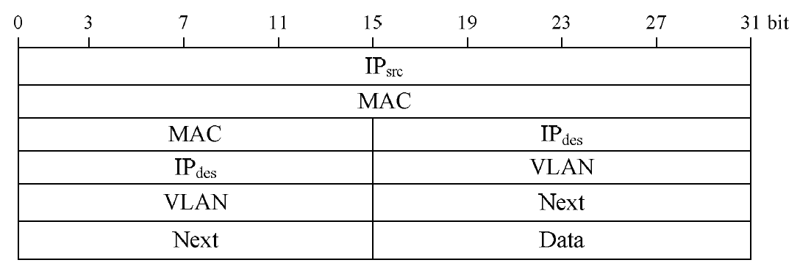
Packet Format
Connection between CE and PE

Slide 8
Exchange modes
CE_VLAN_request
Establishing VLAN
CE_VLAN_response
VLAN ID
CE_MAC_request
Querying about permission for connection
CE_MAC_response
Checking in the database whether the connection is permitted
CE_MAC_terminate
Delete the VLAN ID for connecting

Slide 9
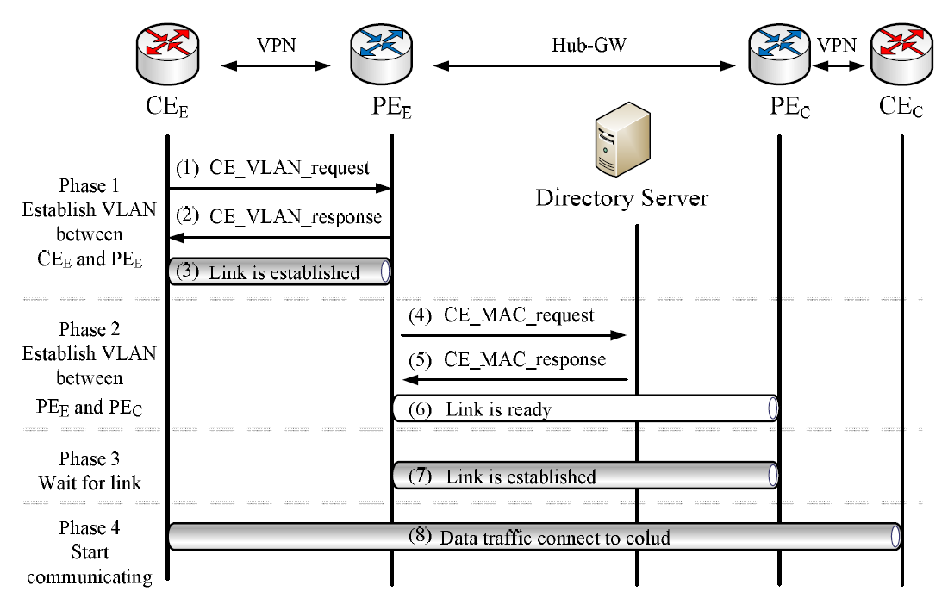
Process of adding a new connection

Slide 10
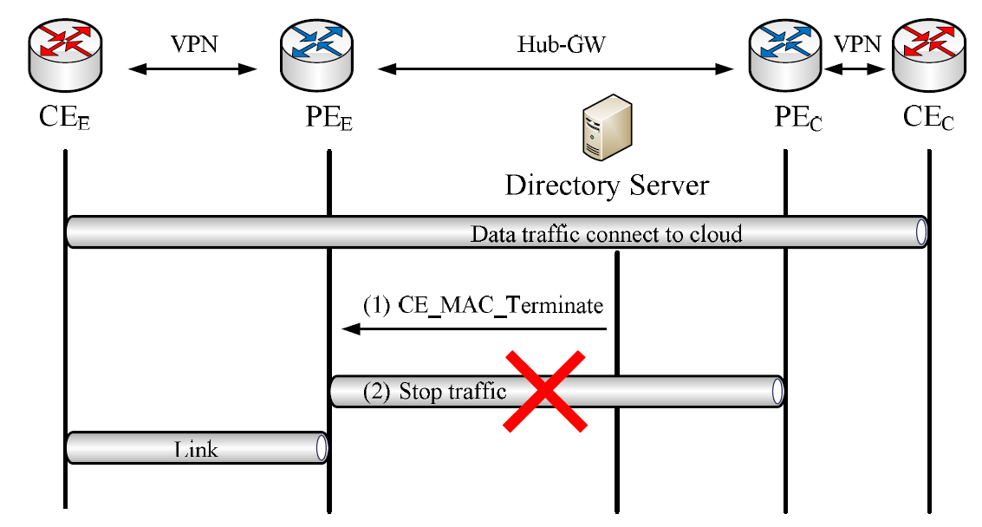
Process of erasing a connection

Slide 11
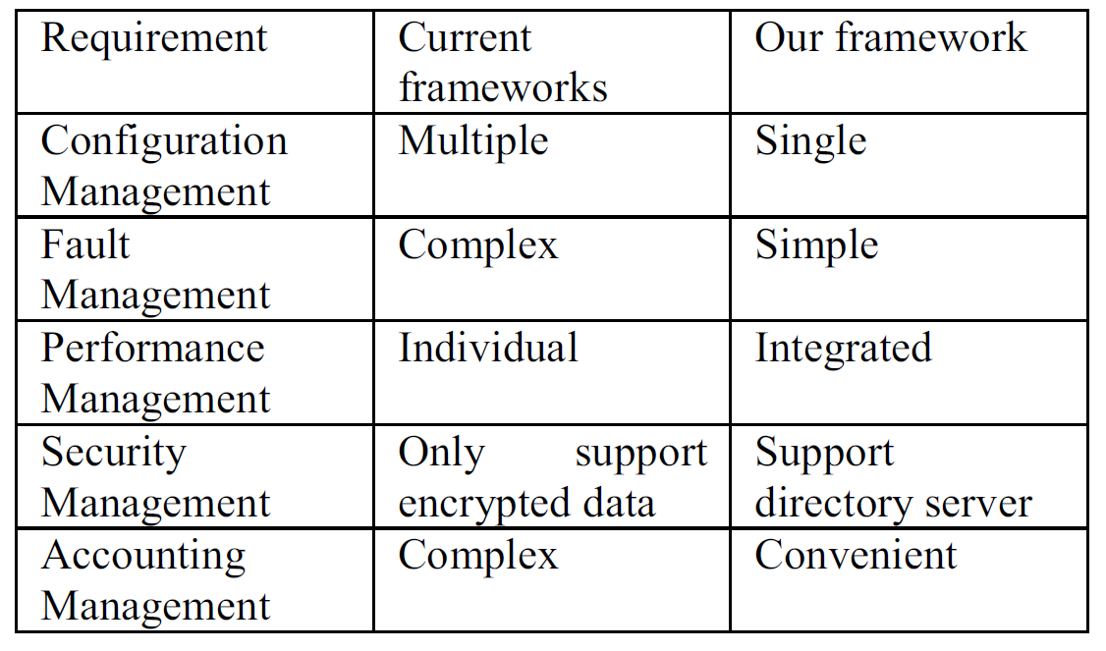
Analysis Result

Slide 12
Conclusion
The user needs only to connect hub-GW by using VPN like PPTP, IPsec or SSL without having to implement a complex network framework.
The management of hub-GW uses bipartite.
Needing to maintain extra table.

