Slide 1
Flexible Access Management System for Campus VLAN Based on OpenFlow
2011 IEEE/IPSJ International Symposium on Applications and the Internet
Yasuhiro Yamasaki Yoshinori Miyamoto Junichi Yamato Yasuhiro Yamasaki * , Yoshinori Miyamoto, Junichi Yamato , Hideaki Goto, Hideaki Sone Tohoku University, Japan *NEC Corporation, Japan

Slide 2
Outline
Backgrounds
VLAN(Virtual Local Area Network)
RADIUS(Remote Authentication Dial In User Service)
SDN(Software Defined Networking)
OpenFlow
Campus VLAN
Campus VLAN / Problems
Different between General network and OpenFlow
Evaluations
Summary

Slide 3
Backgrounds
VLAN(Virtual Local Area Network)
RADIUS(Remote Authentication Dial In User Service)
SDN(Software Defined Networking)
OpenFlow

Slide 4
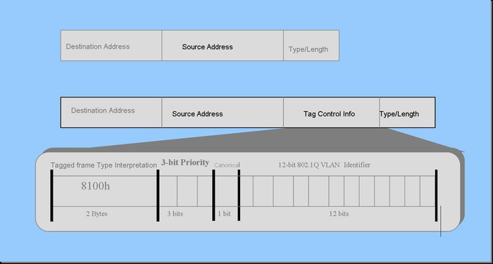
VLAN(Virtual Local Area Network)
A virtual local area network (virtual LAN) is the logical grouping of network nodes. A virtual LAN allows geographically dispersed network nodes to communicate as if they were physically on the same network.

Slide 5
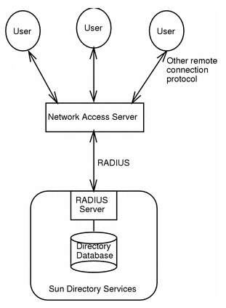
RADIUS(Remote Authentication Dial In User Service)
Authentication
Authorization
Accounting

Slide 6
SDN(Software Defined Networking)

Slide 7
SDN(Software Defined Networking)

Slide 8
OpenFlow

Slide 9
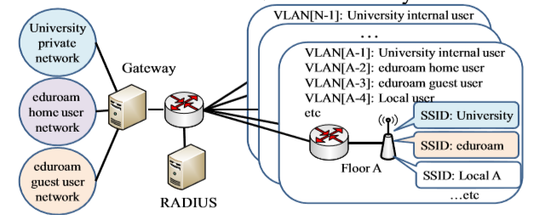
Campus VLAN
Using a lot of VLANs in campus networks
– Department, Floor , Guest-/home-users and so on
For example, roaming system such as eduroam
– The number of VLAN is (SSID/AP The number of VLAN is (SSID/AP × Area).

Slide 10
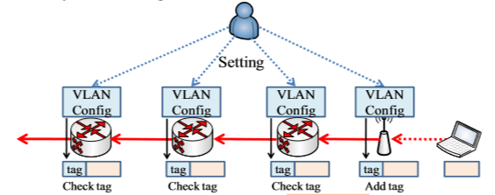
Campus VLAN
Packets are forwarded based on VLAN tag
– Each network must be set to each VLAN configuration.
– Each special field such as VLAN tag is necessary in the header of packet.

Slide 11
Campus VLAN / Problems
IEEE802.1Q has some limitations.
– ID field of VLAN is 12bits (= 4096 ID)
– It is difficult to manage multi stacked VLAN
The system configuration work is laborious.
– It is necessary to set configuration to all network nodes

Slide 12
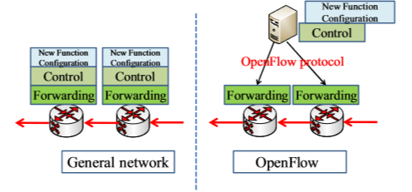
Differences between General network and OpenFlow
Network node: dumb but fast
Control server: intelligent as is expected

Slide 13
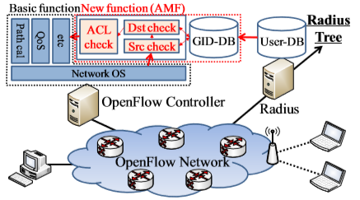
System Architecture
The system configuration becomes lighter
The number of ID isn’t restricted

Slide 14
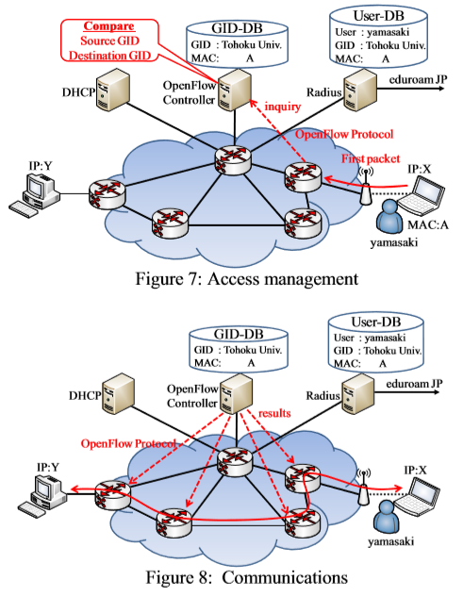

Slide 15
Evaluations
The access management function
The times for communications

Slide 16
Summary
The system manages communication access by virtual group ID (GID) managed in OpenFlow controller instead of VLAN.
The number of ID is hardly restricted and even if GID is changed, the configuration of switches need not be changed because GID is only used in OpenFlow controller.

