Slide 1
Makefile Introduction
Jia – Wei Lin
1

Slide 2
Outline
Why we use make ?
Create a Description File
Rules of Makefile
How make Processes a Makefile?
GCC Flags
Implicit rule (Suffix rules)
Variables(Macros)
Phony Targets
More about Variables
Summary
2

Slide 3
Why we use make ?
Simplify the commands that we input when we compile.
Automatically determines which pieces of a large program need to be recompiled, and issues commands to recompile them.
Just need to read “makefile” file and we will know how this program compile and link the other programs.
3

Slide 4
Create a Description File
To use “make”,we have to create a Description File at first.
Both “Makefile” or “makefile” are description files’ name.
Write your instructions in file.
Typing “make <target>” ,and it will read the instructions from description file by default !
4

Slide 5
Rules of Makefile
Target : dependencies
<tab>commands to make target
<tab > character MUST NOT be replaced be spaces.
target : usually the name of a file.
dependencies : files are used as input to create the target.
5
Notes:
注意：command只能是一行、若超過一行則要用反斜線繼續打

Slide 6
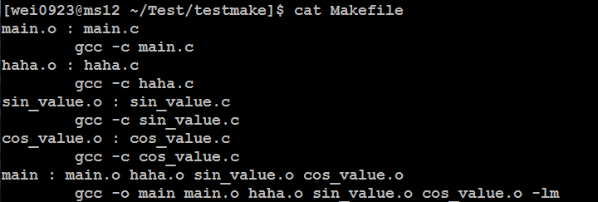
How make Processes a Makefile?
By default, make starts with the first target (not targets whose names start with ‘.’).
Recompile : if the source file, or any of the header files named as dependencies, is more recent than the object file, or if the object file does not exist.
6
Notes:
只輸入make的話只會執行第一個target，所以必須輸入make main

Slide 7
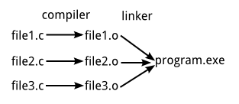
GCC Flags
-c : Only compile the source files, but do not link. Output is an object file. Ex : filename.o
-o file : Link and place output in file file. If `-o' is not specified, the default is to put an executable file in `a.out‘
-l : add a library.
-L/PATH : find the library in PATH.
7
Notes:
-L : LINUX Library通常在預設資料夾裡面，所以可以省略，除非在特定資料夾才需要使用

Slide 8
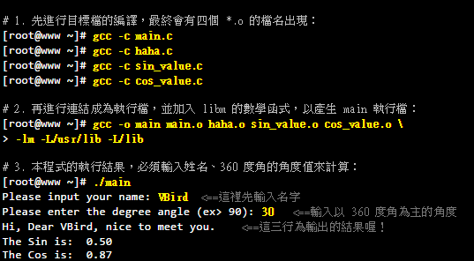
Example - original
main.c ：讓使用者輸入資料與呼叫其他三支副程式
haha.c ：Print String
sin_value.c ：計算輸入的角度(360) sin值
cos_value.c ：計算輸入的角度(360) cos 值
8
Notes:
l ：是『加入某個函式庫(library)』的意思，
m ：則是 libm.so 這個函式庫，其中， lib 與副檔名(.a 或 .so)不需要寫
所以 -lm 表示使用 libm.so (或 libm.a) 這個函式庫的意思～至於那個 -L 後面接的路徑呢？這表示： 『我要的函式庫 libm.so 請到 /lib 或 /usr/lib 裡面搜尋！』

Slide 9
Example – using make
→ Get the executable file “main”, and we can execute the program by ./main now!
9

Slide 10
Implicit rule (Suffix rules)
Using Implicit rule
More implicit rules : make -p
10

Slide 11
Variables(Macros)
Basics of Variable References
foo = c
$(foo) or ${foo} → Get the value ‘c’
OBJS = program.o foo.o utils.o
program : $(OBFS)
cc -o program $(OBJS)
Simply expanded(using ‘:’ ) and recursively expand variables
x = foo
y = $(x) bar y = later bar
x= later
x := foo
y := $(x) bar y = foo bar
x := later
recursively
simply
11
Notes:
In order to make Makefile simplier.

Slide 12
Variables Make Makefiles Simpler
Edit the code by variables
12

Slide 13
Phony Targets
It is not really the name of a file.
Just a name for a command to be executed when you make an explicit request.
Special Built-in Target Names :
all
.PHONY : make will run its command unconditionally.
.SILENT : make will not print the command used to remake those particular files before executing them.
More
13
Notes:
Because the rm command does not create a file named clean, probably no such file will ever exist. Therefore, the rm command will be executed every time you say ‘make clean’.

Slide 14
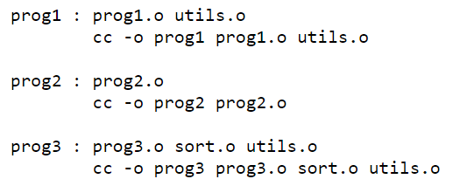
Phony Targets : all
> make prog1 prog2 prog3
> make
14

Slide 15
More about Variables
Automatic Variables :
$@ : The file name of the target of the rule.
$< : The name of the first dependency.
$? : The names of all the prerequisites that are newer than the target.
Macro String Substitution
TEST = apple.c banana.c orange.c
TEST_SUB = ${ TEST : .c = .o}
→TEST_SUB = apple.o banana.o orange.o
15

Slide 16
Summary
make is a tool to make the compile procedure more simpler and easy to understand.
There are still more syntax and rule details about make.
16

Slide 17
Reference
GNU Make
http://www.gnu.org/software/make/manual/make.html#Introduction
CLDP -- Linux 中文文件計劃,第一章 如何寫一個簡單的 Makefile. http://www.linux.org.tw/CLDP/OLD/doc/makefile-ch1.html
用Open Source工具開發軟體: 新軟體開發關念 Chapter 5. Makefile撰寫
http://www.study-area.org/cyril/opentools/opentools/x1075.html
鳥哥的Linux私房菜 :第二十一章
http://linux.vbird.org/linux_basic/0520source_code_and_tarball.php
Makefile 語法簡介
http://tetralet.luna.com.tw/?op=ViewArticle&articleId=185
－－基礎2.compiler、linker與library－－
http://www.w-f.url.tw/shark/p_tutorial/2_compiler.htm
Options Controlling the Kind of Output
https://gcc.gnu.org/onlinedocs/gcc-2.95.3/gcc_2.html
17

