Slide 1
FirewallPK Security tool for centralized Access Control List Management
2014 13th RoEduNet International Conference - Networking in Education and Research

Slide 2
Outline
Introduction
Background
Access Control Entries(ACE)
SDN
Open Network Environment (ONE) Platform Kit (onePK)
FirewallPK
Network Infrastructure
Experimental Evaluation
Reference

Slide 3
Introduction
This paper presents a centralized Access Control List (ACL) management tool over the Cisco Open Network Environment (ONE) Platform Kit (onePK) framework.
Access Control Lists represent a basic security mechanism which allows the implementation of specific rules by permitting or denying all or just a part of the traffic inside or outside your network and can be configured along with all routed protocols.
Usually, the ACLs are manually installed by the network administrator on the edge devices, a process that is not scalable if we are talking about hundreds of devices.

Slide 4
Background
Access Control Entries(ACE)
SDN
Open Network Environment (ONE) Platform Kit (onePK)
FirewallPK

Slide 5
Access Control Entries
An access control entry (ACE) is an element in an access control list (ACL). An ACL can have zero or more ACEs. Each ACE controls or monitors access to an object by a specified trustee.

Slide 6
SDN

Slide 7
SDN

Slide 8
SDN
All the network activity will be monitored in realtime and any potential security attack will be immediately blocked by the proper access control list that will be automatically installed by the application on each device.
A disadvantage of the classic SDN is the fact that all the functionalities of the networking operating system must be migrated to the controller, thus the native functions will not be taken into consideration.

Slide 9
Open Network Environment Platform Kit (onePK)
onePK is a toolkit that enables programmers to develop applications that can easily integrate with a Cisco environment.
onePK is a flexible and straightforward development toolkit that allows to dynamically adapt your network to the permanent changing business requirements.
Its aim is to provide a broad set of APIs that help users:
Extend capabilities of the network and devices
Automate tasks

Slide 10
FirewallPK
The application was built using the Cisco One Platform Kit framework that is currently being standardized.
Functions include
CloudWatcher
FlowChecker
DataPath Service Set(DPSS)
The DataPath Service Set enables applications to classify traffic and then either get copies or create new forwarding paths for packets or flows.

Slide 11
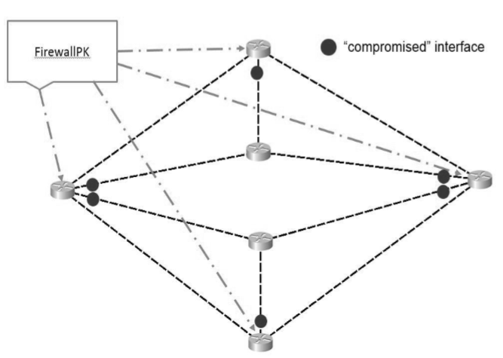
Network Infrastructure

Slide 12
Experimental Evaluation
Cisco onePK API allows the developer to obtain static properties of the network element that he connects to, as well as dynamic properties, such as the CPU usage.
In order to see if there is an increase in the CPU usage, we sent 10000 Internet Control Message Protocol (ICMP) packets and we observed that the CPU utilization raised to a value of 12%.

Slide 13
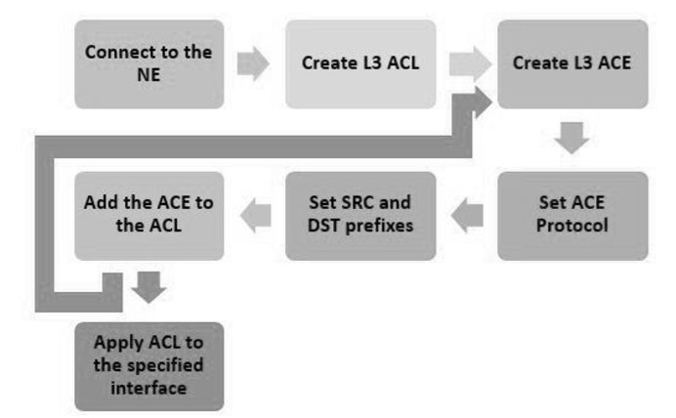
Experimental Evaluation
Filtering different types of network traffic using Access Control Lists

Slide 14
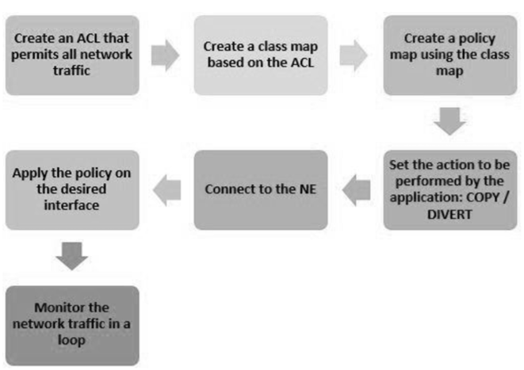
Experimental Evaluation
Real-time monitoring of the network traffic

Slide 15
Conclusion
FirewallPK has been deployed for a framework in course of standardization that implied several limitations, but also provided advantages for a centralized approach of the network topology.
FirewallPK develops a mechanism for collecting different information from the controlled network in real-time and protecting it from the possible security attacks.
Is a new approach to prevent human errors due to manual configuration of hundreds of devices.

Slide 16
Comment
可以增加統計設定時間的比較表
CPU效能視覺化

Slide 17
Reference
Cisco's One Platform Kit (onePK)
DataPath Service Set

