Slide 1
Introduction to OpenNMS
Presenter:Yung-Yu Wang

Slide 2
Outline
What is SNMP (Simple Network Management Protocol)
OpenNMS
Introduce
Install
What can we do
Advance
Demo
Conclusion
Reference

Slide 3
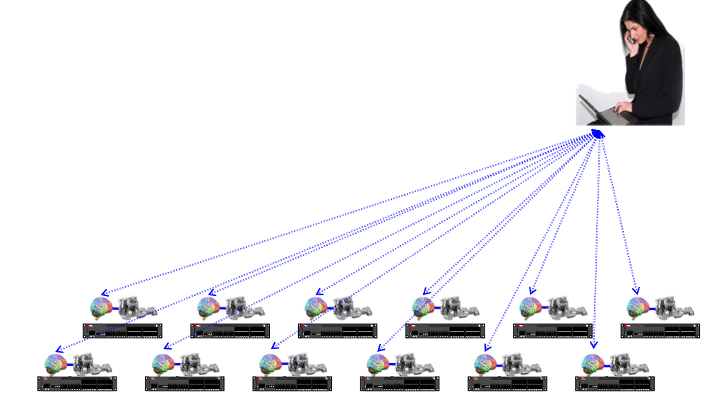
What is SNMP

Slide 4
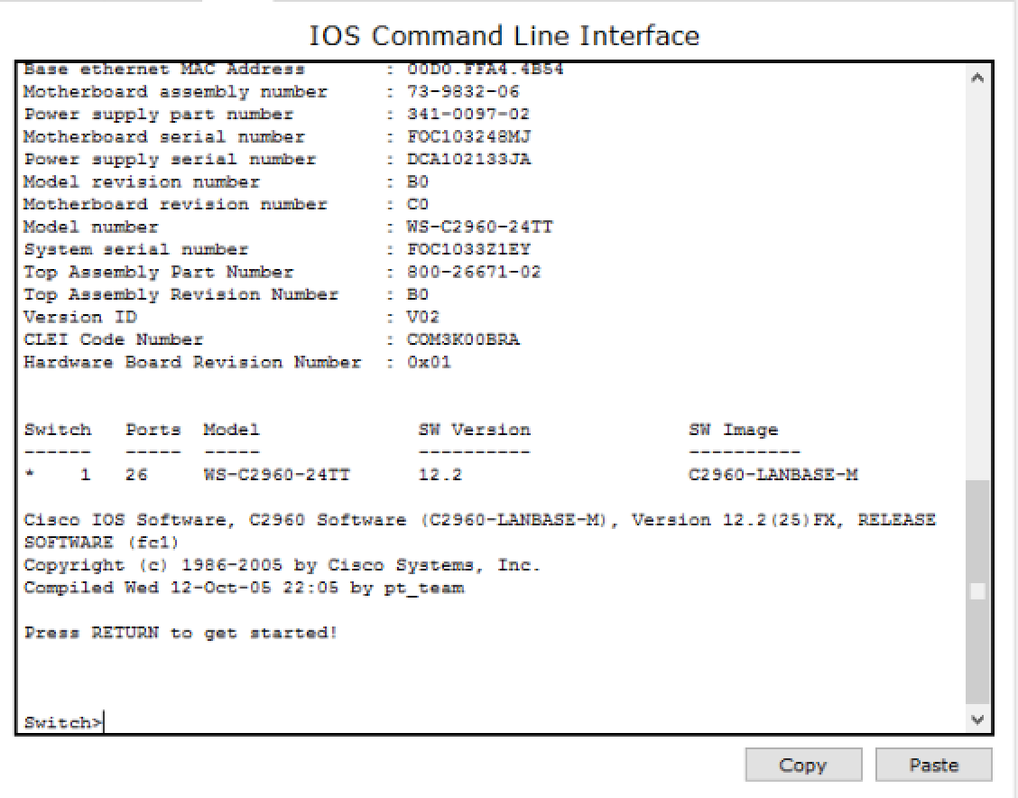
What is SNMP
Telnet (not efficient)

Slide 5
What is SNMP
SNMP Trap : When some events occur on the SNMP server (e.g. switch, router), it can send the alert or notification to the specify SNMP client.
Read : Ask the device(e.g. switch, router) to respond the information
Write : Set the rule to the device(e.g. switch, router)
MIB(Management information base)

Slide 6
OpenNMS
World’s First: The OpenNMS Project was started in July of 1999 and registered on SourceForge in March of 2000. It has years of experience on the alternatives.
Open Source: OpenNMS is 100% Free and Open Source software, with no license fees, software subscriptions or special “enterprise” versions.

Slide 7
OpenNMS (cond.)
Install
Java
PostgreSQL
OpenNMS
Support Platform
Red Hat
Debian
Windows
Mac OS X
Source

Slide 8
OpenNMS (cond.)
What can we do on OpenNMS
detect the status(ICMP,HTTP,SSH,SNMP,etc….)
Scan the subnet
category the server

Slide 9
Demo

Slide 10
Advance usage
MIB compiler
Set the Event to the device

Slide 11
Conclusion
OpenNMS is a powerful network management system, however it doesn’t have the way to send modifying rule to the device manually via SNMP.
Some of the tutorial detail need to be update

Slide 12
Reference
official webpage : http://www.opennms.org/
Installing OpenNMS Network Monitoring And Management Platform On CentOS 7
SNMP wiki
OpenNMS Wiki (official)

