Slide 1
Mint: A Cost-effective Network-address Translation Architecture with Multiple Inexpensive NAT Servers
Chun-Chao Yeh and Chun-Wei Chiu
Department of Computer Sciences
National Taiwan Ocean University
Keelung, Taiwan
2015 Seventh International Conference on Ubiquitous and Future Networks (ICUFN)
1

Slide 2
Outline
Introduction
What is NAT?
What is MAC-rewrite?
What is Multiple NAT?
System design
A. System Architecture and Assumptions
B. Packet Handling
Experiment results
Concluding remarks
2

Slide 3
Introduction
Mint (Multiple Inexpensive Network-address Translation)
All devices require IP addresses in IoT, it is believed that IPv4 (IP address version 4) addresses are going to be exhausted in the near future, wide deployment of IPv6 is unsure.
Cost-effective: provide similar packet-processing power with less cost.
Scalable: allow NAT servers to be added/removed on-demand.
Fault-tolerant: prevent single-point of failure via multiple NAT servers.
Flexible: for example, the approach can effectively support multi-homing connections (multiple connections provided by different ISPs).
3

Slide 4
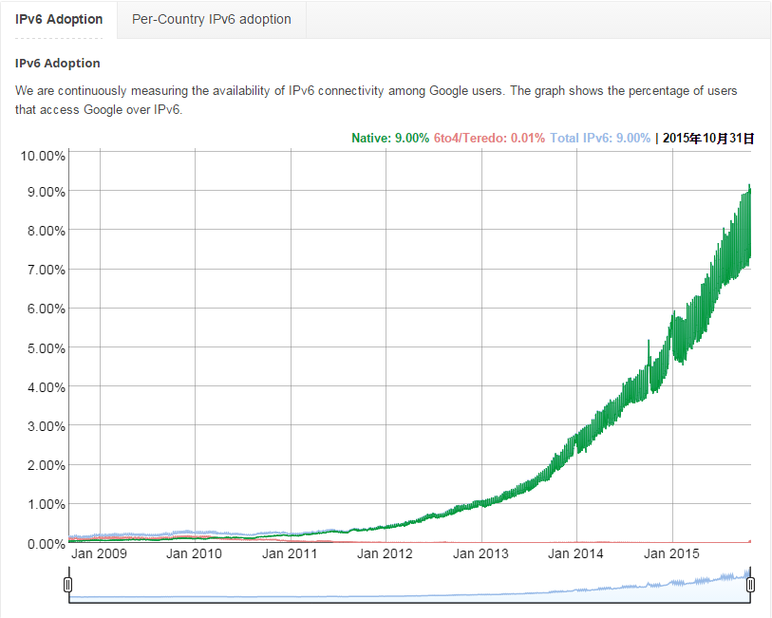
4

Slide 5
NAT: NAT mechanisms enable a group of hosts to share one (external) IP address, while each of the hosts inside the NAT owns their (internal) IP addresses.
5

Slide 6
MAC-rewrite
6

Slide 7
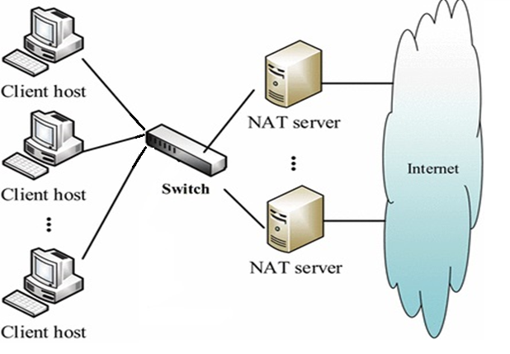
Multiple NAT
7

Slide 8
System design
A.System Architecture and Assumptions
There are two major components in the proposed parallel NAT architecture (Mint-NAT): NAT servers and Mint-NAT gateway. NAT servers:Address translation for each incoming/outgoing packets.
Mint-NAT gateway: As a proxy for all the NAT servers included. Can select a proper NAT server and forward the client packet to the server for NAT services.
8

Slide 9
9

Slide 10
Packet Handling
10

Slide 11
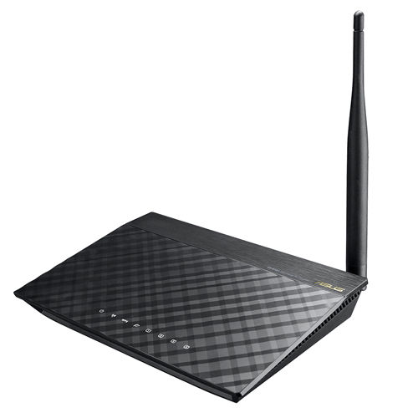
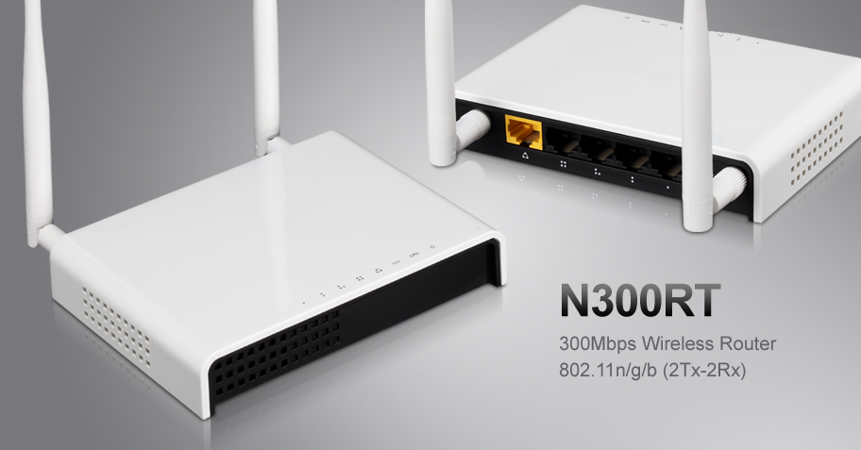
Experiment results
A. System Prototype Implementation and Experiment Setup
three Asus RT-N10+ and one TotoLink N300RT
11

Slide 12
two networks were created, one for the (internal) NAT network (network address 10.0.1.0/24), the other for external network (network address 10.0.2.0/24).Both of the switches are gigabit Ethernet switches (SMC GS801 for SW-l and Asus GX-D1051 for SW-2).
We setup a simple http page with plain text of 644 bytes, which can be transmitted in single Ethernet frame and thus eliminate possible packet partition overhead.
12

Slide 13
P.S Why use 644bytes?
13

Slide 14
14

Slide 15
B. Experiment Results
(with one, two, and three NAT devices (Asus RTN10+) respectively) are 90, 180, and 270 connections per second. The case for four NAT devices (4-nat) resulted in a rate of 320 connections per second.
15

Slide 16
16

Slide 17
Concluding remarks
In this paper, we present a cost-effective NAT service architecture based on multiple NAT servers.
The proposed system architecture, named Mint, utilizes MAC-rewrite techniques and integrates a set of (inexpensive) NAT servers to share the NAT operation loads for each network packets passing between the NAT networks.
We demonstrated the design concept with a prototype system, which includes four NAT devices and a NAT gateway.
Experiments on the prototype system show that the sustained http connection rate can grow linearly whenever more NAT devices being added to the system.
17

Slide 18
Thank you for listening Q&A
18

