Slide 1
Version Control System
Jia-Wei Lin
20151117

Slide 2
Outline
Background
Introduction
Version Control Software
Term - Repository
RCS – Introduction
CVS – Introduction
CVS – Create a repository and add a project
CVS – Checkout files
CVS - Remote Repositories
Summary

Slide 3
Background
In my project team, we are always coding, so the version control system is very helpful for us.
We had built a project in our own server, and there were already some files of source code there. However, we have to transfer these code to the other server.
Version control system can help us to make the transfer mission more easily.

Slide 4
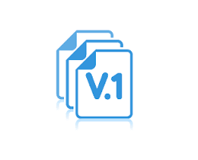
Introduction
A version control system (also known as a Revision Control System) is the files for the source code of programs with monitored access.
Every change made to the source is tracked, along with who made the change, why they made it, and references to problems fixed, or enhancements introduced, by the change.
Undo is not always work.
Notes:
為什麼不用備份的就好? Ans : 版本控制只儲存你修改的部分,而且是以文字的方式儲存,可以節省你的memory

Slide 5
Version Control Software
4 types of software that is used commonly today :
-RCS (Revision Control System)
-CVS (Concurrent Versions System)
-SVN (Subversion)
-Git
Advanced
Notes:
RCS : 1982 CVS : 1990 Git : 2006

Slide 6
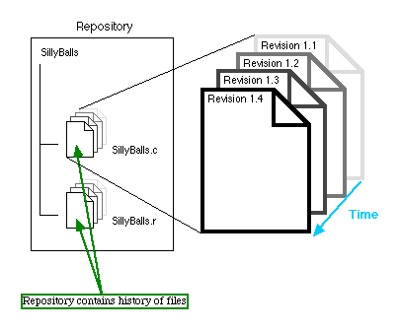
Term - Repository
Repository is a stored location that tracks every change was made to every file and create a complete history of the evolution of the development project.

Slide 7
RCS - Introduction
RCS use a lock-modify-unlock paradigm for managing changes to a file.
RCS is only used to control the single file.
Basic Command :
co -l file : Checkout file and "locked" from use by other programmers.
co –u file : Checkout file and “unlocked”.
ci file : Check-in(Commit) your changed in file.
rlog file : Read the modified record.

Slide 8
CVS - Introduction
Improved from RCS.
CVS supports simultaneous access and modification of files using a copy-modify-merge paradigm.
User can check out a file and make modifications even though another person may be in the process of modifying it as well.
Every time a file is checked in, it is merged with the most recent copy in the CVS repository.

Slide 9
CVS – Create a repository and add a project
The first step in using CVS to manage your source code is creatint a repository.
cvs –d ~/cvsroot init
Tells the system where your default repository.
export CVSROOT=$HOME/cvsroot
export CVSEDITOR=vim
Add your Project
cd project
cvs import –m “MyProject” project <name> <version>

Slide 10
CVS – Checkout files
Now that the source files have been imported, you can check files in and out as needed to make the appropriate modifications.
cvs checkout directory_name

Slide 11
CVS – Commit the file or directory
If you have modify or create a new file, you can use commit to make your change take affect.
cvs commit –m “Message” filename
Notice that all RCS files (files that end with ,v) are created with read-only access, and they record all your modified history.
If you want to commit all directory, using the command add.
cvs add directory_name

Slide 12
CVS – Update
If someone has modified the file and committed the new version, you can use update to get the newest version.
cvs update
This command will update all file in your working directory.
Update will modify your old file to correspond to the file in repository.
→M means Modify.
Notes:
Conflict : http://puremonkey2010.blogspot.tw/2010/12/linux-linuxcvs.html

Slide 13
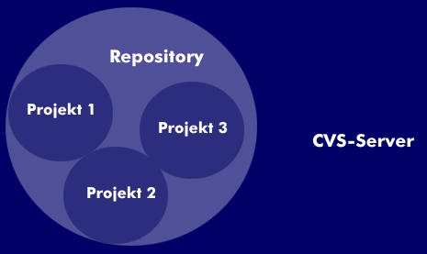
CVS - Remote Repositories
CVS-Client can access the repository by SSH to connect CVS-Server.
We can check out a project from the different filesystem with the -d option, which tells CVS to use a different repository.
cvs -d :ext:username@<ip address>:<cvsroot path> checkout projectname
Notes:
Server and Client 只是相對的概念，只要有安裝CVS的都可以做為Server端或client端

Slide 14
Summary
It is important to make Version Control to track your code in your project, and CVS is a helpful and powerful software.
CVS is convenient for the team in a project which has many source code and files. If you only modify a single file, RCS is a better choice than CVS.
CVS still had some defects(e.g. Directory has no version control), so SVN and Git were developed to replace CVS.

