Slide 1
Introduction to D3.js
Kai – Po
20151124

Slide 2
Outline
Motivation
Content
concept
condition
Application
Demo
Conclusion

Slide 3
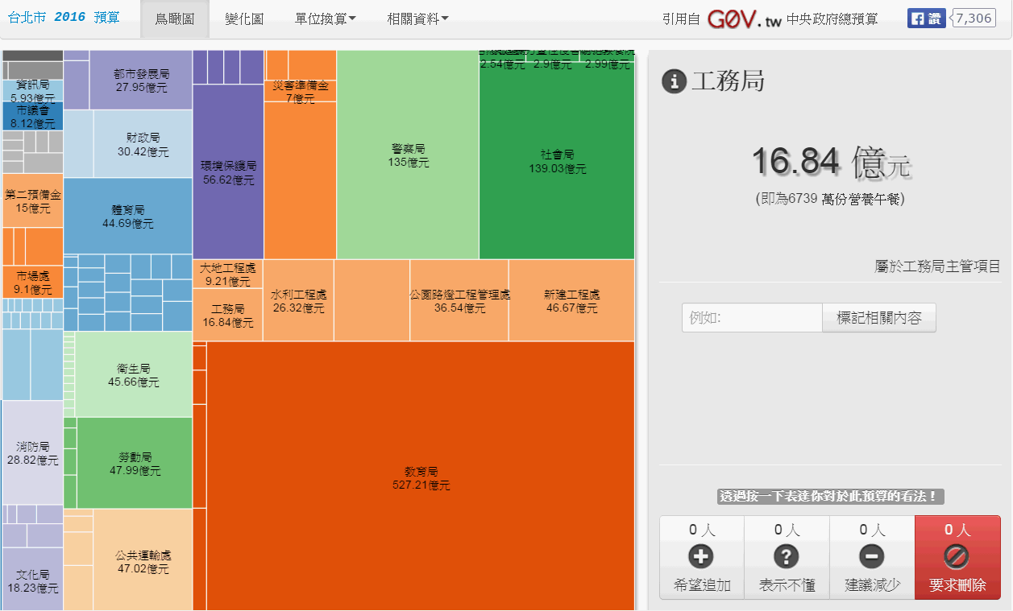
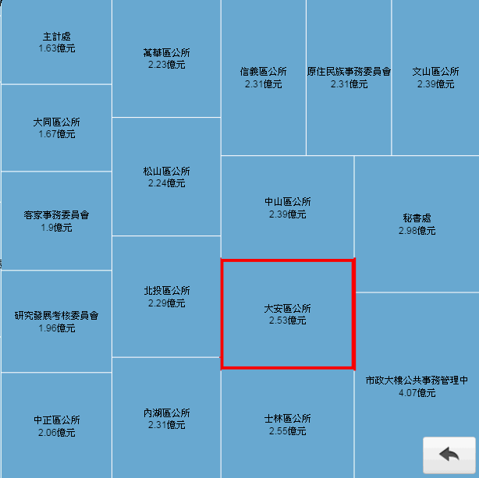
Motivation-grand view
Hyperlink

Slide 4
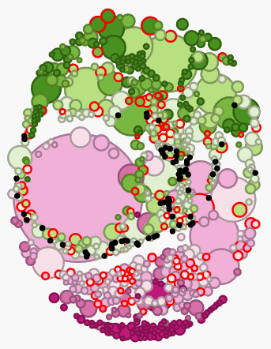
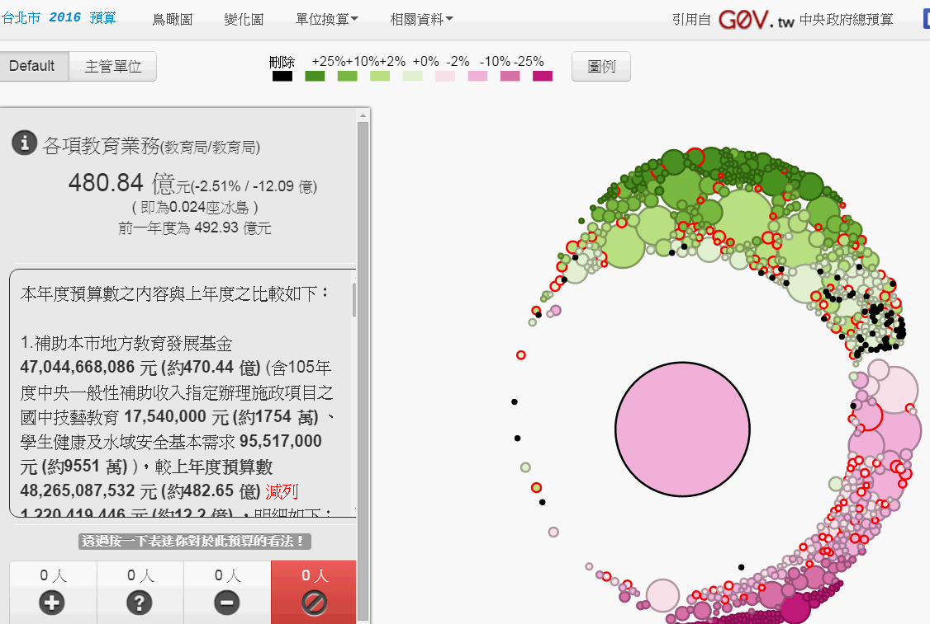
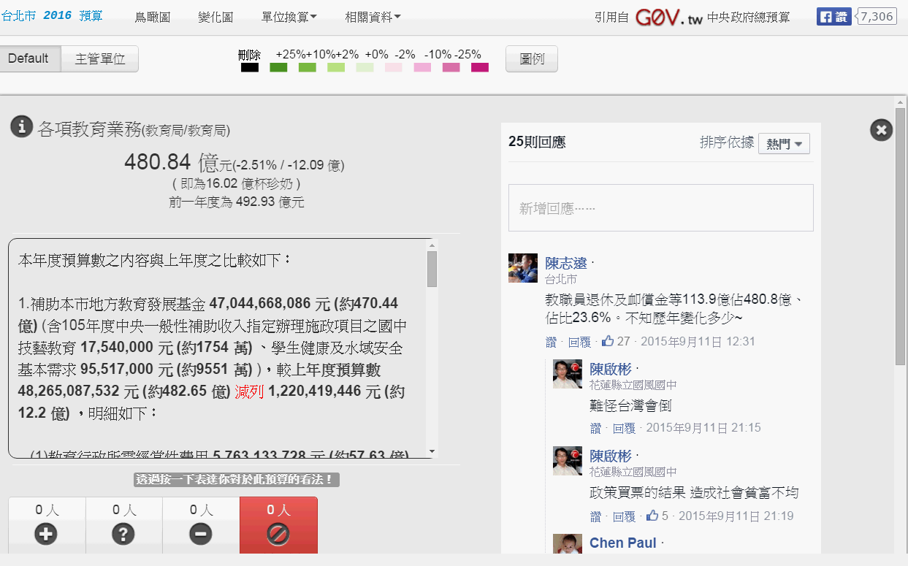
Motivation-literal detail
When I choose the biggest circle .
Website will show up some information which concern of this circle.
Hyperlink choose “Default” at the upper left corner

Slide 5
Content-concept
D3 = Data-Driven Documents.
D3.js is a js library which is used to dynamically display data.
Bind arbitrary data to a Document Object Model (DOM).

Slide 6
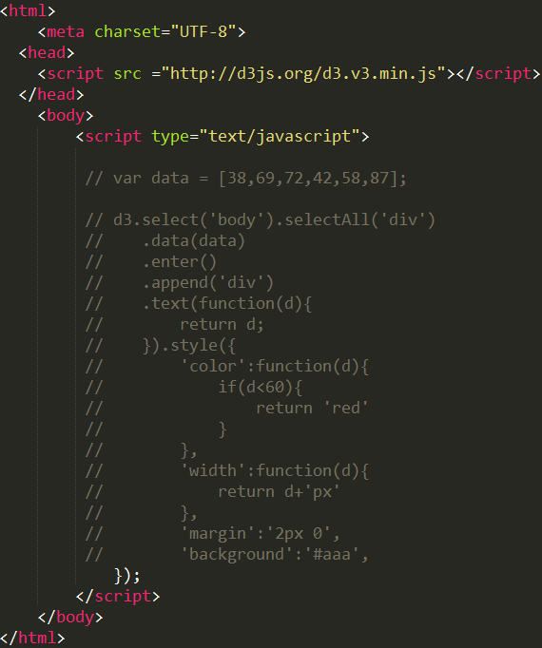
Content-condition
Link directly to the latest version.
Write
Javascript code in the <script>.

Slide 7
Application-crime
使用之開放資料
1. Queensland Open Data site
Hyperlink
choose ”Brisbane CBD” at the bottom of the page

Slide 8
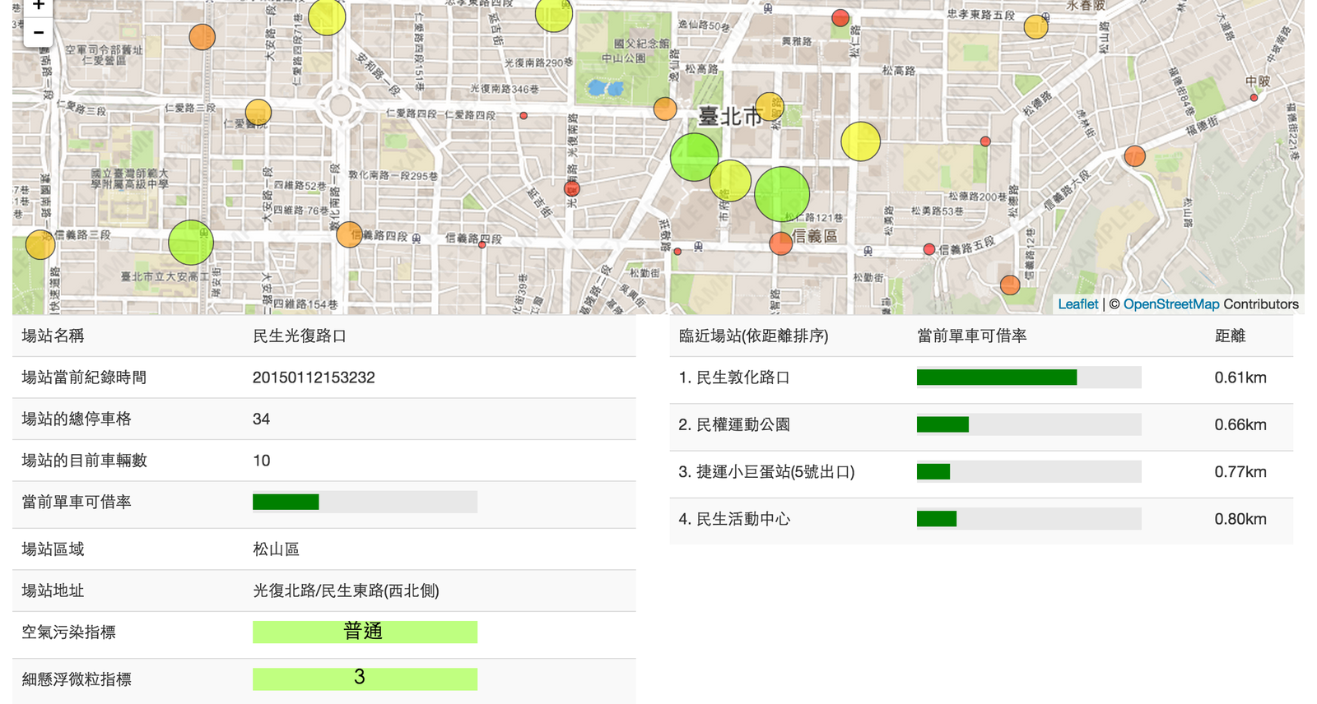
Application-YouBike
使用之開放資料
1. YouBike 微笑單車（JSON）
2. 臺北市臺北旅遊網-景點資料
3. 空氣品質即時污染指標

Slide 9
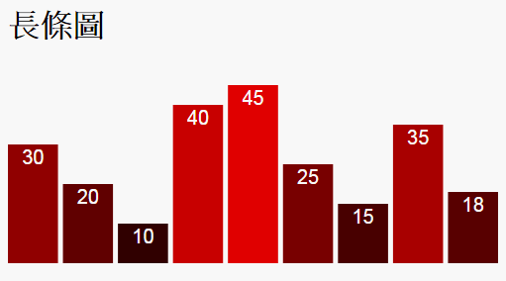
Demo-1-1
Environment Setup:
SVG size
bar_padding
data (array,csv,json)
SVG (Scalable Vector Graphics)
JSON(JavaScript Object Notation)

Slide 10
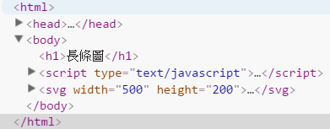
Demo-1-2
SVG Setup:
Add element to <body>
Add element “svg”
Attribute “width”
Attribute “height”

Slide 11
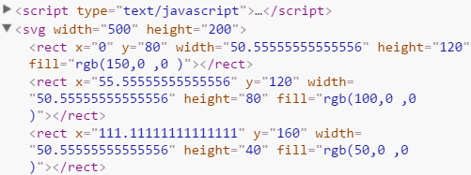
Demo-1-3
Rectangle setup:
Choose “rect” add to <svg>
Data from dataset
Filter data which represent “rect” *(run 9 times)
Bind all data to “rect”

Slide 12
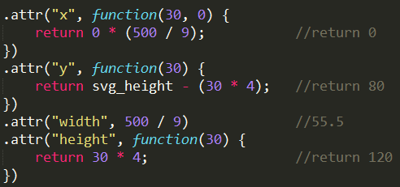
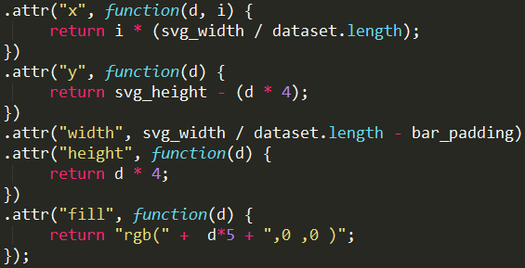
Demo-1-4
Draw rectangle :
Coordinate setup (x,y)
Rectangle size (height,width)
Fill color (RGB)
First case “30”

Slide 13
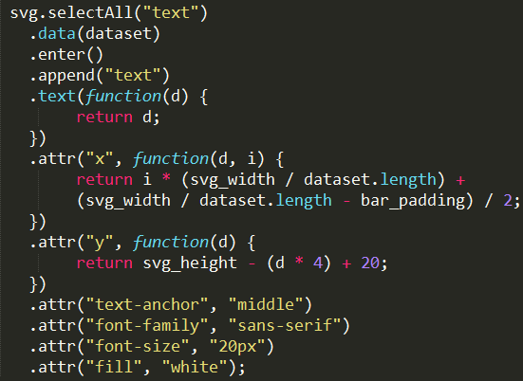
Demo-1-5
Draw text:
Text content
Coordinate setup (x,y)
Text attribute
Fill color

Slide 14
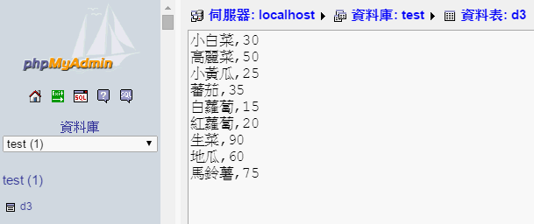
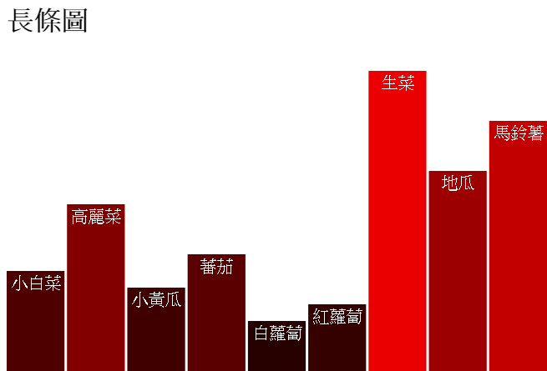
Demo-2

Slide 15
Conclusion
I want to know the operation of the D3.js. Apply it to complex things , for instance , Tai-i cost analysis.
See the data relationship that I can’t see before.

