Slide 1
Load Distribution of an OpenFlow Controller for Role-based Network Access Control
Takayuki Sasaki, Y oichi Hatano, Kentaro Sonoda, Yoichiro Morita, Hideyuki Shimonishi, Toshihiko Okamura NEC 1753 Shimonumabe Nakahara-ku Kawasaki Japan
2013 15th Asia-Pacific
Network Operations and Management Symposium (APNOMS)

Slide 2
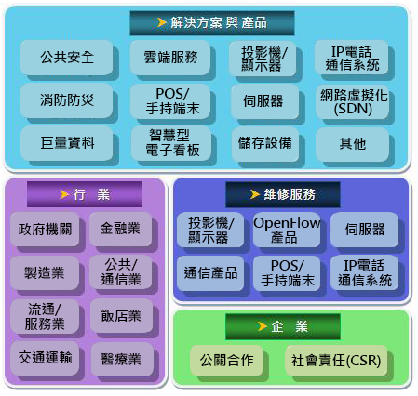
Company introduction

Slide 3
Outline
Introduction
Background knowledge
OpenFlow
Role Based Access Control(RBAC)
Ideas
Approaches of Performance Improvement
System Architecture
RBAC rule conversion
Performance evaluation
Conclusion

Slide 4
Introduction
Network attacks have been coming from outside networks such as internet, and the attacks are prevented by a firewall at the border between inside and outside of a network.
But in recent years, the attacks also have been coming from internal network due to malware infected clients and malicious insiders.

Slide 5
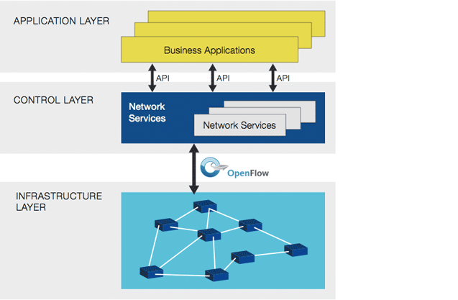
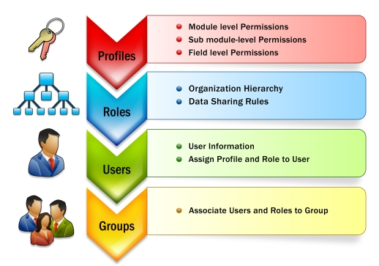
Background knowledge
OpenFlow
Role Based Access Control(RBAC)

Slide 6
OpenFlow
In the OpenFlow architecture, the OpenFlow controller is a single point to make decisions, thus in large network the controller must process all inquiries from OpenFlow switches. Therefore, in large network, the OpenFlow controller may become a bottleneck of the system.

Slide 7
Role Based Access Control(RBAC)
RBAC defines roles as collections of rights, and roles are assigned to users, then it performs access control on the basis of the assigned roles. To reduce difficulty of policy writing, role definition and role assignment can be specified by different administrators
However, the proposed system has a scalability problem due to centralized architecture, because the OpenFlow controller is a single point to be responsible for control of whole network. Specifically, it monitors all traffics by receiving queries from OpenFlow switches, and it performs policy decision and returns a result of the decision to the OpenFlow switches.

Slide 8
Ideas
Policy decision at switch side: This idea distributes the load of the controller to switches. OpenFlow architecture performs all access control decisions at the controller, on the other hand the proposed architecture performs the decisions at switch side according to pre-distributed rules.
Pre-distribution of the rules: For temporal load balancing, the controller dynamically distributes only role assignments to the switches, and role definitions are distributed in advance.

Slide 9
Approaches of Performance Improvement
Well-known approaches used for distributed systems
Horizontal load distribution：This approach improves the controller performance using parallelization techniques.
Solution：Multiple controller architecture
Vertical load distribution：Based on this approach, the policy decision functionality can be performed by OpenFlow switches for reducing the controller load.
Solution：Functional load distribution to the switch
Temporal load distribution： This approach distributes a peak load by preprocessing. Proactive mode is a kind of this approach, and it distributes rules in advance for reducing queries from OpenFlow switches , but access control rules can not be distributed in advance.
Solution：Temporal load distribution of rule distribution

Slide 10
System architecture

Slide 11
RBAC rule conversion

Slide 12
Performance evaluation
estimate the size of ACL rules and RBAC rules：
A user has only one role and each server is specified by one role.
The rules are specified using IP addresses.
Ignore port numbers of TCP and UDP.
300 researchers/ 30 roles
Size of ACL rules = C * P ; 7695=517 * P ; P ≈ 14.9
Size of RBAC rules = C + R * P ; 517(PA) + 30 * 14.9(UA) = 964
Rule reduction ratio = (7695 -964)/7695=87%
C ：number of clients ;517
P ： average number of servers allowed by a role
R ： number of roles ; 30

Slide 13
Performance evaluation

Slide 14
Conclusion
According to experiment result, they estimated the number of rules and identified that RBAC reduces rule size by 87% , thus these switches can store all rules in this case. Furthermore, the half of RBAC rules (permission assignments) can be distributed in advance, thus their architecture reduces the size of dynamically distributed rules by 93% ((7696-517)/7695)compared with ACL rules.

Slide 15
Policy Decision by OpenFlow Switches
ACL comprises tuples of (source IP address, destination IP address, action), thus the rule size is：
size of ACL = # of src IP addresses * # of dest IP addresses = # of clients * # of servers
As for RBAC, assuming a simple situation where a user has one role and a server is specified by one role, the size of RBAC rules is sum of user assignments (UA) and permission assignments (PA). Therefore, its size is calculated as follows.
size of RBAC = # of UA+# of PA = # of clients + # of servers
The rule size of the RBAC is the sum of the clients and servers, on the other hand, the size of ACL is the product of those. Therefore, we can reduce rule size using RBAC.
#=size

Slide 16
Pre-distribution of RBAC Rules
In the proposed architecture, a user's role is associated with a clients IP address at the authentication step. Thus, user assignments (client IP address and role) need to be distributed after the user authentication.
On the other hand, permission assignments can be distributed before the authentication, because permission assignments do not contain information about users (clients), and contain only objects (servers) and actions.

