Slide 1
Introduction to NP-complete . The relationship between Tai-yi schedule and Memory management .
Kai – Po
20160128

Slide 2
Outline
Motivation
Classification problem
NP
Relationship between Tai-yi schedule and Memory management
Conclusion

Slide 3
Motivation
These two nouns are listen from earlier our Tai-yi meeting.
I want to realize them not only for Tai-yi problem but also for the similar problem in the future.

Slide 4
Classification problem
What problem is difficult?
How to describe the problem?
String , Language
NP problem
P ⊆ NP
NP-complete ⊆ NP-hard

Slide 5
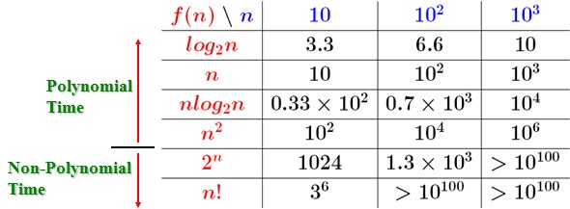
Polynomial time
Definition :
Its running time is upper bounded by a polynomial expression in the size of the input the algorithm.
i.e., T(n) <= O(n^{k}) for some constant k.

Slide 6
P vs NP
 | Deterministic | Non-deterministic
Polynomial time | P | NP
Deterministic : (Permitting at most one next move at any step in a computation).
Non-deterministic : (Permitting more than one choice of next move at some step in a computation) .

Slide 7
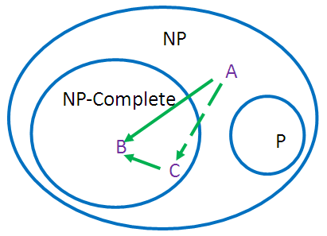
NP-Complete vs NP-Hard
NP-Complete
It solutions are sufficient to deal with any other NP problem in polynomial time.
NP-Hard
Problems that are NP-hard do not have to be elements of NP; indeed, they may not even be decidable.

Slide 8
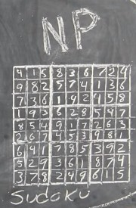
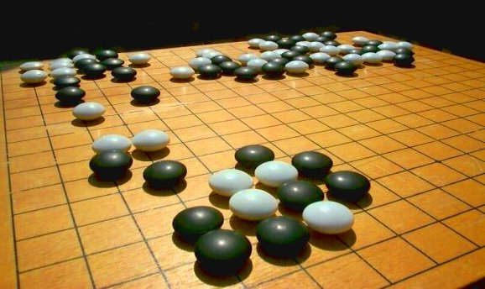
Overview e.g.
P :
Finding shortest path between two point
Sorting
NP-Complete :
Sudoku
Knapsack problem
Complete coloring
NP-Hard :
Win Go games

Slide 9
Useful points about Memory management
The instruction being executed must be in physical memory.
Virtual memory allows files and memory to be shared by two or more process.
Reference bit and Modify bit
Queue
FIFO
Replacement

Slide 10
The character of the Tai-yi schedule
Move function
Each order can be finished in finite time
No state problem about frequency
recently use and not recently use
Priority stack
group ID > approaching ages

Slide 11
Metaphor
Demeter | Memory management
Order | Instruction
Greenhouse | physical memory
PHP program | Queue
Move | Replacement
Queue
Complete list
Swap out
0
1
2
3
4
5
6
7
8
9
10
11
12
13
14
15
Swap in

Slide 12
FIFO page-replacement algorithm

Slide 13
Conclusion
NP
Guess stage
Verification stage
Memory management
Actual details
Algorithm choose
FIFO
Least action

