Slide 1
Using RRDtool to graph sensor's data
Jia-Wei
2016/02/02

Slide 2
Outline
Introduction of RRDtool(Round Robin Database tool)
Round Robin Database
CF (Consolidation Functions) and RRA (Round Robin Archives )
Using RRDtool to graph sensors’ data
Equipment
Step (1)
Step (2)
Step (3)
Demo
Conclusion

Slide 3
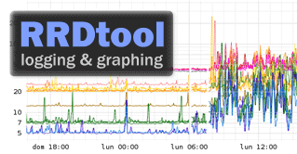
Introduction of RRDtool
RRDtool(Round Robin Database tool) is the OpenSource high performance data logging and graphing system for time series data. RRDtool can be easily integrated in shell scripts, Python or TCL applications.
Notes:
Time Series Data : Every piece of data is associate with a point in time

Slide 4
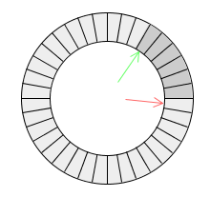
Round Robin Database
In case of linear databases, new data gets appended at the bottom of the database table. Thus its size keeps on increasing.
RRDtool’s data is added along the perimeter. When new data reaches the starting point, it overwrites existing data. This way, the size of an RRDtool database always remains constant.
Notes:
為了remain constan => CF and RRA

Slide 5
CF and RRA
Consolidation Functions(CF) determine how the data is converted to other timescales.
Round Robin Archives (RRA) directive defines how many values the RRD database will archive and for how long. => RRA guarantees that the RRD does not grow over time and that old data is automatically eliminated.
Minimum | Maximum | Average | Last
Using different consolidation functions (CF) allows you to store exactly the type of information that actually interests you in RRA.

Slide 6
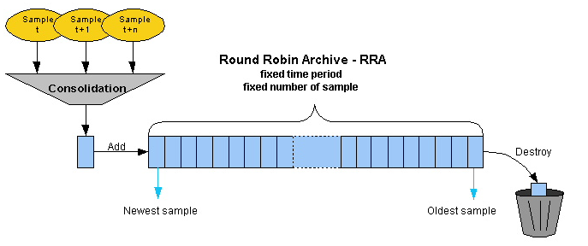
CF and RRA (cont.)
Notes:
Archive KK[ˋɑrkaɪv] 檔案；文件；記錄

Slide 7
Using RRDtool to graph sensors’ data
Step 0 : Equipment and sensors’ data
Step 1 : Create RRD file
Step 2 : Cron job and rrdtool update (adding data to the rrd database)
Step 3 : Graph

Slide 8
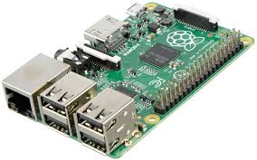
Equipment
Digital relative humidity and temperature sensor AM2302/DHT22
Raspberry Pi
Goal : Monitor the temperature and relative-humidity in Lab 409
Notes:
http://ms14.voip.edu.tw/~wei0923/Files/Sensor/DHT22/

Slide 9
Using RRDtool to graph sensors’ data – (1)
Interval time
300 s = 5 mins
Step 1 : Create RRD file
rrdtool create test.rrd --start N --step 300 \
DS:temp:GAUGE:600:0:50 \
DS:humi:GAUGE:600:0:100 \
RRA:MAX:0.5:1:288
RRA:AVERAGE:0.5:1:288
Now
GAUGE : Absolute data that shouldn’t be modified in any way by rrdtool
Add a Data Source called temp which has values between 0 and 50 ( large enough for inside temp in degrees Celsius ) .
heartbeat timeout
Add a Data Source called humi.
CF
1 specifies how many steps should be averaged before storing the final value.
288 means the number of steps that we will store in database
1*300s*288 = 86400s = 1 day !
Notes:
The heartbeat determines how many undefined values are tolerated.
The step size specifies how often data samples are saved.
0.5 is an internal resolution value and should _not_ be changed.

Slide 10
Using RRDtool to graph sensors’ data – (2)
Step 2 : Cron job and rrdtool update (adding data to the rrd database)
Put rrdtool update commands in shell script
rrdtool update test.rrd N:$temperature:$humidity
Put the script in cron job and execute every 5 minutes
*/5 * * * * sh /home/update.sh
c. After you finishing the works above, the data would be added in rrd database every 5 minutes!
Value 1
Value 2
Notes:
N : use current time as timestamp

Slide 11
Using RRDtool to graph sensors’ data – (3)
Step 3 : Graph
rrdtool graph $now-Temp.png -w 785 -h 120 \
-a PNG \
--title "Temperature in Lab 409" \
--vertical-label "Temperature (°C)" \
DEF:VAR=test.rrd:temp:MAX \
LINE2:VAR#ff0000:"Temperature" \
COMMENT:"Last Updated - $now"
'GPRINT:temp:MAX:Temp Max \: %2.0lf' \
'GPRINT:temp:MIN:Temp MIN \: %2.0lf' \
Width and Heigh
X axis
Define a variable VAR from the database we will use to graph.
Notes:
Printf : http://linux.vbird.org/linux_basic/0330regularex.php#printf

Slide 12
1/30 Sat. 15:30 ~ 1/31 Sun. 15:30

Slide 13
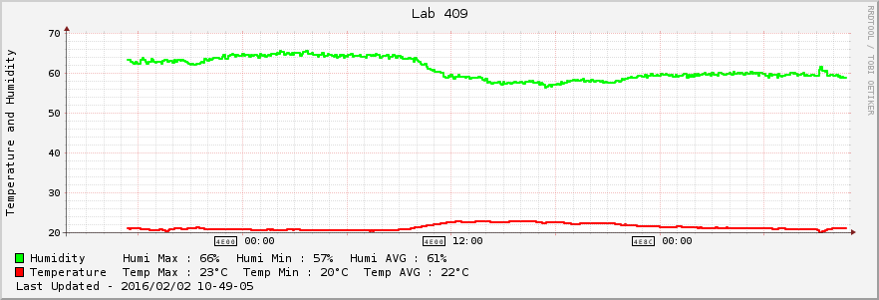
Today I arrived in Lab at 9:00 a.m.
1/31 Sun. 18:00 ~ 2/2 Tue. 11:00

Slide 14
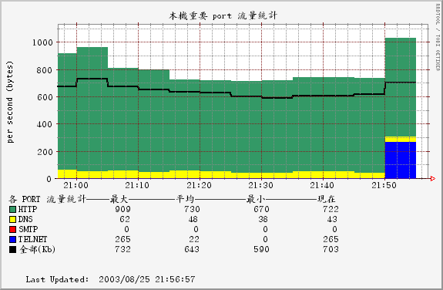
Conclusion
RRDtool
RRDtool is very flexible. You can freely determine how many data you want to show in your graph.
MRTG is simpler and more easier to use than RRDtool , but there are some drawbacks in MRTG :
Cannot combine different sensors into one graph to analysis. A graph only shows the data from a single sensor.
Cannot choose the interval that you want.
MRTG

