Slide 1
The correlation analysis of the economic various between Taiwan and China : The new proving of wavelet coherence analysis
Presenter: Ken

Slide 2
Introduction
What is wavelet
What different between wavelet and fourier
Why do we choose wavelet to analyze
How to analyze the economic various

Slide 3
Background Knowledge
Wavelet can find out what we can`t get with Fourier transform.
Fourier can give us some information, frequency and amplitude, but can`t get the time information.
Wavelet can provide frequency and time simultaneously.

Slide 4
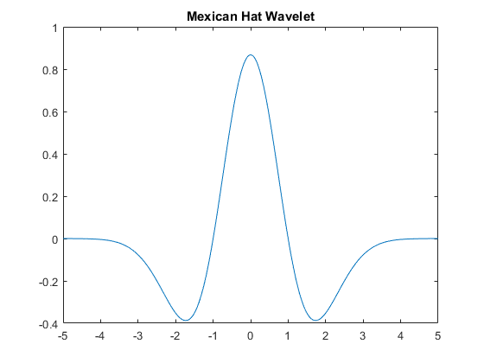
Wavelet
Mexican hat wavelet
lb = -5;
ub = 5;
N = 1000;
[psi,xval] = mexihat(lb,ub,N);
Reference:
https://www.mathworks.com/help/wavelet/ref/mexihat.html?requestedDomain=www.mathworks.com

Slide 5
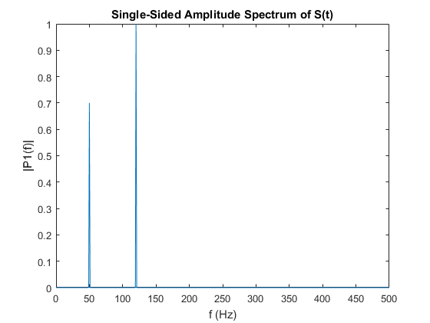
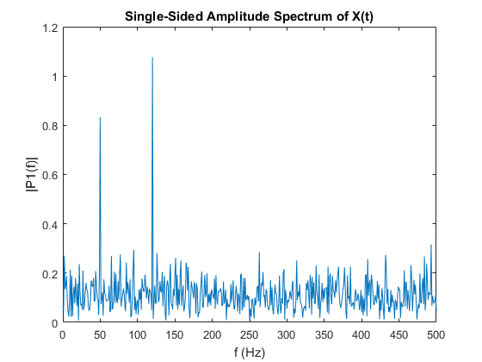
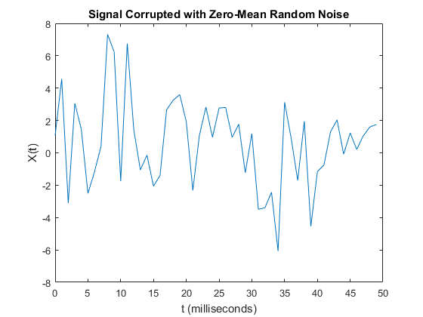
Fourier transform
Fs = 1000;
T = 1 / Fs;
t = 0:T:1;
S = 0.7*sin(2*pi*50*t) + sin(2*pi*120*t);
X = S + 2*randn(size(t));
Y = fft(X);
Reference:
https://www.mathworks.com/help/matlab/ref/fft.html

Slide 6
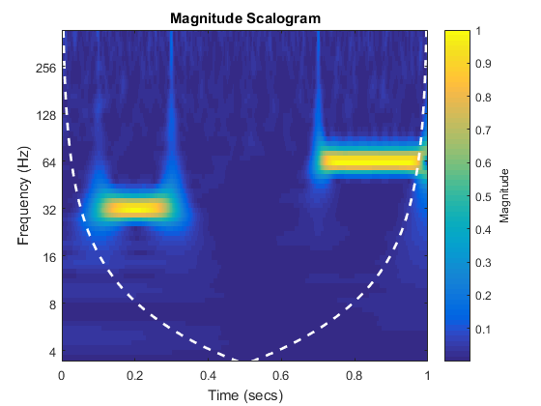
Wavelet transform
Fs = 1000;
T = 1 / Fs;
t = 0:T:1;
x = cos(2*pi*32*t).*(t>=0.1 & t<0.3)…
…+ sin(2*pi*64*t).*(t>0.7);
wgnNoise = 0.05*randn(size(t));
x = x + wgnNoise;
cwt(x,1000)
Reference:
https://www.mathworks.com/help/wavelet/ref/cwt.html?searchHighlight=cwt

Slide 7
Basic Testing
Noisy testing
t=linspace(0,1,500);
f = 10;
x1 = pi/2;
A = 1;
B = 0.5;
y(:,1) = A*sin(2*pi*f*t)…
…+ B * randn(size(t))
y2(:,1) = A*sin(2*pi*f*t+x1)…
…+ B * randn(size(t))
We use three times testing to check the wavelet analyze
Random Testing
x = 0.5*randn(1,500);
y = 0.5*randn(1,500);
Phase testing
t=linspace(0,1,500);
f = 10;
x1 = pi/2;
A = 1;
y(:,1) = A*sin(2*pi*f*t)
y2(:,1) = A*sin(2*pi*f*t+x1)

Slide 8
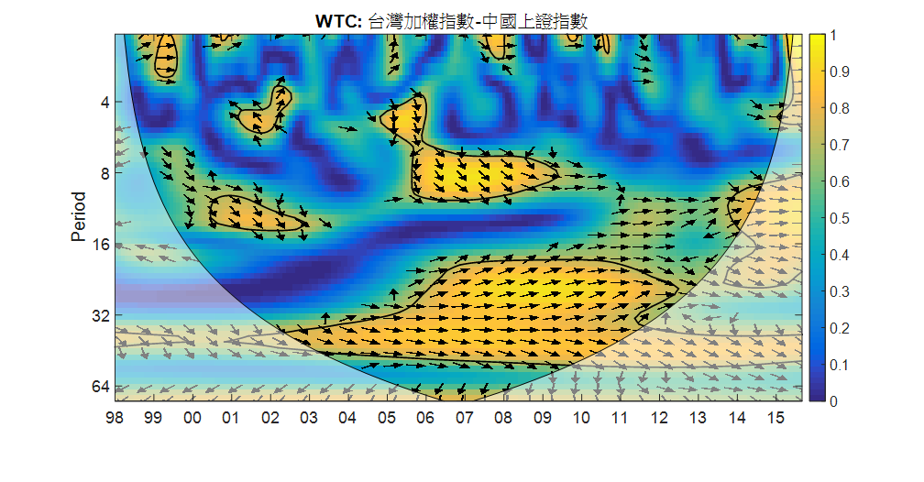
Results
Since 2004, Taiwan has invested 70 billon us dollar. The proportion of overseas investment had risen to 75%.
1989 / 6
The Management on Goods Imported from Mainland China
1990 / 8
Regulations Governing Permission of
Trade Between Taiwan Area and Mainland Area

Slide 9
Questions

