Slide 1
A SDN based fully distributed NAT traversal scheme for IoT global connectivity
Gijeong Kim ,Junho Kim ,Sungwon Lee Kyunghee University
Information and Communication Technology Convergence (ICTC), 2015
28-30 Oct. 2015
Conference Location : Jeju
1

Slide 2
Outline
Introduction
NAT (Network Address Translation)
PAT (Port Address Translation)
Related Works
SDN Based Fully Distributed Nat Traversal Scheme
SDN Based IoT Global Connectivity Management Architecture
Conclusion
2

Slide 3
Introduction
We propose SDN based fully distributed NAT traversal scheme, which enable to distribute centralized NAT processing from NAT gateway to devices. The proposed scheme uses SDN switch and SDN controller instead of NAT gateway and relay server. The main procedure is three steps.
3

Slide 4
NAT (Network Address Translation)
Existing NAT solves to IP address exhaustion problem binding private IP address and public IP address, and NAT traversal such as hole punching scheme enables to communicate End-to-End devices located in different private networks.
4

Slide 5
PAT(Port Address Translation)
Connecting type: many-to-many.
A public IP address can connect 64500 TCP/UDP connections private IP addresses at the same time.
Why 64500 ?
Port Numbers are 16-bit binary numbers and we have 65535 port number available.
5

Slide 6
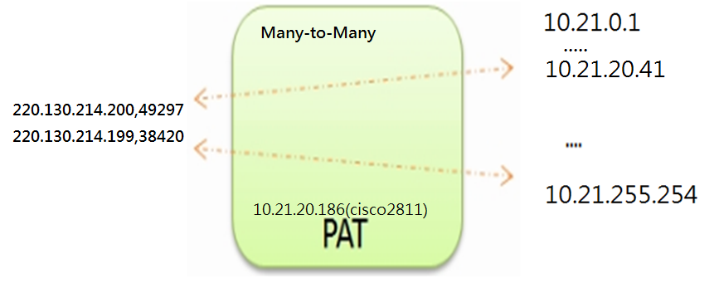
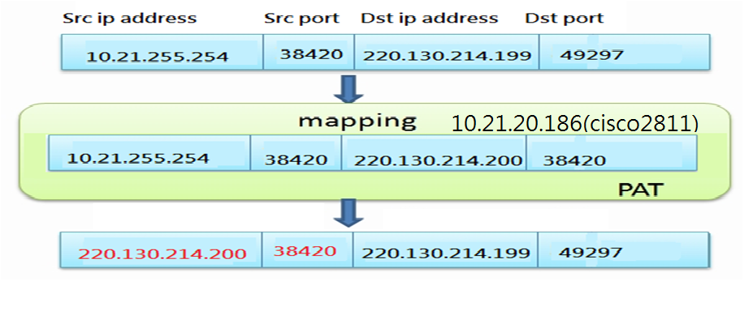
PAT
Figure 1
Figure 2
6

Slide 7
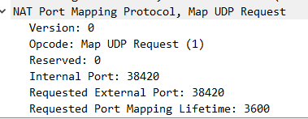
Figure 3
7

Slide 8
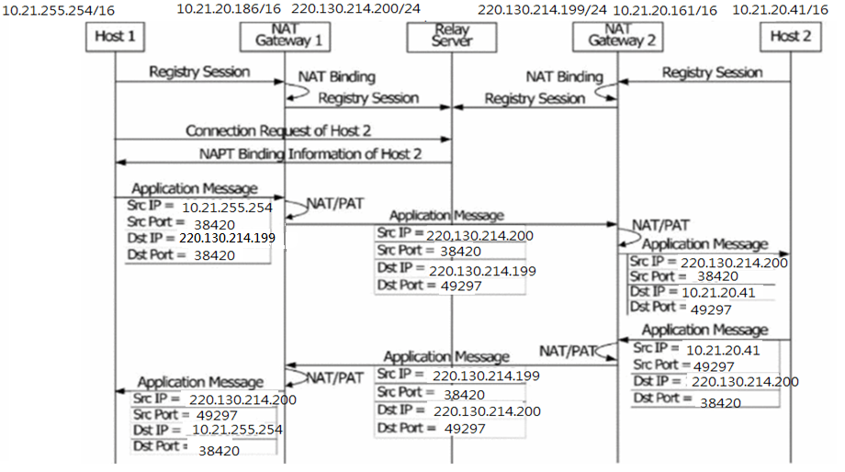
Related Works (P2P mechanism)
Figure 4
8

Slide 9
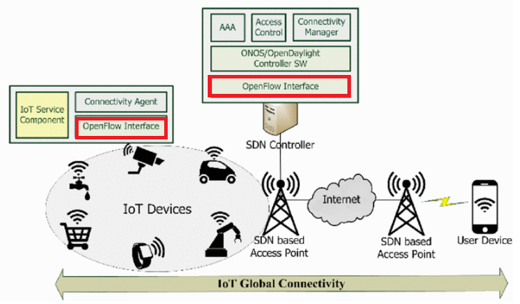
SDN Based Fully Distributed Nat Traversal Scheme
Figure 5
9

Slide 10
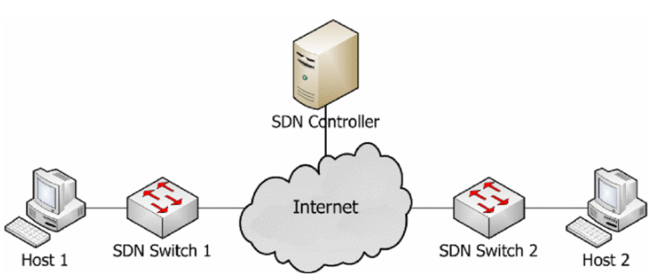
Figure 6
10

Slide 11
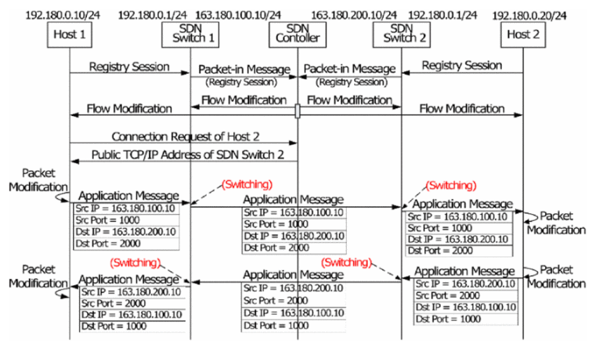
SDN Based Iot Global Connectivity Management Architecture
Figure 7
11

Slide 12
First step
The first step is a procedure of forwarding TCP port and IP address information of host which located in different private networks.
Host 1 and Host 2 forwards session registration message included own information of private IP address and TCP/UDP port to SDN switch, and this step is similar to hole punching NAT traversal scheme.
SDN Switch forwards the message to SDN controller using Packet-in message in OpenFlow.
12

Slide 13
First step
SDN controller designates public IP address and TCP/UDP port to use each host, and forwards flow modification message to SDN switch and hosts in accordance with the designation.
The flow modification message which forwarded hosts consists of rule and action about packet modification, which is transforming private IP address and TCP/UDP port of hosts to public IP address and TCP/UDP port designated by SDN controller.
The flow modification message which forwarded SDN switch consists of rule and action about packet forwarding, which is forwarding a packet received from host to SDN switch and forwarding a packet received from Internet to host matched flow table.
13

Slide 14
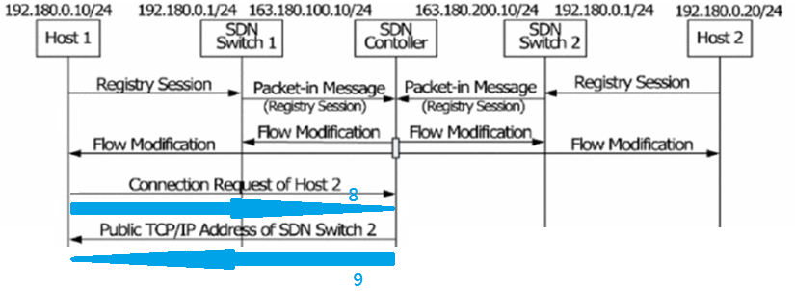
Second step
The second step is a procedure of requesting information of remote host. Source host requests the information of TCP/IP information of remote host to SDN controller.(Because every device have Openflow interface, host can send packets on Openflow protocol)
SDN controller respond information of public IP address and TCP/UDP port of remote host designated by session registration.
14

Slide 15
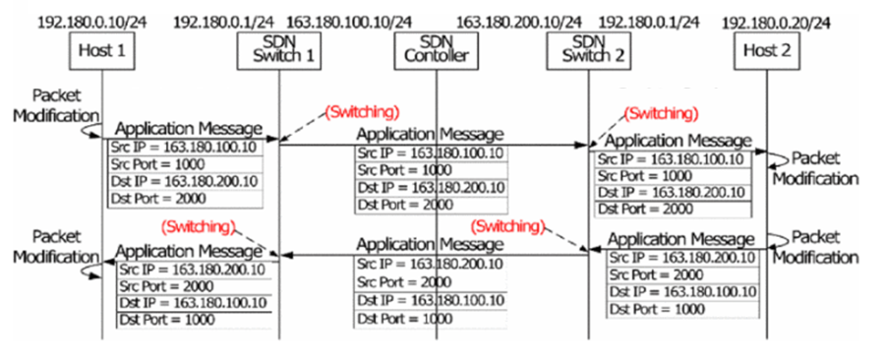
15

Slide 16
Third step
The third step is a procedure of P2P communication between hosts located in different private networks. It enables P2P communication by forwarding packet of source host to remote host, which packet is configured public IP address and TCP/UDP port of remote host designated by SDN controller instead of private IP address and TCP/UDP port of remote host.
16

Slide 17
Conclusion
The scheme is expected to reduce the workload of network and improve transmission delay for performing packet switching without packet modification and distributing centralized NAT workload to devices.
17

Slide 18
Q&A

