Slide 1
UPnP Device Architecture
Presenter: Chelsea

Slide 2
Outline
What is UPnP?
What components does UPnP offer?
What protocol does UPnP use?
How does UPnP work?
Summary

Slide 3
UPnP (Universal Plug and Play)
Derived from the PnP(Plug and Play)
What services does UPnP offer?
Zero-Configuration
Auto Discovery

Slide 4
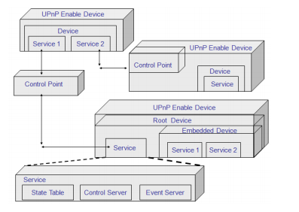
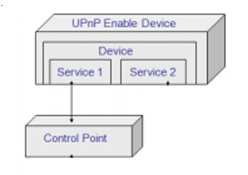
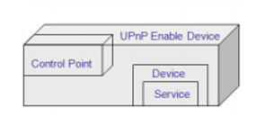
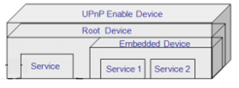
What components does UPnP offer?
Device
Control Point
Service
UPnP Enable Device
UPnP Enable Device
UPnP Enable Device
Device
Root Device
Service 1
Service 2
Control Point
Embedded Device
Device
Service
Service 1
Service
Service 2
Control Point
Notes:
CCID 4 experiment use 1500 bytes
Acknowledgement mechanisms communicating packet loss and ECN information.

Slide 5
What protocol does UPnP use?
GENA(Generic Event Notification Architecture)
GENA is based on HTTP
GENA defines an HTTP notification architecture that transmits notifications between HTTP resources.
SOAP(Simple Object Access Protocol)
SOAP uses XML Information Set for its message format
Notes:
The cookie mechanism aims to avoid Denial-of-Service attacks, which were found to exploit the vulnerability of three-way handshakes of TCP.
During the association establishment, the client and the server of SCTP can negotiate the number of stream in an association.
可以選擇開啟多少個stream

Slide 6
SSDP(Simple Service Discovery Protocol)
Feature :
Control point can search the special services what it need of device in the same subnet by SSDP.
Device can announce about its message to the control point who is in the same subnet by SSDP.
Architecture:
SSDP is based on HTTPU ( HTTP with UDP )
Port number is 1900
In IPv4, the multicast address is 239.255.255.250
In IPv6, the multicast address is FF0X::C
Method :
M-SEARCH :「ssdp:discovery」
M-NOTIFY : 「ssdp:alive」 & 「ssdp:byebye」

Slide 7
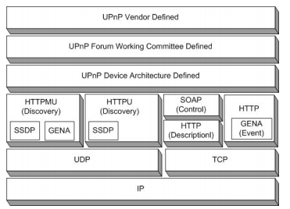
UPnP protocol stack

Slide 8
How does UPnP work?
Addressing
Addressing
Discovery
Description
Eventing
Control
Presentation
Discovery
Description
Eventing
Control
Presentation
Notes:
mapping from the subflow sequence number to the data sequence number

Slide 9
Addressing
DHCP (Dynamic Host Configuration Protocol)
Auto-IP (Automatic IP addressing)

Slide 10
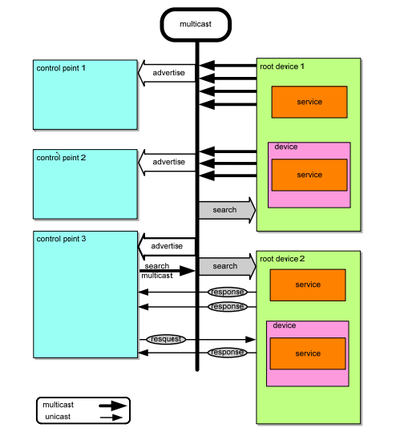
Discovery
SSDP

Slide 11
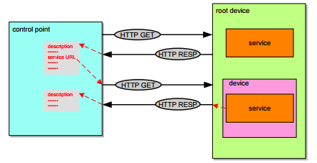
Description

Slide 12
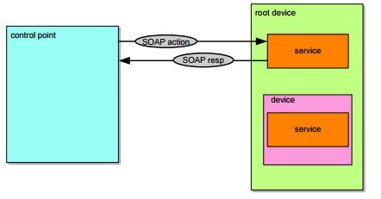
Control
SOAP

Slide 13
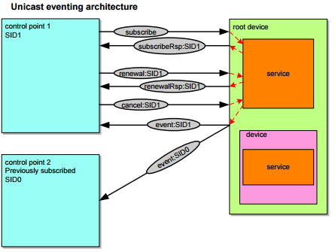
Eventing
GENA
Unicast eventing architecture

Slide 14
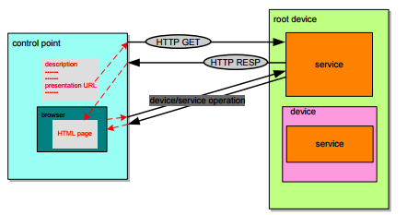
Presentation

Slide 15
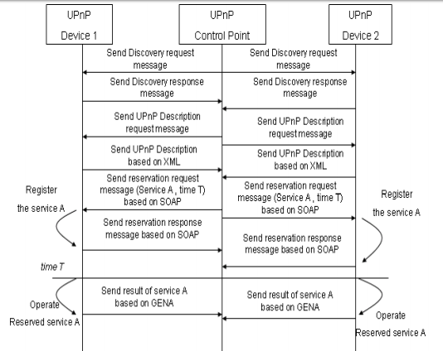

Slide 16
Summary
UPnP technology brings convenience to our life.
It is not very widely used now.
UPnP is intended primarily for residential networks.

Slide 17
Questions and Comment

Slide 18
Reference
http://upnp.org/specs/arch/UPnP-arch-DeviceArchitecture-v1.1.pdf
https://en.wikipedia.org/wiki/Universal_Plug_and_Play
http://jita.csi.chu.edu.tw/Jita_web/publish/vol5_num4/5.pdf
http://speed.cis.nctu.edu.tw/~ydlin/miscpub/survey_UPnP.pdf

