Slide 1
Real-time Transport Control Protocol
Presenter : Nicole Wu

Slide 2
Outline
Overview
RTP
RTCP Mechanics
RTCP Message
RTCP Sending Interval General principles
Conclusion

Slide 3
Overview
PC
Data(RTP multicast)
Data(RTP multicast)
Network
QoS(RTCP)
Multimedia device
QoS(RTCP)
Data(RTP multicast)
PC
Multimedia device
QoS(RTCP)
Multimedia device
Real-time Transport Protocol (RTP) and Real-time Transport Control Protocol(RTCP) are transport protocol for real-time Applications
RTP is a network protocol for delivering multimedia data over IP networks.
RTCP is used to monitor transmission statistics and quality of service (QoS) and aids synchronization of multiple streams
Notes:
progressive streaming,例如 HTTP/TCP ，
realtime streaming,例如 RTP/UDP,

Slide 4
Overview ----Multimedia Protocol Stack
Notes:
RTP和RTCP是base on UDP

Slide 5
RTP
Sequence number：The sequence number increments by one for each RTP data packet sent.
Timestamp：The timestamp reflects the sampling instant of the first octet in the RTP data packet .
SSRC：The SSRC field identifies the synchronization source.
Notes:
總結以上,RTP並不提供服務品質或傳輸可靠性的保證，只提供Timestamp，用來達成同步等能力、Sequence Number，用來決定封包是否遺失等資訊)等一些具有即時特性資料的基本功能

Slide 6
RTCP Mechanics
compound RTCP message
RTCP messages are “stackable”.
RTCP messages are always sent in (at least) pairs.
RTCP messages are sent periodically with a period set to ensure that control messages consume no more than 5% of the session bandwidth.
Notes:
1. To amortize header overhead, multiple RTCP messages can be combined and sent in a compound RTCP message
2. Messages must always contain SS/SR report and a SDES containing the canonical name (CNAME) of the participant
3. Much of the contents of sender & receiver reports are included so that participants can compute the RTCP sending interval

Slide 7
RTCP Message types
Sender reports (SR),type:200
cumulative frame & byte counts
wall clock/timestamp values
Receiver reports (RR), type:201
frame loss/Frame delivery rate
Source description (SDES) , type:202
useful ASCII text strings (user & host name of participant)
BYE, type:203
used to update participant’s SSRC tables
Notes:
在RTCP裡,封包叫message
SDES item裡會有user name等等
BYE是當一個參與者離開時就會送出

Slide 8
RTCP Message encapsulation
IP Header
UDP Header
RTCP header
IP Packet
SR/RR
UCP Datagram
Reception Report Blocks
RTCP
compound
message
RTCP header
SDES/BYE
Item(ex:CName…)
Notes:
rtcp封包一定會有SR和RR,而且在最前面,後面夾著SDE或BYE

Slide 9
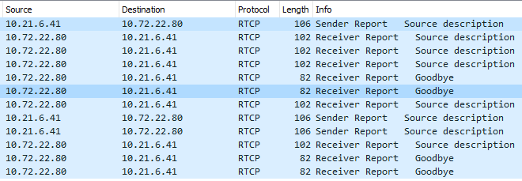

Slide 10
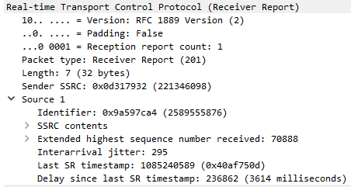
The RTCP sender/receiver report message
Header
Information (only in SR)
Reception report blocks
Header
Reception
Notes:
RTCP message分成三個session
The third section contains zero or more reception report blocks depending on the number of other sources heard by this sender since the last report

Slide 11
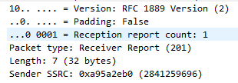
The RTCP sender/receiver report message -----Header
version number (same as RTP)
padding indicator
reception report count (5 bits)
RTCP message type (8 bits)
RTCP message length (16 bits)
SSRC for the sender of this report (32 bits)
此封包的發送者的identifier
Notes:
All report messages have the same 8 byte header

Slide 12
The RTCP sender report message -----Information
NTP timestamp(64 bits)
RTP timestamp(32 bits)
Sender’s packet count(32 bits)
Sender’s octet count(32 bits)

Slide 13
The RTCP sender/receiver report message ----Reception report blocks
source identifier
fraction of RTP packets from this source lost since the last report
cumulative number of lost packets
extended highest sequence number received
estimated average RTP packet interarrival time jitter
last SR timestamp received from this source
delay since receiving the last SR report from this source
Notes:
Each sender and receiver report should contain a reception report block for each synchronization source heard from since the last RTCP report

Slide 15
RTCP Reception Report Blocks ----Loss calculation
Sent RTCP message
Sent SR
Sender
Receiver
Sent RR
The time that RTCP calculate the lost packet
number of packets lost
fraction lost
number of packets expected
Notes:
nbr of packets lost = nbr packets expected – nbr packets received
number of packets expected = EHSNR – initial sequence number
EHSNR = extended highest sequence number received
= number of sequence number cycles x 2^16 + last sequence number received

Slide 16
RTCP Reception Report Blocks ----Jitter calculation
Sent RTP packet
jitternew = jitterold +( instantaneous jitter – jitterold )/16
instantaneous jitter = (reci – rec(i–1)) – (senti – sent(i–1))

Slide 17
RTCP Reception Report Blocks ----Round trip time calculation
Sent RTCP message
sent SR
rec RR
estimated round-trip- time = RR received – SR sent – delay
RR received = time a source received this reception report
SR sent = last SR timestamp received field
delay = delay since last SR report field

Slide 18
RTCP Sending Interval General principles
Generic RTCP transmission guidelines:
RTCP messages should consume no more than 5% of session bandwidth
25% of RTCP bandwidth should be allocated to senders
Notes:
average IAT of sender reports
= average RTCP packet size/ 0.25 x RTCP bandwidth

Slide 19
Conclusion
RTP is a network protocol for delivering multimedia data over IP networks.
RTCP is used to monitor transmission statistics and quality of service (QoS).
A network management tool may monitor the network load based on the RTCP packets without receiving the actual data or detect the faulty parts of the network

Slide 20
Q&A

Slide 21
Reference
RFC3550
RTCP Report
http://reeves.csc.ncsu.edu/Classes/csc573/rtp-rtcp.pdf
http://140.116.72.245/~ruready566/RTP_RTCP.pdf
http://netlab.csie.ntut.edu.tw/seminar/year2010/CKC20101224.pdf
http://www.cs.odu.edu/~cs778/jeffay/Lecture6.pdf
The Research and Implementation of voip multimedia system

