Slide 1
Research of Web Real-Time Communication Based on WebSocket
NCNU CSIE Senior
Jia-Wei Lin

Slide 2
Outline
Traditional Web Real-Time Communication Solutions
HTML5 WebSocket
An example to show why we choose WebSocket
Summary

Slide 3
Traditional Web Real-Time Communication Solutions
AJAX
Polling
Comet
Long-polling
Streaming

Slide 4
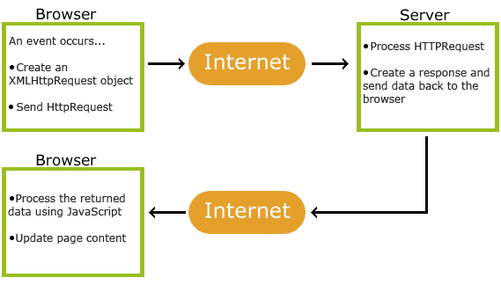
AJAX ( Asynchronous JavaScript And XML )
AJAX applications might use XML to transport data, but it is common to transport data as plain text or JSON text.
AJAX is not a programming language.
AJAX allows web pages to be updated asynchronously by exchanging data with a web server behind the scenes.
Update parts of a web page, without reloading the whole page.
Notes:
http://www.w3schools.com/xml/ajax_intro.asp

Slide 5
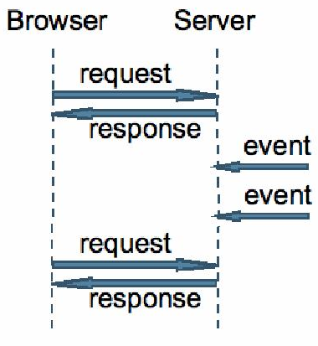
Polling
The client makes a periodic request in a specified time interval to the Server.
Just like the way you refresh web page manually but replaced by auto running program.

Slide 6
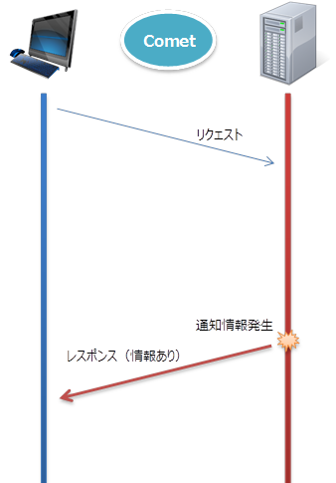
Comet
Comet is a web application model in which a long-held HTTP request allows a web server to push data to a browser, without the browser explicitly requesting it.
Request
Hold request
Data updating
event
Response

Slide 7
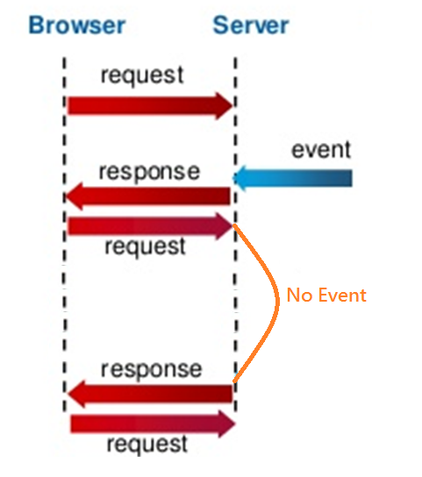
Long-polling
Browser sends a request and the server keeps the request open for a set period of time.
If an event occurs , server response the new coming data to browser, and browser will make another request.
If no event occurs , server sends a response to terminate the open request.
Notes:
當資料頻繁更新時，會造成網路很大的負擔(因為request非常多次, 造成很大的overhead)
所以有了另一種方式-> Streaming

Slide 8
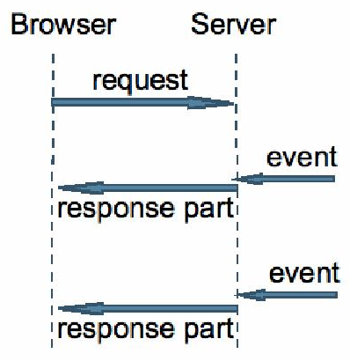
Streaming
Server will never close a connection which sponsored by browser.
Sever sends message at any time.

Slide 9
The Problems are …
All of these methods for providing real-time data involve HTTP request and response headers.
Because of HTTP is half-duplex , we use two TCP connections to simulate full-duplex communication over half-duplex HTTP.
Unnecessary header data and introduce latency !
Significant overhead and complexity!

Slide 10
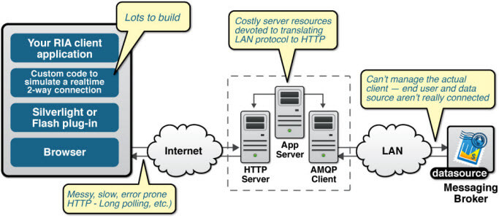
The complexity of Comet applications
Notes:
A rich Internet application (RIA; sometimes called an Installable Internet Application) is a Web application that has many of the characteristics of desktop application software, typically delivered by way of a site-specific browser, a browser plug-in, an independent sandbox, extensive use of JavaScript, or a virtual machine.Adobe Flash, JavaFX,and Microsoft Silverlight are currently the three most common platforms.
AMQP (Advanced Message Queueing Protocol) is an openly published wire specification for asynchronous messaging.

Slide 11
HTML5 WebSockets to the Rescue!
WebSocket is a protocol defined in RFC 6455.
Full-duplex, bidirectional communications channel over a single TCP connection.
Remove the overhead and dramatically reduce complexity.
Notes:
The security model used for this is the origin-based security model common used by web browsers.

Slide 12
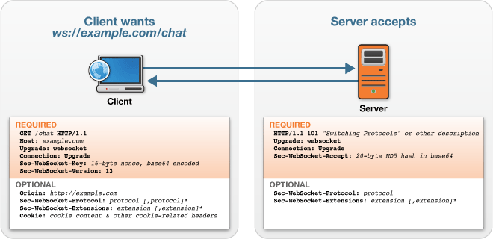
WebSocket Handshake
To establish a WebSocket connection, the client and server upgrade from the HTTP protocol to the WebSocket protocol during their initial handshake.
Notes:
兩個重點
HTTP handshake
Upgrade
The HTTP protocol provides a special mechanism allowing an already established connection to upgrade to a new, incompatible, protocol. This mechanism is always client initiated, and the server may accept or refuse the switch to the new protocol.
The "Connection" header field allows the sender to indicate desired control options for the current connection.

Slide 13
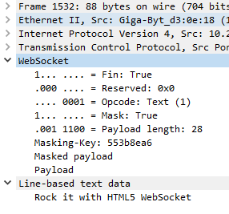
Connection Established
Once the connection is established, data frames can be sent back and forth between the client and the server in full-duplex mode by WebSocket protocol.
The data is minimally framed with just 2 bytes!
Header
Payload
WebSocket Frame
A WebSocket frame in Wireshark

Slide 14
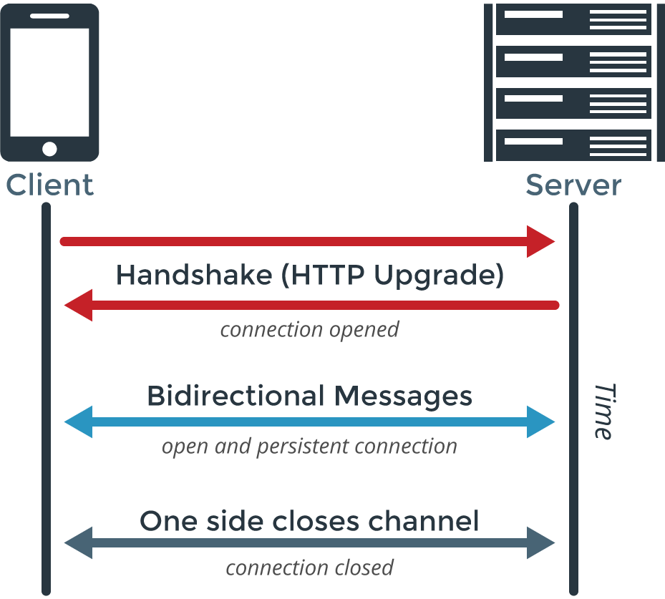
HTTP
WebSocket

Slide 15
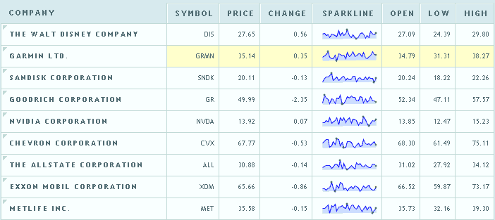
Reduction in Unnecessary Network Traffic and Latency
To illustrate polling, this example will examine a web application in which a web page requests real-time stock data from a web server using a traditional polling model.
A JavaScript stock ticker application

Slide 16
HTTP Request Header
HTTP Response Header
GET /PollingStock//PollingStock HTTP/1.1
Host: localhost:8080
User-Agent: Mozilla/5.0 (Windows; U; Windows NT 5.1; en-US; rv:1.9.1.5) Gecko/20091102
Firefox/3.5.5
Accept: text/html,application/xhtml+xml,application/xml;q=0.9,*/*;q=0.8
Accept-Language: en-us
Accept-Encoding: gzip,deflate
Accept-Charset: ISO-8859-1,utf-8;q=0.7,*;q=0.7
Keep-Alive: 300
Connection: keep-alive
Referer: http://www.example.com/PollingStock/
Cookie: showInheritedConstant=false; showInheritedProtectedConstant=false;
showInheritedProperty=false; showInheritedProtectedProperty=false;
showInheritedMethod=false; showInheritedProtectedMethod=false;
showInheritedEvent=false; showInheritedStyle=false; showInheritedEffect=false
HTTP/1.x 200 OK
X-Powered-By: Servlet/2.5
Server: Sun Java System Application Server 9.1_02
Content-Type: text/html;charset=UTF-8
Content-Length: 21
Date: Sat, 07 Nov 2009 00:32:46 GMT
Request + Response Header
= Totally 871 bytes

Slide 17
If there are a large number of users…
Use case A: 1,000 clients polling every second: Total header in network traffic is
(871 × 1,000) = 871,000 bytes = 6,968,000 bits per second (6.6 Mbps)
Use case B: 10,000 clients polling every second: Total header in network traffic is
(871 × 10,000) = 8,710,000 bytes = 69,680,000 bits per second (66 Mbps)
Use case C: 100,000 clients polling every 1 second: Total header in network traffic is
(871 × 100,000) = 87,100,000 bytes = 696,800,000 bits per second (665 Mbps)

Slide 18
Using WebSocket protocol in these cases
Use case A: 1,000 clients receive 1 message per second: Total header in network traffic is (2 × 1,000) = 2,000 bytes = 16,000 bits per second (0.015 Mbps)
Use case B: 10,000 clients receive 1 message per second: Total header in network traffic is (2 × 10,000) = 20,000 bytes = 160,000 bits per second (0.153 Mbps)
Use case C: 100,000 clients receive 1 message per second: Total header in network traffic is (2 × 100,000) = 200,000 bytes = 1,600,000 bits per second (1.526 Mbps)

Slide 19
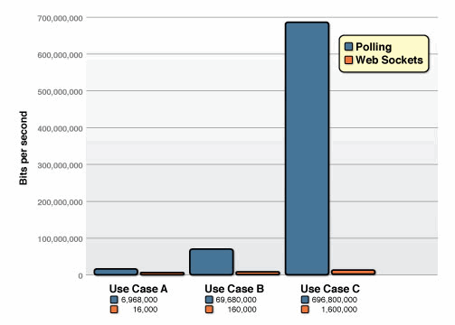

Slide 20
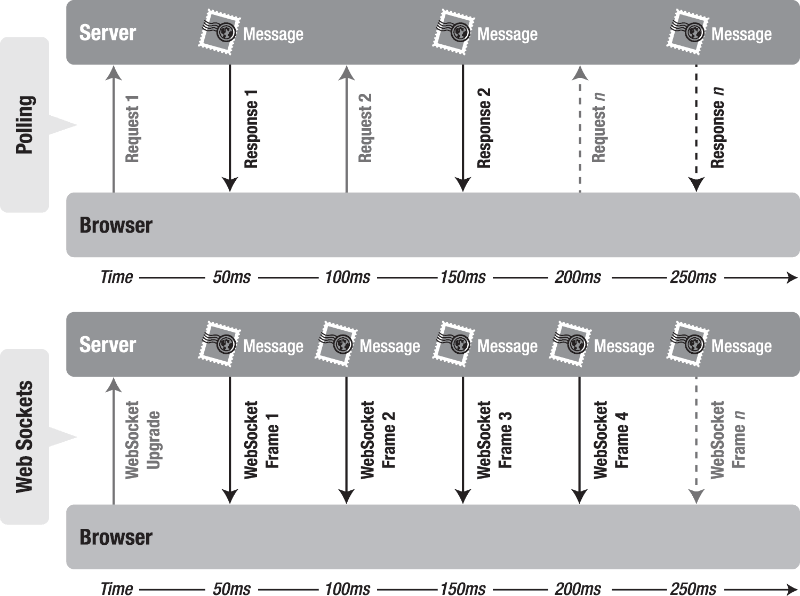
Request 1
Request 2
Request 3
Response 1
Response 2
Response 3
WebSocket
Upgrade
WebSocket
Frame 1
WebSocket
Frame 2
WebSocket
Frame 3
WebSocket
Frame 4
WebSocket
Frame 5

Slide 21
Summary
HTML5 WebSocket provides an enormous step forward in the scalability of the real-time web.
WebSocket can provide a 500:1 or - depending on the size of the HTTP headers - even a 1000:1 reduction in unnecessary HTTP header traffic and 2:1 reduction in latency.

Slide 22
Reference
Peter Lubbers & Frank Greco, Kaazing Corporation , “HTML5 web sockets: A quantum leap in scalability for the web.”
Peter Lubbers, Brian Albers, and Frank Salim ," Chapter 7 Using the WebSocket API" in "Pro HTML 5 Programming", Apress, 2nd edition, 2011.
RFC 6455 – The WebSocket Protocol
W3C School - AJAX introduction
RFC 7230 - Hypertext Transfer Protocol (HTTP/1.1): Message Syntax and Routing , session 6.1 and session 6.7

Slide 23
Browser support WebSocket

