Slide 1
Websocket Application
Presenter: Ken

Slide 2
Outline
Traditional Application (Chat Room、Stock Web)
Websocket Connection
Websocket Application
Summary

Slide 3
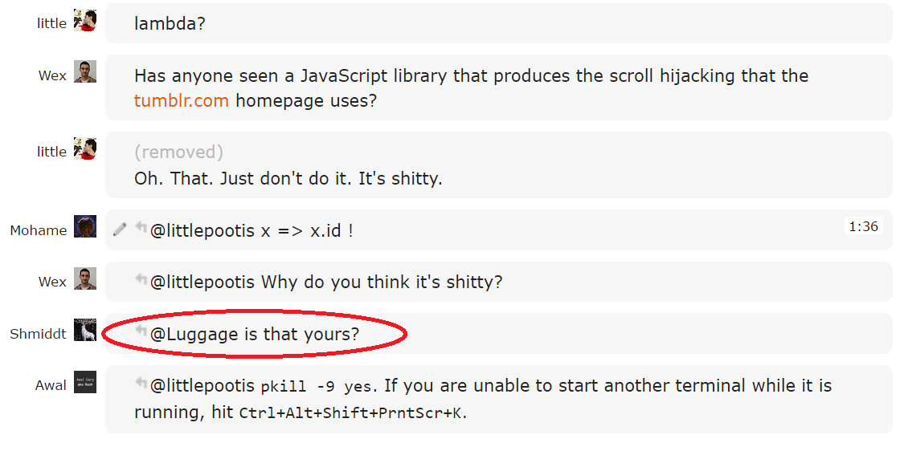
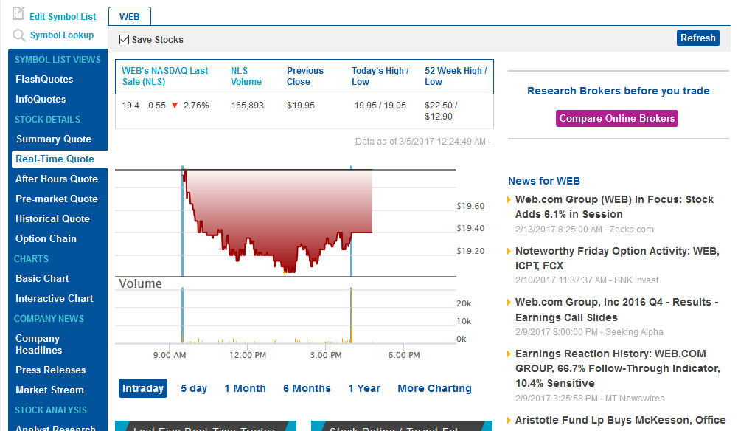
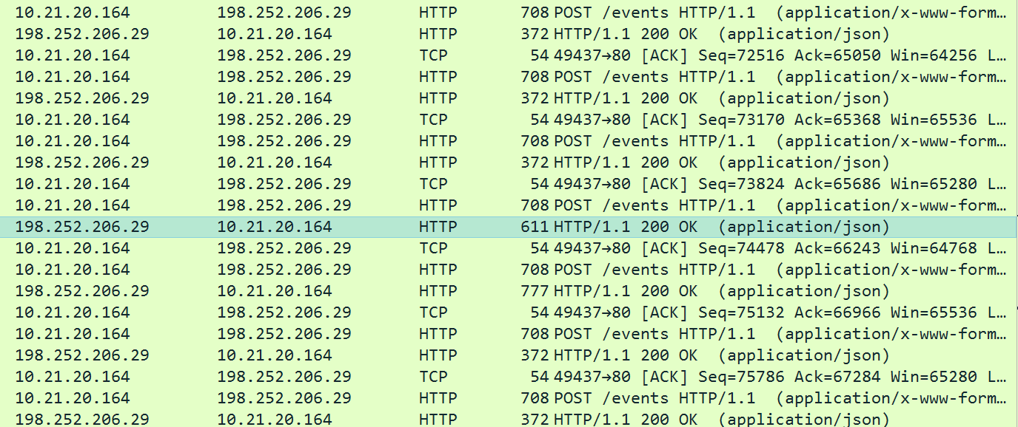
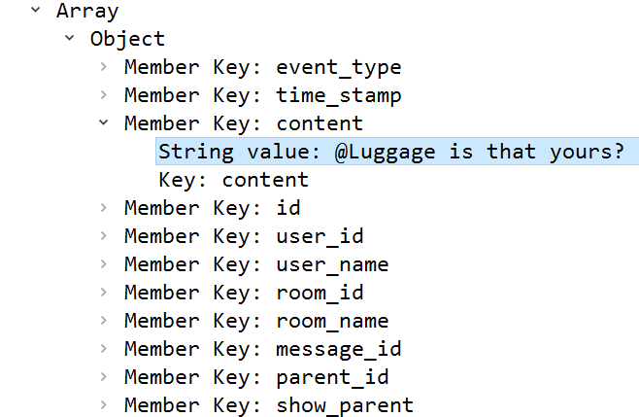
Tradition Application

Slide 4
Problem and Solution
The traditional application uses “Polling” to keep real time. Polling is a solution to make real time, but every request / response costs too many bytes with http headers. So, we can solve the wasting with websocket.
Websocket is a new protocol that could make the real time connection. It can reduce the most unnecessary data with the header to prevent wasting.

Slide 5
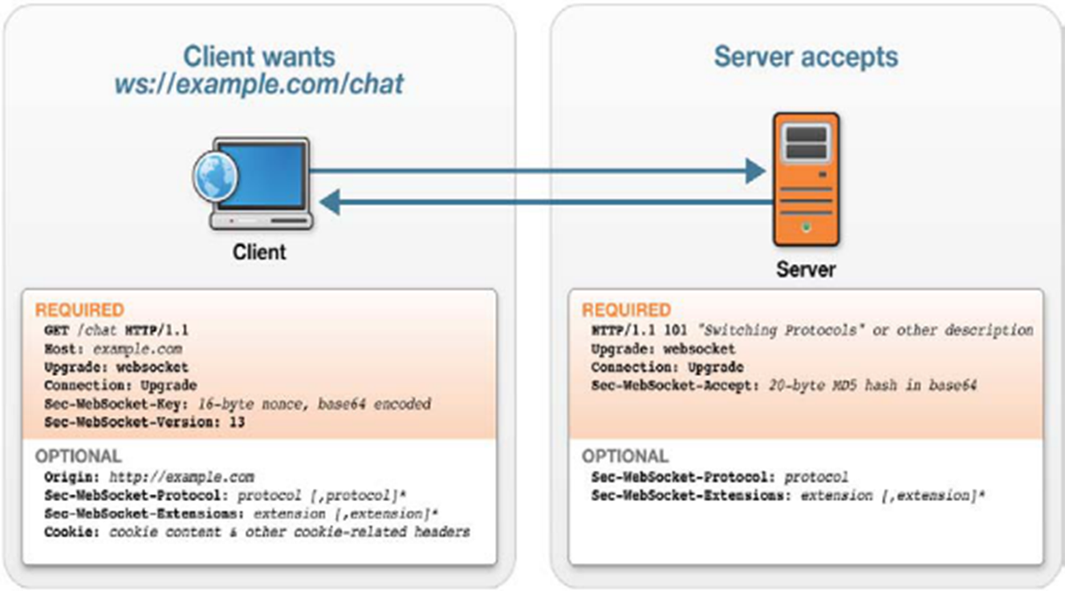
How to make websocket connection
Websocket use http to make the connection.
After the connection established, the connection only use websocket protocol.

Slide 6
HTTP Header

Slide 7
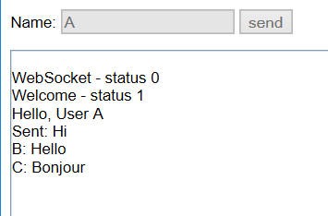
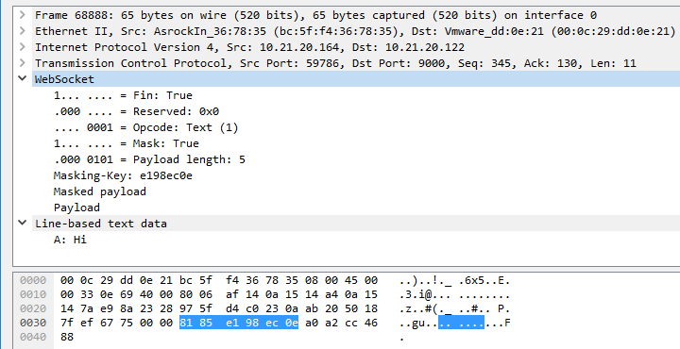
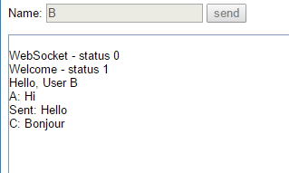
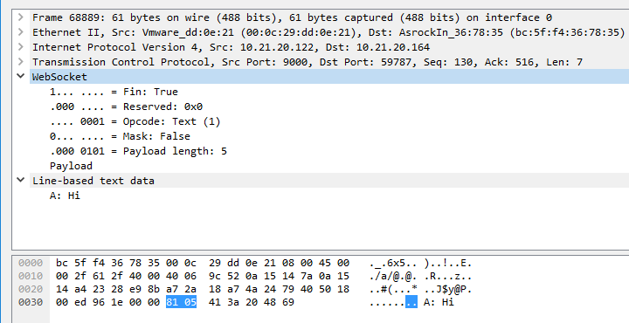
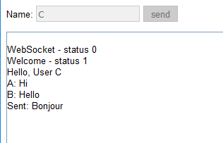
Websocket Application (Chat Room)
Client to Server
The masking-key is 4 bytes
Server to Client
Only 2 bytes header !

Slide 8
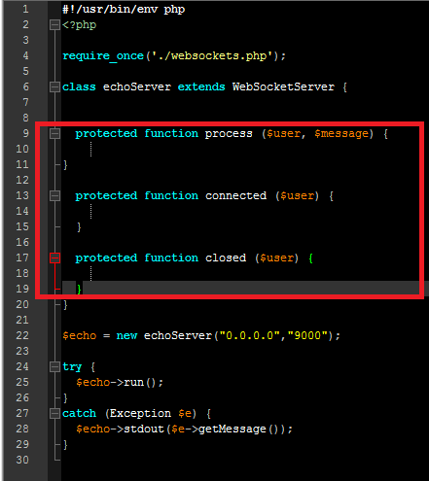
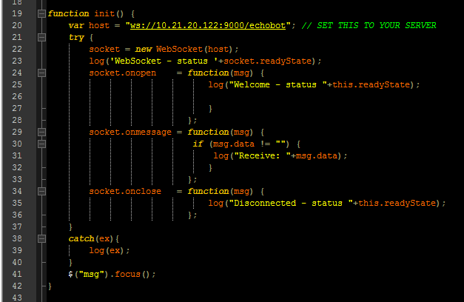
Websocket establish
Server
PHP
Client
Javascript & html

Slide 9
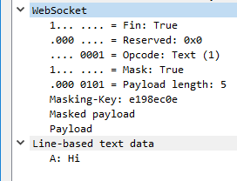
Websocket Frame

Slide 10
Websocket experimental result
I have tried to send continuous packages with websocket, and there are some features.
If I send continuous small package to client, the it will fill the TCP header with websocket.
If I send continuous large package to client, it’s seem that nothing different with the traditional method (ex: HTTP)

Slide 11
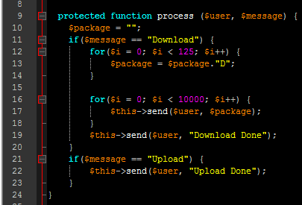
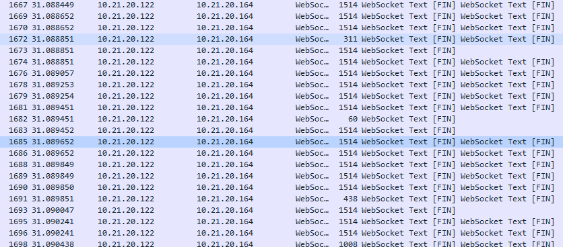
Every payload is 125bytes, websocket fill the TCP to the maximum content.

Slide 12
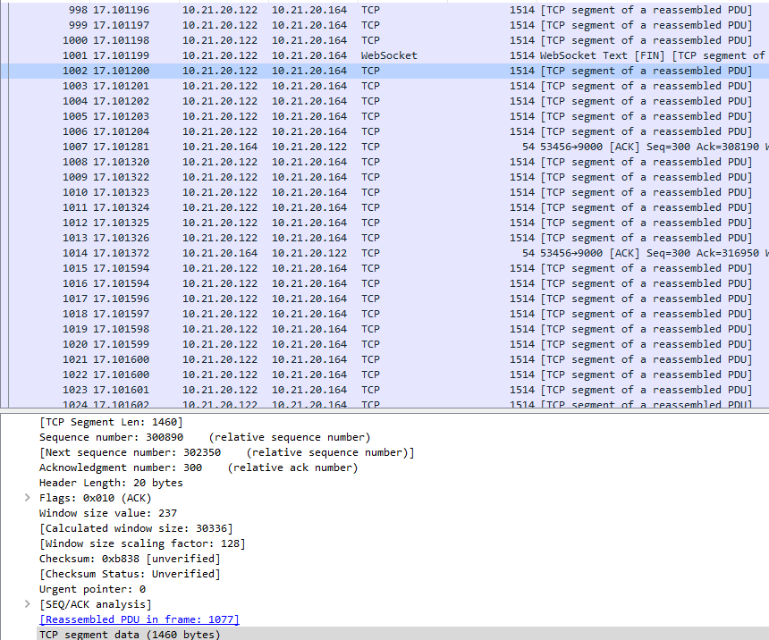
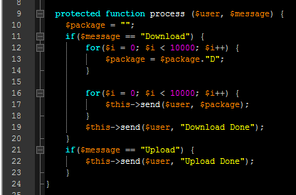
If I request a 100000 bytes data, It will deliver the rest data to TCP segment.

Slide 13
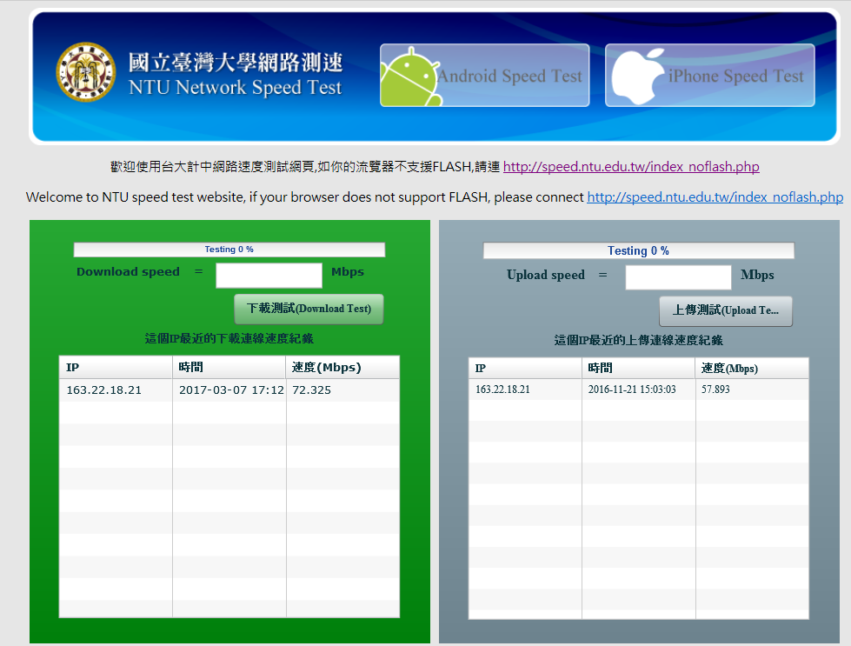
It looks like nothing different with the traditional method.

Slide 14
Summary
Websocket can reduce the most unnecessary wasting.
Websocket is more complex.
If send a large package with websocket, it has no advantage with traditional method.

Slide 15
Reference
RFC Websocket Protocol
What are Websockets
MAC Frame Format
PHP Websocket Server

Slide 16
Q & A
Thanks for listening.

