Slide 1
Gateway redundancy protocols
Jakub Pavlik, Ales Komarek, Vladimir Sobeslav and Josef Horalek
Faculty of Informatics and Management
University of Hradec Kralove,
Czech Republic
Published in: Computational Intelligence and Informatics (CINTI)
Date of Conference: 19-21 Nov. 2014
Publisher: IEEE
Presenter: Jack
1

Slide 2
Outline
INTRODUCTION
NETWORK DESIGN
REDUNDANCY PROTOCOLS
HSRP(Hot Standby Router Protocol )
VRRP(Virtual Router Redundancy Protocol )
GLBP(Gateway Load Balancing Protocol )
Functions Comparison
PRACTICAL MEASURING OF PROTOCOLS
MEASURING RESULTSVI
CONCLUSION
2

Slide 3
INTRODUCTION
There is high demand for high availability and reliability of data networks today.
Networks have become the backbone of almost every information services.
In most of cases, data network outages are unacceptable in the enterprise companies and 2 minute downtime can cause a loss of several million dollars for e.g. in stock markets.
3

Slide 4
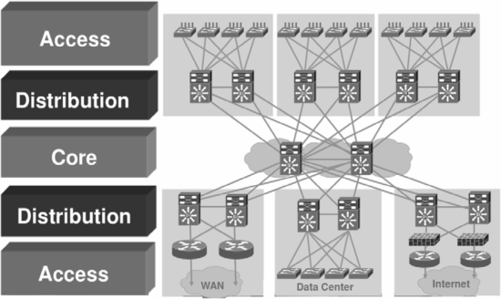
Network Design
Hierarchical Network Design Model
The three-layer hierarchical model allows merging and filtering data flow on three independent routed or switched levels.
4

Slide 5
1. Core layer:
Core layer provides high-speed backbone of the entire network.
It provides high-speed links with low response for data transmission over the backbone line. Reliability and high availability is ensured by redundancy of active elements and lines between them.
It’s suitable for network load balancing using redundant links.
5

Slide 6
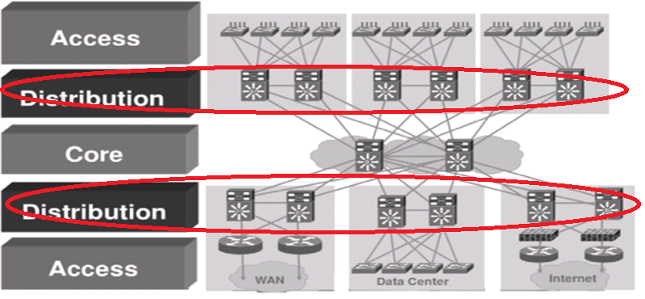
2. Distribution layer:
This layer is the interface between the core layer and access layer and between work groups at the access layer.
It implements policies, filtering and sets priorities and queues for data operations.
Distribution layer provides routing between the access layers and the core layer and routes packets between different VLANs on the access layer.
6

Slide 7
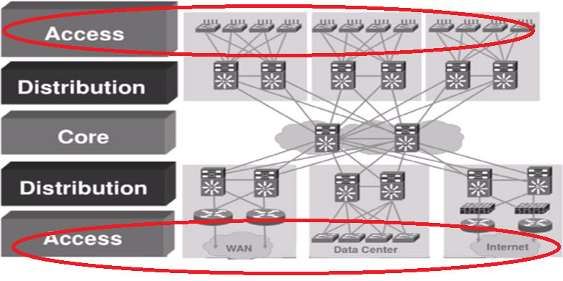
3. Access layer:
The access layer provides user access to the network.
Users can access the network locally or remotely.
Local users typically use the network switch for the access.
Users can access the network remotely through the Internet using VPN connection.
Thy can use various technologies for the Internet connection.
7

Slide 8
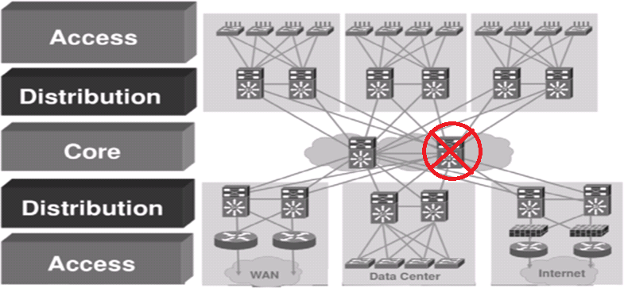
Redundancy in network design
Redundant network design complies with the requirements of network availability by duplication of network elements.
The purpose is to get rid of single point of failure, which means that failure of any network component will cause malfunction of entire network.
8

Slide 9
Redundancy Protocols
The goal of this section is to describe possible solutions for default gateway redundancy implemented by specific protocols.
There are three protocols: HSRP, VRRP and GLBP. Each of them is described in following subsections
9

Slide 10
HSRP
Hot Standby Router Protocol was developed by Cisco company and is described in standard documentation RFC 2281.
HSRP provides a mechanism to ensure high availability of the default gateway (first hop router).It allows to use backup gateway immediately in case of failure of primary (default) gateway.
10

Slide 11
Single active router is selected from the HSRP group. This router physical processes and routes the packets sent to a virtual interface router.
Single virtual router is configuration of IP and MAC address for HSRP (standby) group. The virtual router forms an interface for communication between the physical router and end stations in the network.
MAC address of the virtual router has following form: 0000.0c07.acXX where the last byte address XX is the number of HSRP (group) in hexadecimal format.
11

Slide 12
VRRP
Virtual Router Redundancy Protocol (VRRP) is being
developed by IETF. It is an open protocol, the current version
3 is described in RFC 5798. The third version IPV4 and
IPV6 is based on the second version, described in RFC 3768.
The protocol was designed to increase the availability
of the default network and solves the problem with default
gateway failure. Features and functions are very similar to the
HSRP protocol.
12

Slide 13
GLBP
Gateway Load Balancing Protocol is also for increase availability through redundancy WAN gateway.
This is a Cisco proprietary protocol same like HSRP.
The greatest benefit of this protocol is load balancing, which is the distribution of network traffic between multiple routers in the GLBP group .
The previous protocols HSRP and VRRP can use only a single router inside of a group for incoming packets directed to the address of the virtual gateway, which cannot utilize the performance of other routers.
13

Slide 14
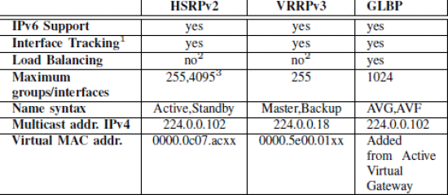
Functions Comparison
14

Slide 15
Practical Measuring of Protocols
All that is described in this chapter was configured and measured on the physical topology.
15

Slide 16
Measuring the Delay of New Active Gateway Selection
The main purpose of gateway redundancy protocols is to increase the network availability while minimizing delays that cause unavailability of network resources.
It is just the delay which plays the key role and impacts the network outage latency for to the end user.
This choice depends on the activation of preempt mode. In the default HSRP configuration, the preempt function is disabled. In contrast, the VRRP protocol default configuration is preemptive.
16

Slide 17
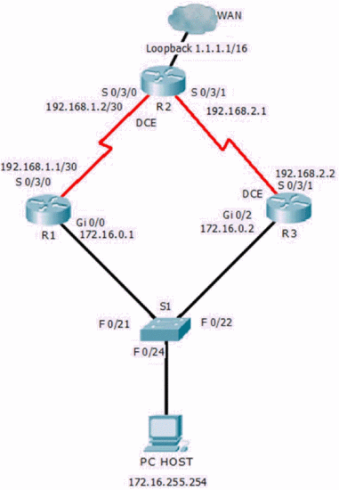
Network Topology
17

Slide 18
Method of Measurement and Data Processing
The active router selection for the HSRP, VRRP and GLBP protocols is achieved by turning off the interface on which the protocol operates.
This effort is contributed by the configured interface tracking function, which allows the power-off interface to reduce the priority of the group by a predefined value.
18

Slide 19
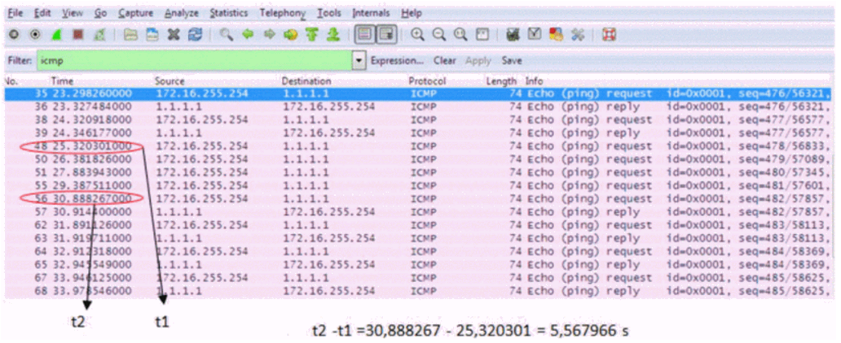
19

Slide 20
Measuring Results
The average value of delay election of a new active gateways are higher than expected.
Downtime connection using the protocol VRRP version 3 is around three seconds in the default configuration of this protocol by source and VRRP hello interval value takes one second by default.
According to these parameters we run 20 measurements and got average downtime 9.12 seconds, mean 8.59 seconds
20

Slide 21
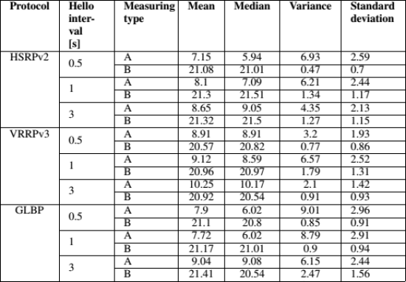
Table II: Measuring results The measured values are always rounded to two decimal places. The values in row A are delay times of selecting a new active gateway. The values in row B are delay times of reselecting the original active gateway.
21

Slide 22
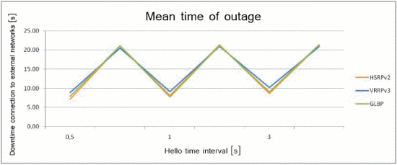
22

Slide 23
Conclusion
The biggest difference between the protocols is the supported function of load balancing/sharing by GLBP protocol.
The other protocols do not include this feature, where workaround can be configuring multiple VLAN and assigning different VLANs to different default gateways, which are made by more physical routers.
23

